Slide 1


Slide 2

Y bore ‘ma byddwn yn…
This morning we’ll…
Rhannu’r data diweddaraf, tueddiadau ymddangosol ac edrych ar wledydd a phroffesiynau eraill
Gwahodd panel o arbenigwyr i rannu’u barn ac ateb eich cwestiynau
Arddangos y cynlluniau diweddaraf ar gyfer mynd i’r afael â materion sy’n ymwneud â recriwtio a chadw yng Nghymru
Rhoi mewnwelediad i wefan genedlaethol a gwasanaeth newydd i hyrwyddo gyrfaoedd a dilyniant gyrfaol mewn addysg
Share the latest data, emerging trends and look at other countries and professions
Invite a panel of experts to share their views and answer your questions
Showcase the latest plans to tackle recruitment and retention issues in Wales
Give exclusive insight to the new national website and service to promote careers and career progression in education

Slide 3
Beth mae’r data’n ei ddangos: dadansoddiad o’r darlun recriwtio a chadw yng Nghymru
What the data shows:
an analysis of the recruitment and retention picture in Wales
Hayden Llewellyn
Prif Weithredwr, CGA
Chief Executive, EWC
Deborah Roberts
Rheolwr Casglu Data ac Adrodd, CGA
Data Collection and Reporting Manager, EWC
Elizabeth Brimble
Cyfarwyddwr Cofrestru, Cymwysterau a Phriodoldeb i Ymarfer, CGA
Director of Registration, Qualifications and Fitness to Practise, EWC

Slide 4
Trosolwg o'r Sesiwn
Session Overview
Recriwtio
Cadw
10 Canfyddiadau Allweddol
Ffynonellau Data:
  Cofrestr Ymarferwyr Addysg CGA
  Ffynonellau allanol ee. PLASC, SWAC, HESA, HEFCW
  Ansoddol
Recruitment
Retention
10 Key Findings
Data Sources:
  EWC Register of Education Practitioners
  External sources e.g. PLASC, SWAC, HESA, HEFCW,
  Qualitative

Slide 5
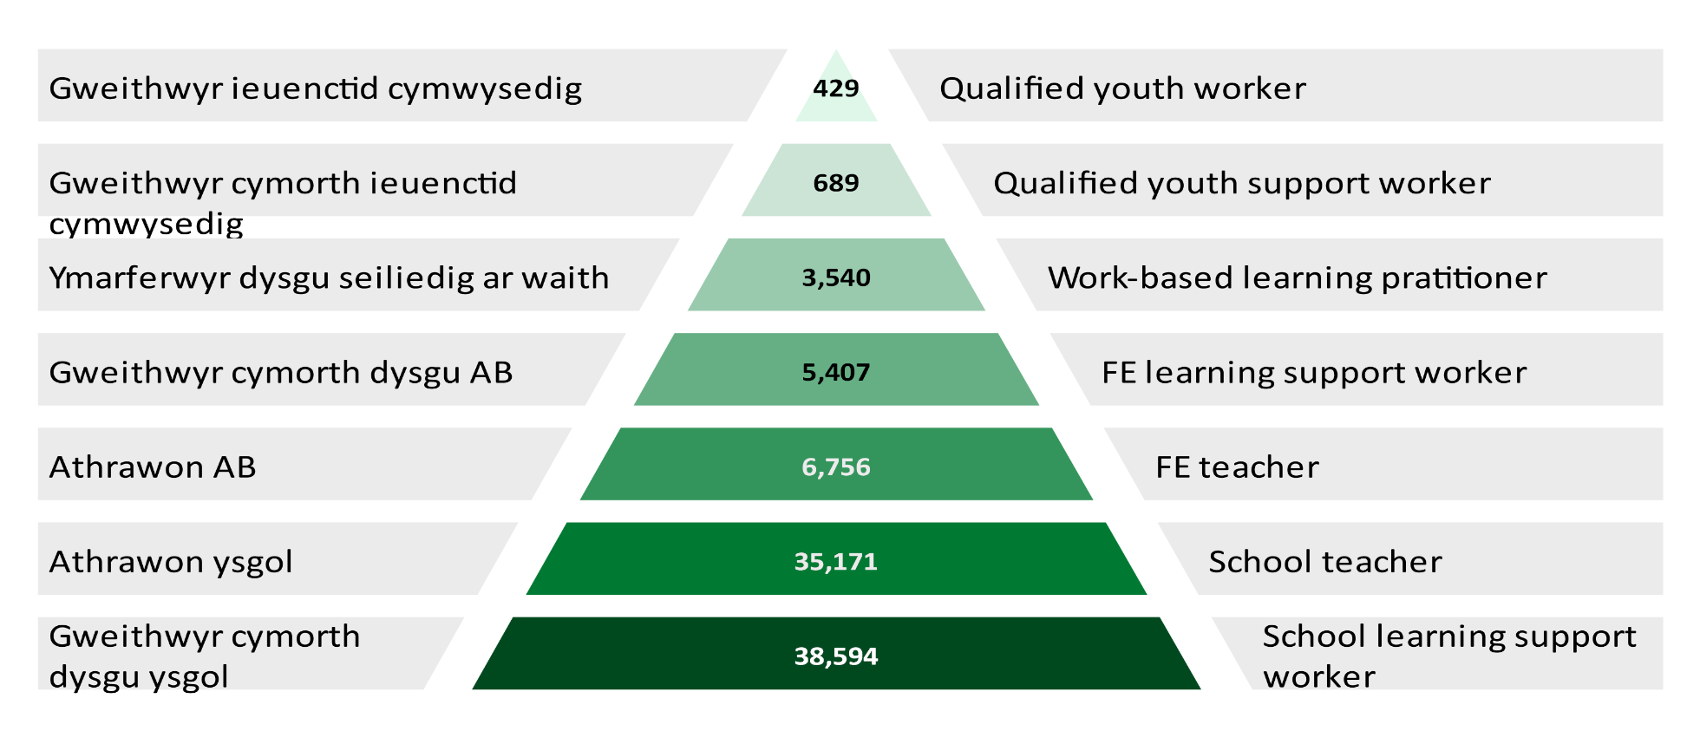
Nifer yr ymarferwyr sy'n gymwys i weithio ym mhob categori
Number of practitioners eligible to work in each category
1 Mawrth 2020
1 March 2020

Slide 6
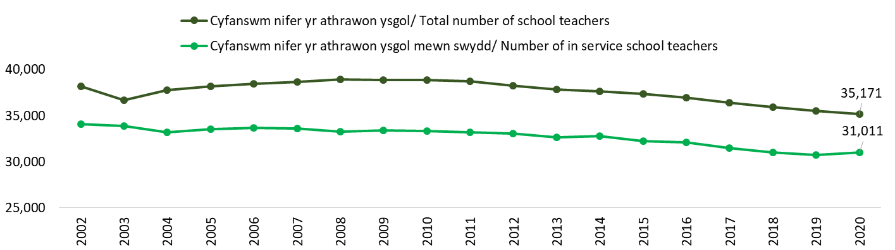
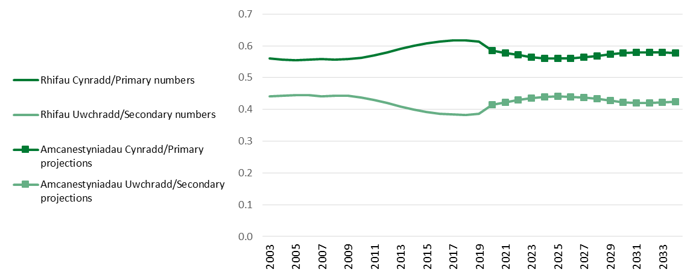
Cofrestru athrawon ysgol
School teacher registration
Niferoedd disgyblion a rhagamcaniadau
Pupil number and projections
Cynyddodd y gymhardeb o ddisgyblion o 18.4 yn 2015 i 19.3 yn 2020 (cynnydd ym maint dosbarthiadau)
Nifer yr ysgolion a gynhelir wedi gostwng o 1,773 yn 2009 i 1,494 yn 2019
Pupil ratio has increased from 18.4 in 2015 to 19.3 in 2020 (increase class sizes)
The number of maintained schools has decreased from 1,773 in 2009 to 1,494 in 2019

Slide 7
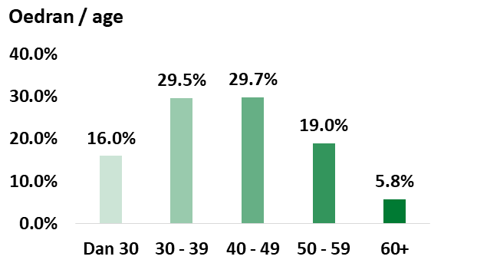
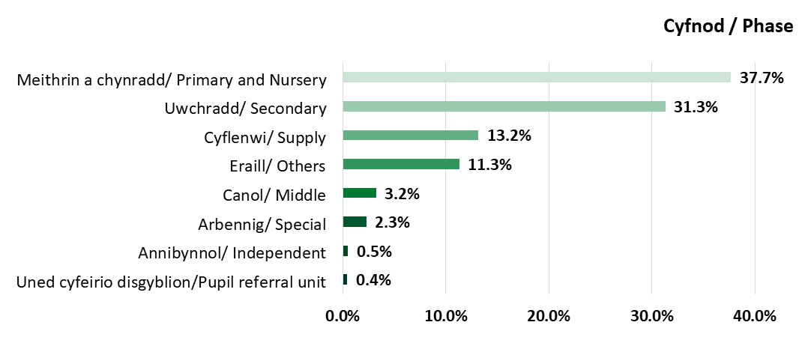
DATA ATHRAWON YSGOL CGA
1 MAWRTH 2020
EWC SCHOOL TEACHER DATA
1 MARCH 2020
Wedi datgan anabledd
Yn unol â Deddf Cydraddoldeb 2010
Yn datgan eu bod yn wyn neu o unrhyw gefndir gwyn arall*
Yn fenywod
75.5%
91.2%
0.6%
Are female
Declare themselves as white or any other white background*
Declared a disability
In accordance with the Equality Act 2010
Yn gallu dysgu drwy gyfrwng y Gymraeg
Yn siarad Cymraeg
CYMRAEG
27.2%
33.6%
Are able to teach through the medium of Welsh
Are Welsh speakers
*Includes White: English/ Welsh/ Scottish/ Northern Irish/ British, White: Irish, Gypsy, Traveller or Irish Traveller (merged due to small numbers)
*Yn cynnwys: Gwyn: Saesneg/ Cymreig/ Albanaidd/ Gogledd Iwerddon/ Prydeinig, Gwyn: Gwyddelig, Sipsi, Teithiwr neu Deithiwr Gwyddelig (wedi’u cyfuno oherwydd niferoedd bychain)

Slide 8
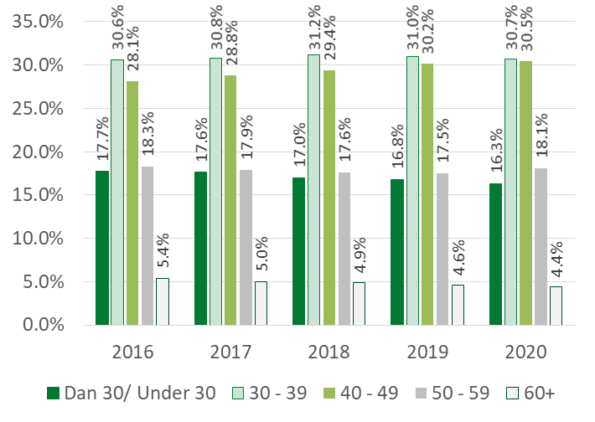
Athrawon ysgol mewn swydd fesul oedran a rhanbarth
School teachers in service by age and region
Awdurdod lleol lle maent wedi’u cyflogi/ Local authority employed | Dan 30 / Under 30 |  | 50+
 | Nifer/ Number | % | Nifer/ Number | % | Gwahaniaeth / Difference (%)
Blaenau Gwent | 66 | 13.4 | 94 | 19.1 | 5.7
Pen-y-bont ar Ogwr / Bridgend | 170 | 12.9 | 259 | 19.6 | 6.7
Caerffili / Caerphilly | 278 | 18.5 | 219 | 14.6 | -3.9
Caerdydd / Cardiff | 541 | 16.9 | 662 | 20.7 | 3.8
Sir Gâr / Carmarthenshire | 227 | 14.8 | 325 | 21.2 | 6.4
Ceredigion | 93 | 15.0 | 141 | 22.8 | 7.8
Conwy | 117 | 12.1 | 216 | 22.4 | 10.3
Sir Ddinbych / Denbighshire | 122 | 13.2 | 202 | 21.9 | 8.7
Sir y Fflint / Flintshire | 198 | 14.7 | 285 | 21.1 | 6.4
Gwynedd | 146 | 15.5 | 204 | 21.6 | 6.1
Sir Fôn / Isle of Anglesey | 91 | 17.1 | 94 | 17.6 | 0.6
Merthyr Tudful / Merthyr Tydfil | 81 | 16.3 | 95 | 19.1 | 2.8
Sir Fynwy / Monmouthshire | 90 | 13.2 | 150 | 22.0 | 8.8
Castell Nedd Port Talbot / Neath Port Talbot | 183 | 15.9 | 204 | 17.7 | 1.8
Casnewydd / Newport | 303 | 20.4 | 231 | 15.5 | -4.8
Sir Penfro / Pembrokeshire | 150 | 15.8 | 190 | 20.0 | 4.2
Powys | 133 | 11.9 | 260 | 23.2 | 11.3
Rhondda Cynon Taf | 298 | 15.7 | 327 | 17.2 | 1.5
Abertawe / Swansea | 310 | 15.9 | 366 | 18.7 | 2.9
Torfaen | 149 | 19.1 | 129 | 16.5 | -2.6
Bro Morgannwg/ Vale of Glamorgan | 187 | 14.1 | 277 | 20.9 | 6.8
Wrecsam / Wrexham | 172 | 15.0 | 231 | 20.2 | 5.1
Cyfanswm / Total | 4,105 | 15.6 | 5,161 | 19.6 | 4.0
 | ALlau gwledig fel yn ôl CLlLlC/ Rural LAs as per WLGA
 | Cyfran uchaf o 29 ac yn iau/ Highest proportion of 29 and under
 | Cyfran uchaf o 50+/ Highest proportion of 50+
 | % uchaf o’r 50% o AGEHI mwyaf difreintiedig gradd 1-955/ Highest % LSOAs in most deprived 50% ranks 1-955

Slide 9
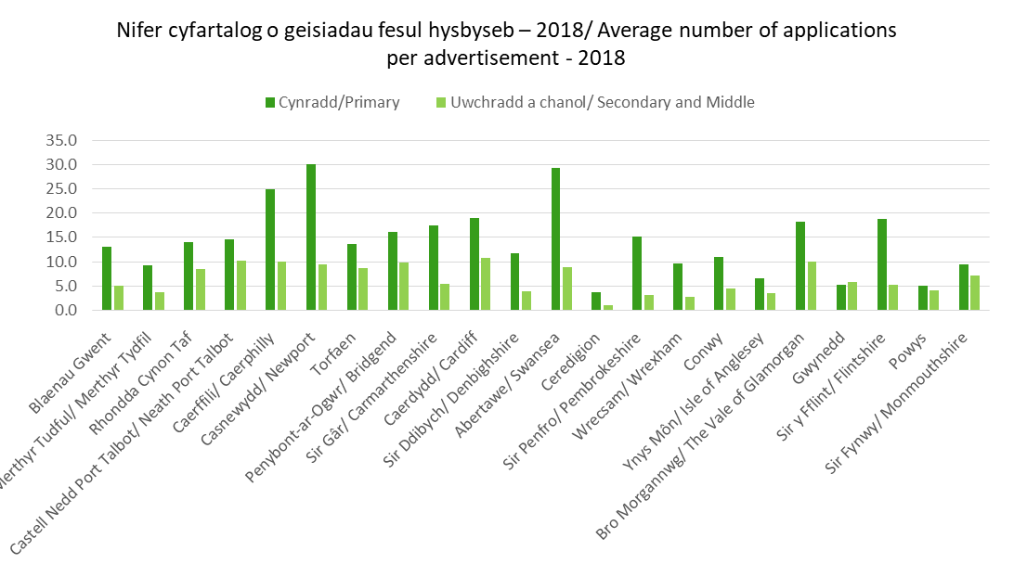
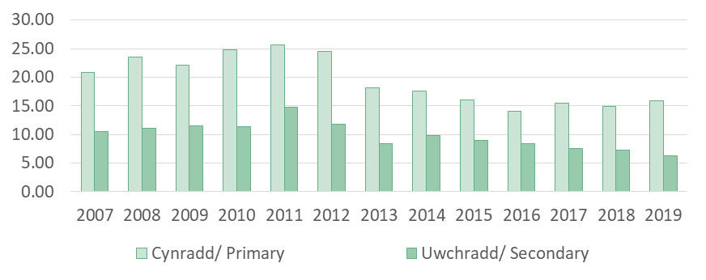
Nifer y ceisiadau /No. of applications | 2007 | 2008 | 2009 | 2010 | 2011 | 2012 | 2013 | 2014 | 2015 | 2016 | 2017 | 2018 | 2019
Cynradd/ Primary | 13,369 | 15,428 | 13,831 | 15,190 | 16,709 | 19,316 | 13,205 | 13,852 | 12,727 | 11,013 | 13,161 | 11,476 | 11,826
Uwchradd/ Secondary | 9,228 | 9,594 | 7,871 | 7,659 | 10,215 | 10,560 | 8,567 | 7,397 | 7,408 | 7,370 | 7,307 | 5,815 | 5,166
Nifer cyfartalog o geisiadau fesul swydd ar gyfer cynradd ac uwchradd fesul iaith/
Average number of applications per post for primary and secondary phase by language
Graddiwyd yr awdurdodau lleol o’r chwith i’r dde yn ôl yr ardaloedd â'r ganran uchaf o ardaloedd yn y 50% mwyaf difreintiedig yng Nghymru yn ôl MALlC 2019.
Local authorities are ranked left to right according to the highest percentage of areas in the most deprived 50% in Wales as per WMID 2019.
Adnabyddir yr ardaloedd ‘Gwledig’ (9) fel yn ôl categoreiddio CLlLlC (2012), sef: Ynys Môîn, Gwynedd, Conwy, Sir Ddinbych, Powys, Ceredigion, Sir Penfro, Sir Gâr a Sir Gâr.
The ‘Rural’ areas (9) are identified as the WLGA (2012) categorisation, namely: Isle of Anglesey, Gwynedd, Conwy, Denbighshire, Powys, Ceredigion, Pembrokeshire, Carmarthenshire and Monmouthshire.

Slide 10
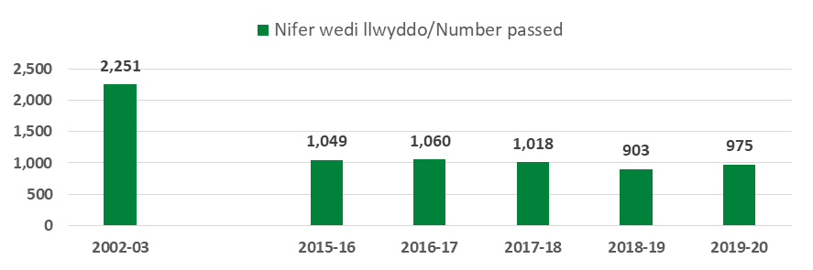
ANGau
NQTs
AGA fesul blwyddyn
ITE by year
AGA (Cymru) 2019-20 pwnc yr hyfforddwyd ynddo / ITE (Wales) 2019-20 Subject trained | Wedi llwyddo/Passes | (%)
Celf / Art | 5 | 1.2
Celf a dylunio / Art and Design | 15 | 3.7
Bioleg / Biology | 11 | 2.7
Cemeg/ / Chemistry | 12 | 3.0
Cyfuniad / Gwyddoniaeth Cyffredinol Combined/General Science | 16 | 4.0
Dylunio a thechnoleg / Design and Technology | 13 | 3.2
Drama | 23 | 5.7
Saesneg / English | 49 | 12.1
Daearyddiaeth / Geography | 28 | 6.9
Hanes / History | 44 | 10.9
TGCh / ICT | 4 | 1.0
Mathemateg / Mathematics | 37 | 9.1
Cerddoriaeth / Music | 13 | 3.2
Addysg Awyr Agored / Outdoor Education | 4 | 1.0
Addysg Gorfforol / Physical Education | 54 | 13.3
Ffiseg / Physics | 5 | 1.2
Addysg Grefyddol / Religious Education | 15 | 3.7
Gwyddoniaeth / Science | 2 | 0.5
Cymraeg / Welsh | 21 | 5.2
Astudiaethau Busnes / Business Studies | 5 | 1.2
Technoleg Gwybodaeth / Information Technology | 4 | 1.0
Ieithoedd Tramor Modern / Modern Foreign Languages | 19 | 4.7
Ffrangeg / French | 2 | 0.5
Sbaeneg / Spanish | 4 | 1.0
Sylwch: Mae nifer fach o fyfyrwyr o Canada wedi’u cynnwys yma. 61 oedd hyn yn 2019-20
Note: Included are a small number of students from Canada. For 2019-20 was 61.
975 o fyfyrwyr fesul cyfnod hyfforddi (2019-20)
The 975 students by phase trained (2019-20)
Myfyrwyr cynradd - Israddedig ac Ôl-raddedig / Primary students - Undergraduate and Postgraduate |  | Myfyrwyr uwchradd - Israddedig ac Ôl-raddedig/ Secondary students - Undergraduate and Postgraduate
Nifer/Number | % | Nifer/Number | %
570 | 58.5 | 405 | 41.5
 | 2003 | 2016 | 2017 | 2018 | 2019 | 2020
Wedi llwyddo AGA yng Nghymru /Passed ITE Wales | 2,251 | 1,049 | 1,060 | 1,018 | 903 | 975
ANGau cofrestredig yr hyfforddwyd yng Nghymru / Registered NQTs trained in Wales | 1,356 | 941 | 982 | 895 | 869 | n/a
ANGau cofrestredig yr hyfforddwyd yn Lloegr a gweddill y DU / Registered NQTs trained in England and rest of UK | 182 | 210 | 225 | 270 | 291 | n/a
Cyflawnwyd sefydlu yng Nghymru / Completed induction in Wales | n/a | 1,260 | 1,067 | 1,095 | 1,027 | 1,093
Llwybrau eraill i SAC (Ebrill-Mawrth)
Other routes to QTS (April-March)
Blwyddyn cyflawni SAC/ Year of award of QTS | AEE/ EEA | Gogledd Iwerddon/ Northern Ireland | Yr Alban / Scotland | Rhaglen Athrawon Graddedig / GTP | Teach First Cymru
Cyn 2017/ Prior to 2017 | 420 | 16 | 74 | 680 | 106
2017 – 2018 | 33 | 0 | 1 | 72 | 29
2018 – 2019 | 22 | 0 | 6 | 67 | 22
2019 - 2020 | 13 | 0 | 6 | 81 | 16
Derbyniwyd 251 o geisiadau ar gyfer cydnabyddiaeth ond nad oedden nhw’n bodloni’r meini prawf.
251 applications have been received for recognition but did not meet the criteria.

Slide 11
% recriwtio i darged AGA
% ITE recruitment to target
 | Blwyddyn Derbyn/ Intake Year
 | 2016 | 2016 | 2017 | 2018 | 2019 | 2020
 | HESES | HESES | HESES | HESES | CGA / EWC | CGA / EWC
Ôl-raddedig / Postgraduate
Cynradd / Primary | 90 | 91 | 90 | 77 | 95 | 126
Uwchradd – pynciau blaenorthiaethol / Secondary -priority subjects
Mathemateg / Mathematics | 53 | 73 | 61 | 65 | 30 | 60
Cemeg / Chemistry | 49 | 72 | 55 | 59 | 36 | 61
Ffiseg / Physics | 77 | 65 | 47 | 56 | 18 | 60
Cemeg a Ffiseg / Chemistry & Physics | n/a | n/a | n/a | n/a | 10 | n/a
Ieithoedd Modern / Modern Languages | 31 | 45 | 41 | 24 | 44 | 53
Cymraeg / Welsh | 54 | 69 | 46 | 27 | 29 | 34
Technoleg Gwybodaeth / Information Technology | 33 | 45 | 43 | 30 | 19 | 48
Uwchradd – Pynciau eraill / Secondary - Other subjects
Celf / Art | 80 | 53 | 47 | 78 | 56 | 115
Bioleg a Gwyddoniaeth Integredig / Biology and Integrated science | 47 | 51 | 57 | 49 | 29 | 65
Astudiaethau Busnes / Business Studies | 62 | 100 | 62 | 54 | 69 | 100
Dylunio a Thechnoleg / Design & Technology | 40 | 35 | 40 | 29 | 14 | 35
Drama | 73 | 73 | 86 | 73 | 83 | 97
Saesneg / English | 70 | 77 | 70 | 44 | 51 | 82
Daearyddiaeth / Geography | 69 | 81 | 75 | 47 | 64 | 62
Hanes / History | 112 | 107 | 102 | 114 | 98 | 125
Cerddoriaeth / Music | 77 | 41 | 48 | 26 | 31 | 97
Gweithgareddau awyr agored / Outdoor activities | 102 | 60 | 80 | 140 | 50 | 60
Addysg Gorfforol / Physical Education | 102 | 98 | 102 | 106 | 96 | 123
Addysg Grefyddol / Religious Education | 81 | 72 | 72 | 75 | 40 | 71
Cyfanswm Uwchradd / Secondary total | 63 | 66 | 61 | 55 | 44 | 72
Israddedig / Undergraduate
Cynradd / Primary | 91 | 91 | 81 | 69 | 72 | 95
Mathemateg / Mathematics | 64 | 109 | 55 | 59 | n/a | n/a
Gwyddoniaeth / Science | 55 | 100 | 46 | 82 | n/a | n/a
Dylunio a Thechnoleg / Design & Technology | 15 | 36 | 18 | 18 | n/a | n/a
Cymraeg / Welsh | 0 | 20 | 40 | 0 | n/a | n/a
Cerddoriaeth / Music | 60 | 100 | 50 | 0 | n/a | n/a
Mae’r ffigurau yn seiliedig ar ffigurau targed AGA a oedd yn cael eu monitro gan HEFCW (2015 hyd at 2020) a EWC (2019 hyd at 2020). Ffynhonnell: HEFCW, HESES, HESA
Figures based on ITE intake target figures monitored by HEFCW (2015 to 2018) and EWC (2019 to 2020). Source: HEFCW, HESES, HESA

Slide 12
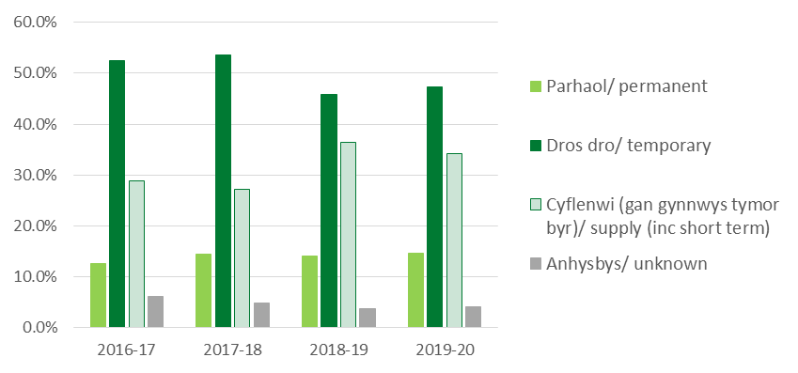
ANGau - Sefydlu
NQTs - Induction
Mae’r mwyafrif o ANGau yn dechrau ar gytundeb byrdymor, cyflenwi neu rhan amser
Most NQTs start induction on a temporary contract, supply or part time
Amser i gwblhau sefydlu / Time to complete induction | 2011-12 | 2012-13 | 2013-14 | 2014-15 | 2015-16 | 2016-17 | 2017-18 | 2018-19
3 thymor/ 3 terms | 41.3% | 48.7% | 52.9% | 54.8% | 58.6% | 58.5% | 60.9% | 51.9%
4-6 tymor/ 4-6 terms | 29.9% | 34.7% | 31.6% | 30.7% | 26.0% | 28.5% | 22.6% | 31.2%
7-9 tymor/ 7-9 terms | 7.1% | 7.2% | 4.6% | 4.1% | 4.7% | 2.9% | 1.3% | Ddb n/a
10-12 tymor/ 10-12 terms | 1.3% | 1.3% | 1.2% | 1.5% | 0.9% | 0.2% | Ddb n/a | Ddb n/a
13+ tymor/ 13+ terms | 2.3% | 1.1% | 1.0% | 0.5% | 0.3% | Ddb n/a | Ddb n/a | Ddb n/a
Heb ei gyflawni eto/ Not yet completed | 18.1% | 7.0% | 8.7% | 8.3% | 9.5% | 9.7% | 15.2% | 16.9%
Methwyd sefydlu / Failed induction | 0.0% | Ddb n/a | Ddb n/a | 0.1% | Ddb n/a | 0.2% | Ddb n/a | Ddb n/a
Mae cyflenwi’n cynnwys lleoliadau ad-hoc ac estynedig
Supply includes ad-hoc and longer term placements
Nifer wedi pasio Sefydlu Medi-Awst / Induction passes Sept – Aug | 2015 –2016 |  | 2016 –2017 |  | 2017 –2018 |  | 2018 –2019 |  | 2019 –2020
Cyfnod / Phase | Nifer / Number | % | Nifer / Number | % | Nifer / Number | % | Nifer / Number | % | Nifer / Number | %
Cynradd / Primary | 476 | 38.0% | 403 | 37.8% | 377 | 33.8% | 399 | 39.2% | 419 | 39.0%
Canol / Middle | 18 | 1.4% | 20 | 1.9% | 35 | 3.1% | 42 | 4.1% | 46 | 4.3%
Uwchradd / Secondary | 428 | 34.2% | 353 | 33.1% | 358 | 32.1% | 351 | 34.4% | 361 | 33.6%
Gall cyflogaeth athro (math o gytundeb a/neu oriau gweithio) newid yn ystod y cyfnod Sefydlu. 3 thymor neu gyfwerth yw’r gofyniad lleiafswm
During induction a teacher’s employment (contract type and/or hours worked) may change. 3 term or equivalent is the minimum requirement.

Slide 13
Heriau
Challenges
  Materion byd-eang o ran recriwtio athrawon
  Gofyn i hyfforddeion fod â gradd ‘B’ mewn Saesneg a Mathemateg
  Gwell gymhelliannau ariannol i hyfforddi fel athro ysgol yn Lloegr
  Cyhoeddusrwydd blaenorol negyddol am ansawdd hyfforddiant yng Nghymru
  Adborth blynyddol gan fyfyrwyr – y farn fod y gyrfa yn dod yn fwyfwy anodd a bod y proffesiwn ddim yn ddeniadol
  Y baich gwaith a gweinyddu canfyddedig
  Anawsterau wrth lwyddo cael swyddi parhaol yng Nghymru.
  Global issues in teacher recruitment
  The requirement for trainees to hold a B grade in Mathematics and English
  Better financial incentives to train as a school teacher in England
  Previous negative publicity about the quality of training in Wales
  Annual student feedback - perception that the career is getting harder and that the profession is unattractive
  Perceived workload and administration
  Difficulties in obtaining permanent posts in Wales

Slide 14
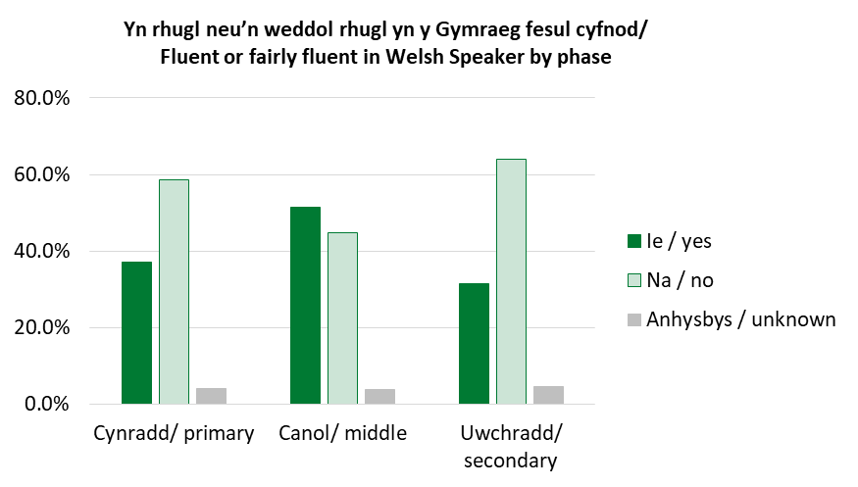
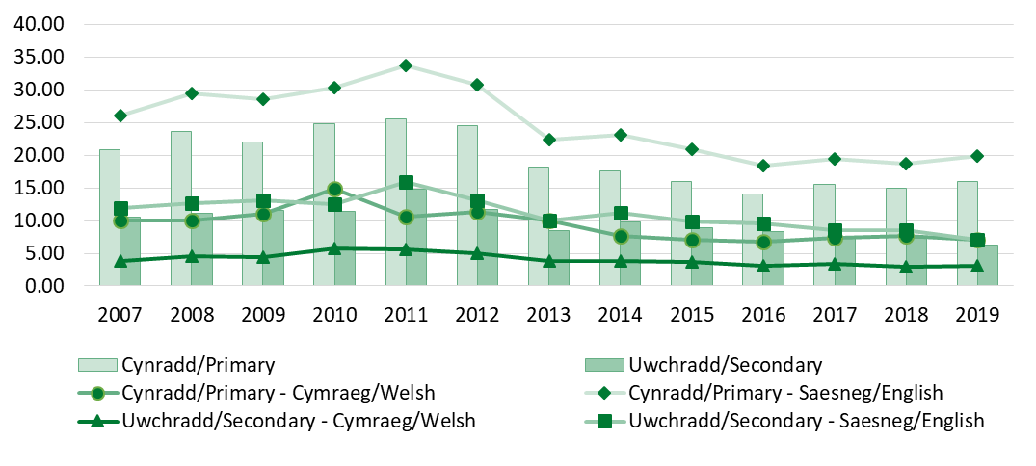
Y Gymraeg
Welsh language
Targed 1 miliwn o siaradwyr Cymraeg erbyn 2050 – Mae’r tueddiad o athrawon ysgol sy’n siarad Cymraeg (33.6%) neu’n gallu gweithio trwy’r Gymraeg (27.2%) wedi parhau’n weddol sefydlog gydag ychydig o amrywio blwyddyn ar flwyddyn. (3.8% yn anhysbys yn y ddau).
Target of 1 million welsh speakers by 2050 - The trend of school teachers who are Welsh speakers (33.6%) or are able to work through the medium of Welsh (27.2%) has continued to remain fairly static with little variance year on year. (3.8% unknown in both).
Athrawon ysgol/ school teachers | Heb sgiliau/ No skills | Mynediad/ Entry Level | Sylfaenol/ Foundation Level | Canolradd/ Intermediate Level | Uwch/ Advanced Level | Hyfedredd/ Proficient Level
Cymru/ Wales | 4866 | 5926 | 4885 | 2179 | 1785 | 6422
HESES, HESA, PLASC
% y swyddi gwag cyfrwng Cymraeg heb eu llenwi
% of Welsh medium vacancies unfilled
% y swyddi gwag heblaw cyfrwng Cymraeg heb eu llenwi
% of non-Welsh medium vacancies unfilled
 | 2010 | 2011 | 2012 | 2013 | 2014 | 2015 | 2016 | 2017 | 2018 | 2019
Cynradd/ Primary | 2.3% | 2.6% | 3.2% | 2.8% | 4.4% | 6.0% | 6.8% | 4.1% | 3.5% | 4.0%
Uwchradd a chanol/ Secondary and Middle | 1.8% | 0.0% | 1.9% | 2.6% | 9.2% | 3.2% | 9.9% | 7.6% | 23.6% | 9.5%
 | 2010 | 2011 | 2012 | 2013 | 2014 | 2015 | 2016 | 2017 | 2018 | 2019
Cynradd / Primary | 4.0% | 5.0% | 3.0% | 6.9% | 4.9% | 7.8% | 6.5% | 10.0% | 6.7% | 7.4%
Uwchradd a Chanol / Secondary and Middle | 2.9% | 2.4% | 4.0% | 3.0% | 7.4% | 7.2% | 5.7% | 9.0% | 7.6% | 10.3%

Slide 15
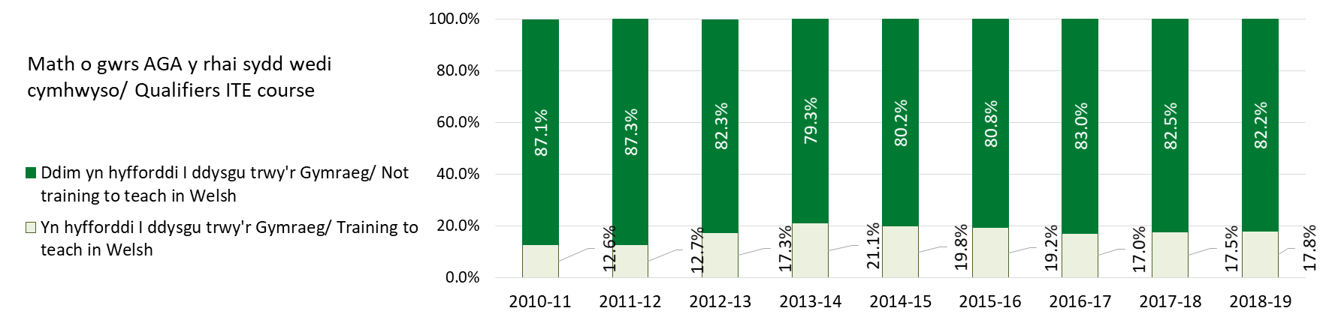
Y Gymraeg
Welsh language
Mae’r nifer o ANGau (wedi’u hyfforddi yng Nghymru) sy’n gallu siarad Cymraeg wedi cynyddu o 23.4% yn 2016 i 34.6% yn 2020.
NQTs (trained in Wales) able to speak Welsh has increased from 23.4% in 2016 to 34.6% in 2020
Targedau derbyn a chrynodeb o recriwtio 2020/21/ Intake targets and summary of recruitment 2020/21 | Nifer targed cyffredinol/ Overall target number | Nifer gwirioneddol a recriwtiwyd/ Actual recruitment number | % o’r darged/ % of target figure | Nifer cyfrwng Cymraeg a recriwtiwyd/ Welsh medium recruitment number | %% o’r darged – cyfrwng Cymraeg/ of target figure - Welsh medium
Cynradd/ Primary | 724 | 822 | 113.5 | 162 | 22.4
Uwchradd/ Secondary | 1,003 | 717 | 71.5 | 116 | 11.6
Cyfanswm/ Total | 1,727 | 1,539 | 89.1 | 278 | 16.1
Ffynhonnell/ Source: PLASC, SWAC

Slide 16
Pynciau
Subjects
Pwnc a addysgir yn erbyn pwnc hyfforddiant / Subject taught Vs trained | Hyfforddwyd yn y pwnc / Trained in subject | Hyfforddwyd yn y pwnc / Trained in subject (%) | Hyfforddwyd mewn pwnc gwahanol / Trained in another subject | Hyfforddwyd mewn pwnc gwahanol / Trained in another subject (%) | Pwnc hyfforddi anhysbys / Subject trained unknown | Pwnc hyfforddi anhysbys / Subject trained unknown (%) | Cyfanswm / Total | Cyfanswm / Total (%)
Bioleg / Biology | 271 | 59.0 | 187 | 40.7 | 1 | 0.2 | 459 | 100
Cemeg / Chemistry | 211 | 48.7 | 218 | 50.3 | 4 | 0.9 | 433 | 100
Saesneg / English | 1,208 | 75.2 | 366 | 22.8 | 33 | 2.1 | 1,607 | 100
Mathemateg / Mathematics | 1,239 | 78.6 | 306 | 19.4 | 31 | 2.0 | 1,576 | 100
Ffiseg / Physics | 162 | 42.7 | 213 | 56.2 | 4 | 1.1 | 379 | 100
Addysg Grefyddol / Religious Education | 404 | 64.6 | 211 | 33.8 | 10 | 1.6 | 625 | 100
Gwyddoniaeth / Science | 418 | 34.3 | 784 | 64.3 | 18 | 1.5 | 1,220 | 100
Cymraeg / Welsh | 729 | 73.0 | 260 | 26.0 | 10 | 1.0 | 999 | 100
Nid yw SAC yn benodol i bwnc nac ystod oedran.
QTS not age range or subject specific

Slide 17
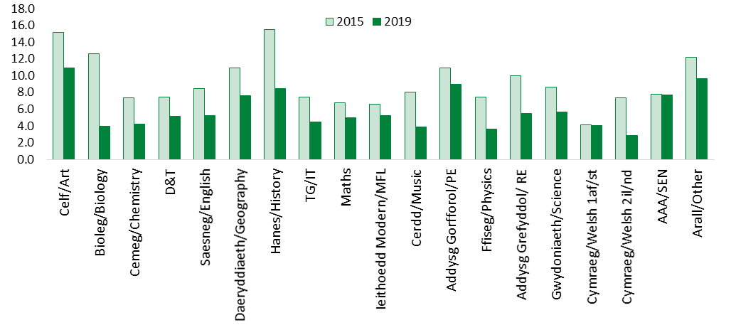
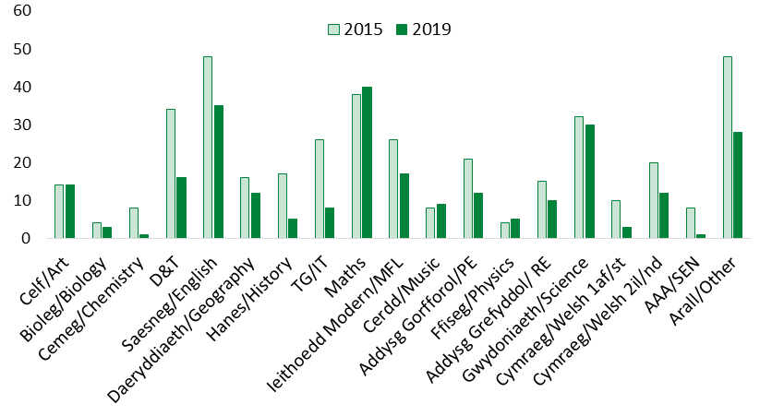
Nifer cyfartalog y ceisiadau fesul swydd fesul pwnc
Average number of applications per post by subject
 | Celf/Art | Bioleg/Biology | Cemeg/Chemistry | D&T | Saesneg/English | Daeryddiaeth/Geography | Hanes/History | TG/IT | Maths | Ieithoedd Tramor/MFL | Cerdd/Music | Ymarfer Corff/PE | Ffiseg/Physics | Addysg Grefyddol/ RE | Gwydoniaeth/Science | Cymraeg/Welsh 1af/st | Cymraeg/Welsh 2il/nd | AAA/SEN | Arall/Other
2014 | 12.4 | 10.6 | 7.8 | 14.7 | 8.8 | 12.8 | 11.4 | 6.7 | 7.4 | 12.4 | 9.8 | 16.8 | 5.1 | 9.3 | 8.4 | 5.8 | 10.1 | 9.1 | 10.5
2015 | 15.2 | 12.6 | 7.4 | 7.5 | 8.5 | 10.9 | 15.5 | 7.4 | 6.8 | 6.6 | 8.0 | 11.0 | 7.5 | 10.0 | 8.7 | 4.1 | 7.3 | 7.8 | 12.2
2016 | 9.3 | 4.5 | 4.1 | 8.2 | 6.9 | 5.6 | 12.4 | 8.0 | 7.0 | 6.7 | 10.4 | 15.9 | 4.6 | 11.2 | 7.9 | 3.5 | 6.5 | 5.1 | 12.7
2017 | 10.7 | 3.9 | 4.2 | 7.9 | 8.0 | 5.7 | 9.6 | 5.3 | 6.1 | 9.0 | 6.1 | 16.2 | 4.8 | 9.2 | 5.8 | 3.6 | 6.1 | 4.6 | 8.6
2018 | 13.4 | 4.2 | 4.0 | 7.7 | 7.3 | 7.5 | 8.7 | 6.0 | 5.7 | 5.5 | 4.7 | 11.6 | 5.5 | 7.4 | 5.7 | 4.0 | 4.0 | 10.6 | 10.6
2019 | 11.0 | 4.0 | 4.3 | 5.2 | 5.3 | 7.6 | 8.5 | 4.5 | 4.9 | 5.2 | 3.9 | 9.0 | 3.6 | 5.5 | 5.6 | 4.1 | 2.8 | 7.7 | 9.7
Nifer yr athrawon uchradd a adawodd y proffesiwn fesul pwnc
Number of secondary teachers leaving the profession by subject
 | Celf/Art | Bioleg/Biology | Cemeg/Chemistry | D&T | Saesneg/English | Daeryddiaeth/Geography | Hanes/History | TG/IT | Maths | Ieithoedd Tramor/MFL | Cerdd/Music | Ymarfer Corff/PE | Ffiseg/Physics | Addysg Grefyddol/ RE | Gwydoniaeth/Science | Cymraeg/Welsh 1af/st | Cymraeg/Welsh 2il/nd | AAA/SEN | Arall/Other
2015 | 14 | 4 | 8 | 34 | 48 | 16 | 17 | 26 | 38 | 26 | 8 | 21 | 4 | 15 | 32 | 10 | 20 | 8 | 48
2016 | 13 | 5 | 10 | 29 | 56 | 18 | 27 | 21 | 38 | 27 | 13 | 22 | 11 | 22 | 36 | 9 | 13 | 7 | 54
2017 | 13 | 9 | 4 | 22 | 30 | 14 | 9 | 13 | 54 | 24 | 10 | 19 | 2 | 14 | 31 | 10 | 10 | 10 | 35
2018 | 10 | 2 | 3 | 17 | 35 | 9 | 10 | 3 | 34 | 13 | 11 | 12 | 6 | 16 | 31 | 6 | 17 | 10 | 36
2019 | 14 | 3 | 1 | 16 | 35 | 12 | 5 | 8 | 40 | 17 | 9 | 12 | 5 | 10 | 30 | 3 | 12 | 1 | 28
Ffynhonnell / Source: PLASC

Slide 18
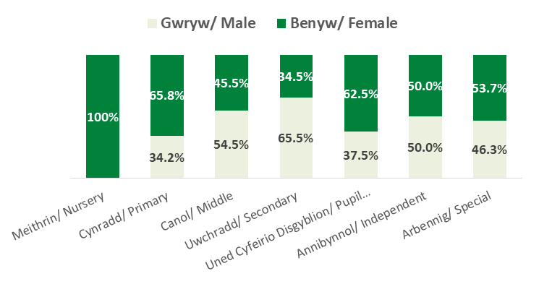
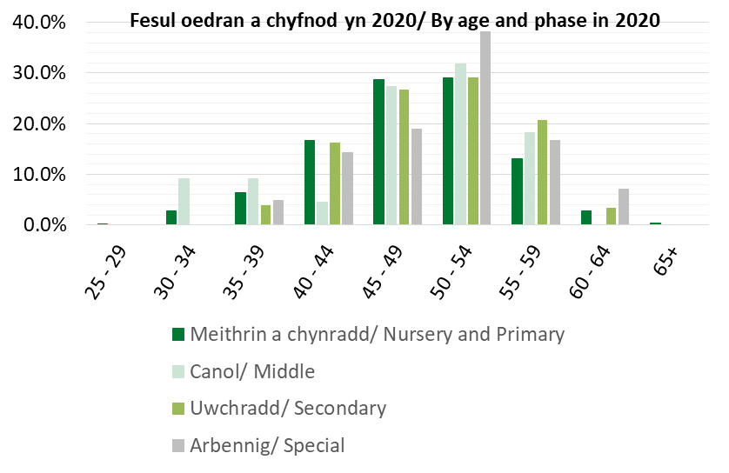
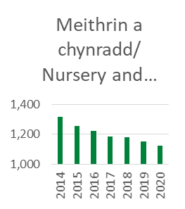
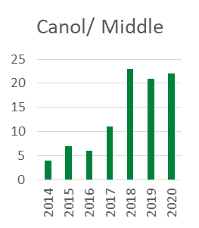
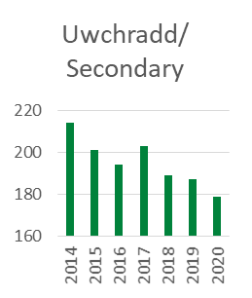
Penaethiaid
Headteachers
Mae’r nifer o benaethiaid wedi gostwng gan 6.2% o fewn y pum mlynedd diwethaf i 1,386 yn 2020
The number of headteachers has declined by 6.2% in the last five years to 1,386 in 2020
2014 | 2015 | 2016 | 2017 | 2018 | 2019 | 2020
1,597 | 1,523 | 1,478 | 1,458 | 1,451 | 1,428 | 1,386
Yn gallu gweithio trwy gyfrwng y Gymraeg
33.6%
Are able to work through the medium of Welsh
CYMRAEG
Penaethiaid sy’n siaradwyr Cymraeg
Nifer y penaethiaid fesul cyfnod rhwng 2014 a 2020
The number of headteachers by phase from 2014 to 2020
39.1%
headteachers
are Welsh speakers

Slide 19
CPCP
NPQH
CPCP / NPQH | Meithrin a Chynradd/ Nursery and primary | Canol/ Middle | Uwchradd/ Secondary | UCD, annibynnol/ PRU, independent | Cyfanswm/ Total
Pennaeth gyda CPCP/ Headteacher with NPQH | 937 | 18 | 160 | 11 | 1,126
Pennaeth heb CPCP/Headteacher without NPQH | 185 | 4 | 17 | 13 | 219
CPCP (nid yw’n bennaeth) fesul blwyddyn cyflawni/ NPQH (not headteachers) by year of award | 2000 a chyn/ 2000 and prior | 2001 - 2005 | 2006 - 2010 | 2011 - 2015 | 2016 - 2020 | Cyfanswm/ Total
Dirprwy bennaeth/ Deputy headteacher | 2 | 37 | 61 | 62 | 296 | 458
Pennaeth cynorthwyol/ Assistant headteacher | 0 | 12 | 26 | 22 | 77 | 137
Pennaeth blwyddyn, pennaeth adran/ Head of year, head of department or teacher | 2 | 45 | 38 | 37 | 53 | 175
CPCP (ddim yn benaethiaid)/ NPQH (not headteachers) | Meithrin a chynradd/ Nursery and Primary | Canol/ Middle | Uwchradd/ Secondary | Arbennig ac Uned Cyfeirio Disgyblion/ Special and Pupil Referral Unit | Cyfanswm/ Total
Dirprwy bennaeth/ Deputy headteacher | 316 | 15 | 113 | 14 | 458
Dan 30/ Under 30 | 1 | 0 | 0 | 0 | 1
30 - 39 | 57 | 3 | 13 | 2 | 75
40 - 49 | 177 | 9 | 54 | 7 | 246
50 - 59 | 76 | 3 | 43 | 4 | 126
60 + | 5 | 0 | 3 | 2 | 10
Pennaeth cynorthwyol/ Assistant headteacher | 49 | 15 | 66 | 7 | 137
Dan 30/ Under 30 | 0 | 0 | 0 | 0 | 0
30 - 39 | 12 | 2 | 10 | 0 | 24
40 - 49 | 26 | 8 | 28 | 4 | 66
50 - 59 | 11 | 5 | 27 | 3 | 46
60 + | 0 | 0 | 1 | 0 | 1
Pennaeth adran, pennaeth blwyddyn neu athro/ Head of department, Head of year or teacher | 107 | 8 | 38 | 16 | 169
Under 30 | 0 | 0 | 0 | 0 | 0
30 – 39 | 18 | 1 | 2 | 0 | 21
40 – 49 | 42 | 4 | 10 | 7 | 63
50 – 59 | 42 | 3 | 24 | 8 | 77
60 + | 5 | 0 | 2 | 1 | 8
Cyfanswm/ Total | 472 | 38 | 217 | 37 | 764
Mae 6 cofrestrai sy’n gweithio yn y sector annibynnol heb eu cynnwys yma
Not included are 6 registrant employed in the independent sector

Slide 20
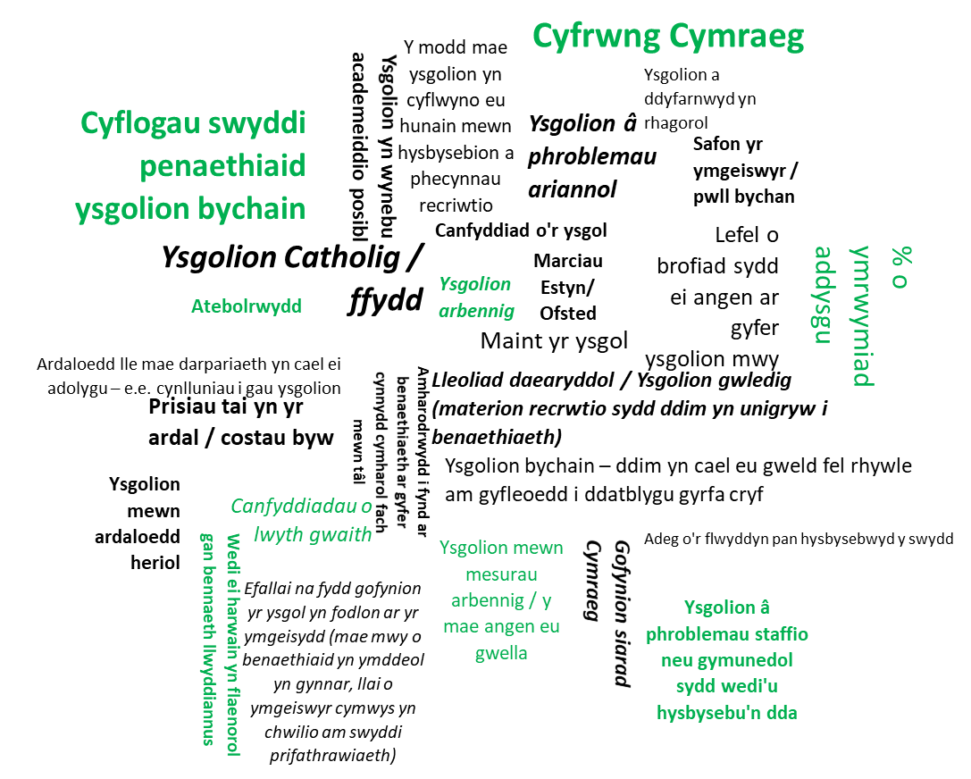
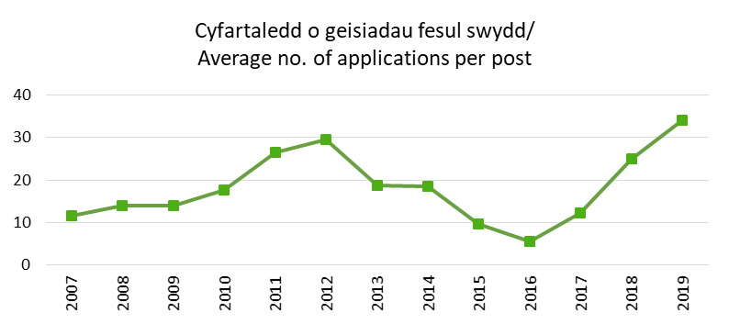
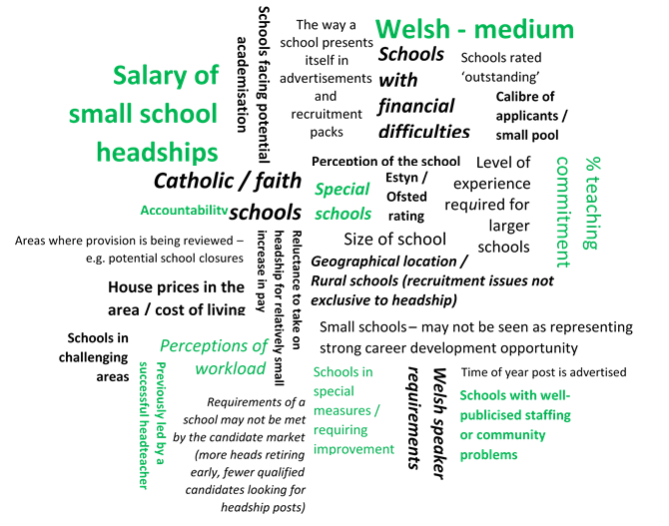
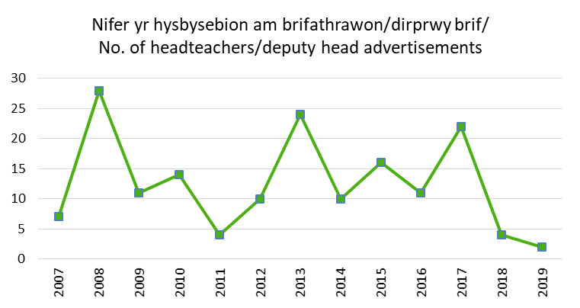
Rhai o’r rhesymau pam bod rhai swyddi penaethiaid yn anodd i’w llenwi
Reasons some headteacher posts are more difficult to fill
Recriwtio i rolau arwain
Recruitment of leadership roles
Ffynhonnell/ Source: PLASC

Slide 21
Cadw
Retention
Athrawon newydd – AGA Cymru
New teachers – ITE Wales
 | 2016 |  | 2017 |  | 2018 |  | 2019 |  | 2020
 | Nifer/ Number | % | Nifer/ Number | % | Nifer/ Number | % | Nifer/ Number | % | Nifer/ Number | %
Nifer y myfyrwyr wedi ennill SAC/ Number of students awarded QTS | 1,049 |  | 1,060 |  | 1,018 |  | 903 |  | 975
Wedi cofrestru gyda CGA ar ôl ennill SAC/ Registered with EWC following award | 822 | 78.4 | 856 | 80.8 | 802 | 78.8 | 727 | 80.5 | 765 | 78.5
Athrawon newydd – AGA Lloegr
New teachers – ITE England
 | 2016 | 2017 | 2018 | 2019 | 2020
 | Nifer/ Number | Nifer/ Number | Nifer/ Number | Nifer/ Number | Nifer/ Number
Wedi hyfforddi yn Lloegr, wedi cofrestru gyda CGA ar ôl ennill SAC/ Trained in England, registered with EWC following award | 210 | 225 | 270 | 291 | 149
Sylwch: mae’r y niferoedd wedi’u cofrestru ar gyfer 2020 yn y ddau dabl fel ar 8 Hydref a bydd hyn yn cynyddu hyd at ddiwedd y flwyddyn.
Note: The numbers registered for 2020 in both tables is as at 8 October 2020 and will continue to increase until year end.

Slide 22
Gyrfa cynnar
Early career
 | AGA Cymru/ ITE Wales |  | AGA Lloegr/ ITE England
 | 2014 |  | 2014
 | Nifer/ Number | % | Nifer/ Number | %
Nifer y myfyrwyr a enillodd SAC / Number of students who gained QTS | 1,356
Wedi’u cofrestru gyda CGA ar ôl ennill SAC/ Registered with EWC following award | 1,012 | 74.6 | 172
Wedi’u cofrestru ym Mawrth 2015 a Mawrth 2020/ Registered March 2015 and March 2020 | 782 | 77.3 | 72 | 41.9
Dadansoddiad o’r 818 o gofrestreion o garfan 2014 Cymru - Mawrth 2020
March 2020 employment breakdown of the 818 registrants from the 2014 Welsh cohort
 | Meithrin a chynradd/ Nursery and primary | Canol/ Middle | Uwchradd/ Secondary | Annibynnol/ UCD / Independent/ Special/PRU | Cyflenwi/ Supply | Eraill mewn/allan o swydd/ Others in/out of service
Pennaeth/ Headteacher | 1 | 0 | 0 | 0
Pennaeth cynorthwyol a dirprwy bennaeth/ Assistant and Deputy head | 2 | 0 | 0 | 0
Pennaeth adran/ Head of department | 0 | 2 | 5 | 0
Pennaeth blwyddyn/ Head of year | 0 | 0 | 1 | 0
Athro neu athro uwch/ Teacher or senior teacher | 319 | 33 | 283 | 20
Cyfanswm/ Total | 322 | 35 | 289 | 20 | 87 | 65
Dadansoddiad o gyflogaeth y 72 o gofrestreion yr hyfforddwyd yn Lloegr - Mawrth 2020
March 2020 employment breakdown of the 72 registrants who trained in England
 | Meithrin a chynradd/ Nursery and primary | Uwchradd/ Secondary | Arbennig | Cyflenwi/ Supply | Eraill mewn/ allan o swydd/ Others in/out of service
Athro neu athro uwch/ Teacher or senior teacher | 28 | 26 | 2
Cyfanswm/ Total | 28 | 26 | 2 | 8 | 8

Slide 23
Gyrfa cynnar
Early career
Mawrth 2020 – y rhanbarth mae’r 818 o gofrestreion o garfan 2014 Cymru yn gweithio ynddyn nhw
March 2020 region working of the 818 registrants from the 2014 Welsh cohort
Rhanbarth/ region | Wedi cofrestru yn 2020/ Registered in 2020
 | AGA Cymru/ ITE Wales
GCA/ EAS | 129
GwE | 122
CCD/ CSC | 207
ERW | 202
Annibynnol/ Independent | 6
Eraill mewn ac allan o swydd/ Others in and out of service | 152
Cyfanswm/ Total | 818
Mawrth 2020 – y rhanbarth mae’r 72 o gofrestreion yr hyfforddwyd yn Lloegr yn gweithio ynddo
March 2020 region working of the 72 registrants who trained in England
Rhanbarth/ region | Wedi cofrestru yn 2020/ Registered in 2020
 | AGA Lloegr/ ITE England
GCA/ EAS | 14
GwE | 20
CCD/ CSC | 14
ERW | 8
Eraill mewn ac allan o swydd/ Others in and out of service | 16
Cyfanswm/ Total | 72

Slide 24
Canol gyrfa/ Gyrfa hwyr
Mid-year/late career
Proffil oedran holl athrawon ysgol/ Age profile all school teachers | 2016 |  | 2017 |  | 2018 |  | 2019 |  | 2020
 | No. | % | No. | % | No. | % | No. | % | No. | %
Dan 30/ Under 30 | 6,334 | 17.2 | 6,192 | 17 | 6,010 | 16.7 | 5,827 | 16.4 | 5,614 | 16
30 - 39 | 10,686 | 28.9 | 10,690 | 29.3 | 10,709 | 29.8 | 10,555 | 29.7 | 10,390 | 29.6
40 - 49 | 10,078 | 27.2 | 10,177 | 28 | 10,192 | 28.4 | 10,336 | 29.1 | 10,459 | 29.7
50 - 59 | 7,192 | 19.5 | 6,919 | 19 | 6,707 | 18.6 | 6,612 | 18.6 | 6,672 | 19
60 + | 2,661 | 7.2 | 2,448 | 6.7 | 2,311 | 6.4 | 2,215 | 6.2 | 2,036 | 5.7
Cyfanswm/ Total | 36,951 | 100 | 36,426 | 100 | 35,929 | 100 | 35,545 | 100 | 35,171 | 100
Mae proffil oedran y rheiny sydd ar ganol eu gyrfa yn parhau’n iach.
Rydym wedi edrych ar broffil y cofrestreion hyn fesul rhanbarth a’r cyfnod maent yn gweithio ynddo dros y 5 mlynedd diwethaf – nid oes pryderon i’w nodi
Rhaid nodi’r gostyniad graddol yn y ganran o athrawon ysgol sy’n gweithio y tu hwnt i 60 oed
The age profile of those mid career remains healthy
We have looked at the profile of these registrants by region and phase working over the last 5 years – there are no concerns to note
Of note is the gradual percentage reduction in school teachers working past the age of 60

Slide 25
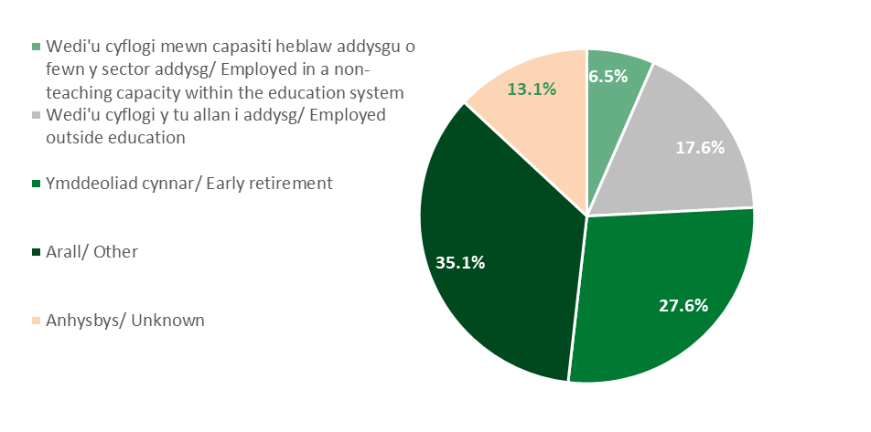
Athrawon a adawodd y proffesiwn fesul y nifer o flynyddoedd o brofiad
Teachers who left the profession by number of years experience
Ymddeoliad cynnar/ Early retirement | 2017 | 2018 | 2019
Cynradd/ Primary | 106 | 104 | 106
Uwchradd/ Secondary | 97 | 79 | 63
Celf/ Art | 1 | 1 | 6
Bioleg/ Biology | 2 | 1 | .
Cemeg/ Chemistry | 2 | 1 | 1
Dylunio a thechnoleg/ Design & Technology | 7 | 3 | 5
Saesneg/ English | 10 | 6 | 6
Daearyddiaeth/ Geography | 4 | 5 | 2
Hanes/ History | 3 | 4 | 4
Technoleg Gwybodaeth/ Information Technology | 1 | 2 | .
Mathemateg/ Mathematics | 15 | 8 | 11
Ieithoedd Tramor Modern/ Modern Foreign Languages | 6 | 2 | 5
Cerddoriaeth/ Music | 3 | 4 | .
Addysg Gorfforol/ Physical Education | 10 | 4 | 5
Ffiseg/ Physics | . | 5 | 1
Addysg Grefyddol/ Religious Education | 4 | 2 | .
Gwyddoniaeth/ Science | 4 | 5 | 2
Cymraeg iaith gyntaf/ Welsh first language | 3 | 1 | 1
Cymraeg ail iaith/ Welsh second language | 1 | 5 | 6
Cydlynydd AAY/ SEN coordinator | 5 | 4 | 1
Pwnc arall/ Other subject | 15 | 15 | 7
Pennaeth/dirprwy bennaeth ac ati / Headteacher/deputy head etc. | 1 | 1 | .
Cyfanswm/ Total | 203 | 183 | 169
 | Nifer y blynyddoedd o brofiad/ Number of years experience
2019 | 0-5 | 6-10 | 11-15 | 16-20 | 21-25 | 26-30 | 31+ | Cyfanswm/ Total
Cynradd/ Primary | 74 | 46 | 39 | 65 | 40 | 41 | 46 | 351
Uwchradd/ Secondary | 75 | 36 | 33 | 27 | 24 | 33 | 33 | 261
Cyfanswm/ Total | 149 | 82 | 72 | 92 | 64 | 74 | 79 | 612
2015 | 0-5 | 6-10 | 11-15 | 16-20 | 21-25 | 26-30 | 31+ | Cyfanswm/ Total
Cynradd/ Primary | 86 | 50 | 46 | 62 | 25 | 45 | 63 | 377
Uwchradd/ Secondary | 69 | 47 | 44 | 52 | 43 | 54 | 94 | 403
Cyfanswm/ Total | 155 | 97 | 90 | 114 | 68 | 99 | 157 | 780
Ffynhonnell/ Source: PLASC

Slide 26
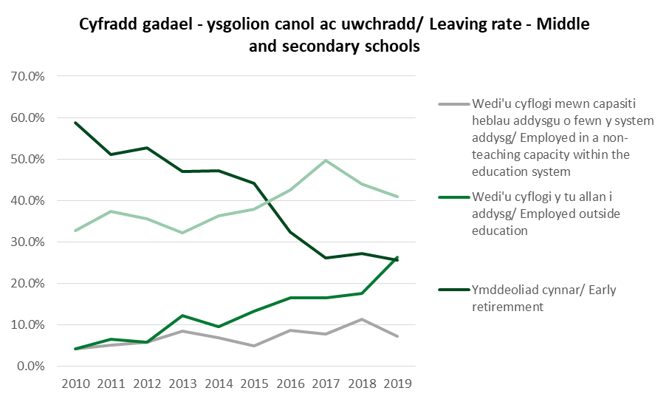
 | Cyfanswm: Athrawon cymwysedig/ Total: Qualified teachers |  |  |  |  |  |  | Cyfanswm: athrawon cymwysedig/ Total: Qualified teachers | Athro heb gymhwyso/ Unqualified teacher | Athrawon eraill/ Other teachers (1) | Athro cyflenwi parhaol/ Permanent supply teacher (2) | Athro cyflenwi dan gytundeb/ Contracted supply teacher (3) | Hyfforddeion AGA/ ITT Trainees (4) | Cyfanswm athrawon/ Total teachers
 | Pennaeth gweithredol/ Executive headteacher | Penaethiaid/ Headteachers | Penaethiaid dros dro/ Acting headteachers | Dirprwy benaethiaid/ Deputy headteachers | Penaethiaid cynorthwyol/ Assistant headteachers | Ymarferydd arweiniol/ Leading practitioner | Athrawon dosbarth cymwysedig/ Qualified classroom teachers
 |  |  |  |  |  |  |  |  | . | . | . | . | .
Dan 25/ Under 25 | . | . | . | . | . | . | 795 | 795 | 20 | 45 | 5 | 5 | 110 | 985
25 - 29 | . | * | * | 15 | 20 | * | 3220 | 3265 | 50 | 135 | 20 | 5 | 45 | 3520
30 - 39 | 5 | 110 | 30 | 290 | 250 | 20 | 7700 | 8410 | 60 | 270 | 20 | 15 | 25 | 8800
40 - 49 | 15 | 575 | 45 | 560 | 470 | 35 | 6485 | 8185 | 50 | 225 | 20 | 10 | 10 | 8505
50 - 59 | 20 | 580 | 30 | 245 | 200 | 10 | 3225 | 4305 | 50 | 120 | 15 | 15 | * | 4505
60 + | * | 40 | * | 20 | 10 | . | 385 | 460 | 15 | 10 | 5 | 5 | * | 500
Anhysbys/ Unknown | . | * | * | * | * | . | 65 | 75 | . | * | . | . | . | 75
Cyfanswm/ total | 45 | 1305 | 115 | 1135 | 950 | 70 | 21875 | 25490 | 245 | 805 | 85 | 55 | 195 | 26880
Canran o athrawon a adawodd y proffesiwn
Percentage of teachers who left the profession
Cyfnod/ Phase | 2010 | 2011 | 2012 | 2013 | 2014 | 2015 | 2016 | 2017 | 2018 | 2019
Cynradd/ Primary | 2.6% | 2.4% | 2.5% | 2.6% | 2.7% | 2.8% | 2.8% | 2.7% | 2.5% | 2.7%
Canol/ Middle | n/a | n/a | 4.2% | 2.5% | 1.3% | 4.3% | 1.8% | 1.7% | 1.6% | 1.1%
Uwchradd/ Secondary | 3.3% | 3.4% | 2.7% | 2.9% | 3.1% | 3.3% | 3.7% | 2.9% | 2.5% | 2.3%
Cyfanswm / Total (%) | 2.8% | 2.8% | 2.6% | 2.7% | 2.8% | 2.9% | 3.1% | 2.7% | 2.4% | 2.4%
Cyfanswm yr athrawon/ Total number of teachers (headcount) | 27,108 | 26,869 | 27,056 | 27,064 | 26,755 | 26,453 | 26,172 | 26,129 | 25,802 | 25,844
Ffynhonnell/ Source: PLASC/SWAC

Slide 27
Ymchwil ansoddol
Qualitative research
Lle mae recriwtio’n fwy heriol:
    Cyfrwng Cymraeg, pynciau STEM, ysgolion gwledig, rolau arweinyddiaeth (yn enwedig cyfrwng Cymraeg, ardaloedd gwledig ac ysgolion ffydd).
Ansawdd ysgolion yn cael effaith ar recriwtio, i rolau arweinyddiaeth yn arbennig.
Anodd recriwtio athrawon o gefndiroedd lleiafrifol ethnig oherwydd niferoedd isel o athrawon cymwysedig o gefndiroedd duon ac Asiaidd a lleiafrifoedd ethnig (BAME).
“Gradd B” yn rhan o ofynion mynediad efallai’n cael effaith negyddol ar recriwtio.
Gwella hyrwyddo’r proffesiwn yng Nghymru: Elfen greadigol y cwricwlwm newydd; diwylliant o gydweithredu o fewn system addysg Cymru; lefel newydd o her ddeallusol y rhaglenni AGA newydd.
Rhwystr o fewn y sytem o ran arweinyddiaeth ganol – dirprwyon nad ydynt am symud ymlaen i brifathrawiaeth oherwydd baich gwaith ychwanegol yn rhwystro’r rheiny y mae angen arnynt ennill profiad fel dirprwy cyn iddynt allu ymgeisio am rôl fel pennaeth.
Pryderon o ran a yw’r CPCP yn addas i’r diben neu beidio, ac a yw’n cael effaith negyddol ar recriwtio uwch arweinwyr o safon uchel.
Dysgu proffesiynol yn elfen allweddol wrth gefnogi cadw.
Lleoliad ysgolion yn cael effaith ar recriwtio: manteision bod ar goridor yr M4; anawsterau i’r siroedd ar yr arfordir wrth iddynt golli staff i Loegr.
Recruitment is more challenging:
    Welsh medium; STEM subjects; rural schools; leadership roles (particularly in Welsh medium, rural schools and faith schools).
Quality of schools impacts on recruitment, especially for leadership roles
Difficult to recruit teachers from minority ethnic backgrounds due to the low numbers of BAME qualified teachers.
‘B grade’ entry requirement for ITE potentially having a negative impact on recruitment.
Improve promotion of the profession in Wales: creativity offered by the new curriculum; culture of collaboration in the education system in Wales; new level of intellectual challenge offered by the new ITE programmes.
Blockage in the system around middle leadership – deputies not wishing to progress to headship due to additional workload are stopping those who need to get experience as a deputy before being able to apply for headship.
Concerns around whether the NPQH is fit for purpose, and whether it is having a negative impact on the recruitment of quality senior leaders.
Effective professional learning is a key element in supporting retention.
Location of schools does impact on recruitment: benefits to being on M4 corridor; difficulties for border counties losing staff to England.

Slide 28
Crynodeb
Summary
Yn wahanol i’r boblogaeth gyffredinol yng Nghyrmu nid yw proffil athrawon ysgol yn amrywio – Cymreig, Gwyn, Benywod gyda lefelau isel o athrawon duon ac Asiaidd a lleiafrifoedd ethnig neu’r rheiny sydd wedi datgan anabledd.
Mae’r proffil oedran yn gytbwys ond bydd proffil y grŵp canol-gyrfa presennol yn heneiddo a bydd angen iddo gael ei gefnogi gan fewnbwn iach o ANGau.
Mae recriwtio yn y sector Cynradd yn ddigonol. Mae angen gwella hyn mewn rhai pynciau yn y sector uwchradd.
Arwyddion cynnar o gynnydd mewn recriwtio i AGA (cynradd ac uwchradd). % cynyddol o ANGau cofrestredig yn cael eu hyfforddi yn Lloegr i AGA yn peri goblygiadau.
Mae’r nifer sy’n cwblhau’r broses Sefydlu bob blywddyn yn braidd yn codi neu gostwng. 5 uchel yn ei gwblhau trwy gytundebau cyfnod penodol neu gyflenwi.
Profile of school teachers unvarying unlike the general population in Wales – Welsh, White and Female with low levels of BAME teachers or those with a disability recorded.
Age profile is balanced but the current mid-career group will get older and needs to be supported by a healthy throughput of NQTs.
Primary recruitment is sufficient. Secondary requires improvement in some subjects.
Early signs of an increase in recruitment to ITE (primary an secondary). Increasing % of registered NQTs being trained in England has implications.
Number completing Induction each year barely fluctuates. High % complete via fixed term contracts or supply.

Slide 29
Anoddach recriwtio i swyddi cyfrwng Cymraeg. % o’r gweithlu yn gallu gweithio trwy gyfrwng y Gymraeg yn weddol sefydlog – mae hyn yn peri goblygiadau i darged 2050.
Anoddach recriwtio i bynciau uwchradd penodol. Rhai athrawon yn dysgu pynciau na chawsant eu hyfforddi i’w dysgu.
Anoddach recriwtio penaethiaid mewn rhan amgylchiadau, e.e. uwchradd, cyfrwng Cymraeg, ardaloedd gwledig. CPCP yn ffactor.
Nid yw cadw athrawon yng Nghymru yn broblem arwyddocaol:
  Mewnbwn o AGA i gofrestru â CGA
  Cadw ar ôl 5 mlynedd
  Cadw mewn-gyrfa
  Ymddeoliad cynnar
10. Nifer o ffactorau y mae angen i ni fod yn ystyriol ohonyn nhw mewn perthynas â chadw, e.e llesiant, tâl ac amodau, strwythur gyrfaol, dysgu proffesiynol, baich gwaith, biwrocratiaeth, atebolrwydd a’r economi ehangach.
Cynhelir briffiadau pellach mwy penodol ar Gyflenwi, y Gymraeg, Arweinyddiaeth a Gweithwyr Cefnogi Dysgu Ysgol.
Harder to recruit to Welsh-medium posts. % of workforce able to work through the medium of Welsh is fairly static – has implications for 2050 Target.
Harder to recruit to certain secondary subjects. Some teachers are teaching subjects they have not trained to teach in.
͏͏͏͏͏͏Headteachers harder to recruit in certain circumstances e.g. secondary, Welsh medium, rural areas. NPQH is a factor.
Teacher retention in Wales is not a significant problem:
  Throughput from ITE to EWC registration
  Retention after 5 years
  In - career retention
  Early retirement
10. A number of factors that we need to be mindful of in respect of retention e.g. wellbeing, pay & conditions, career structure, professional learning, workload, bureaucracy, accountability, the wider economy.
Further briefings will be held more specifically on Supply, Welsh language, Leadership and School Learning Support Workers.

Slide 30
Recriwtio a chadw – gwledydd a phroffesiynau eraill
Recruitment and retention – other countries and professions
Bethan Holliday-Stacey
Cyfarwyddwr Datblygiad Proffesiynol, Achredu a Pholisi, CGA
Director of Professional Development, Accreditation and Policy, EWC
Hayden Llewellyn
Prif Weithredwr, CGA
Chief Executive, EWC

Slide 31

Cyd-destun rhyngwladol: Her fyd-eang
Mae heriau yng Nghymru
  Tueddiadau ar i lawr o ran recriwtio athrawon
  STEM, y Gymraeg a phrifathrawiaeth
Mae gwledydd eraill yn wynebu problemau tebyg
  Angen 69m o athrawon erbyn 2030 (OECD 2019)
International context:
A global challenge
There are challenges in Wales
  Downward trends in teacher recruitment
  STEM, Welsh language and headship
Other countries face similar issues
  69m teachers required by 2030 (OECD 2019)

Slide 32



Ein hymchwil
Sail dystiolaeth:
  Astudiaeth y Brifysgol Agored / Prifysgol Abertawe wedi’i chomisiynu gan CGA
  Cyfnodolion, erthyglau newyddion, adroddiadau’r llywodraeth ac ati
Ystyriwyd y gwledydd canlynol:
  Lloegr; Yr Alban; Iwerddon; gwledydd eraill yr Undeb Ewropeaidd; Awstralia; Canada; UDA.
Our research
Evidence base:
  EWC commissioned OU / Swansea University study
  Journals, news articles, government reports etc.
Countries considered:
  England; Scotland; Ireland; other EU nations; Australia; Canada; USA.

Slide 33
Gwledydd gwahanol – materion cyffredin
Different countries – common issues
Baich gwaith / biwrocratiaeth
Workload/bureaucracy
Statws y proffesiwn
Status of the profession
STEM
STEM
Recriwtio mewn ardaloedd gwledig a difreintiedig
Recruitment in rural and disadvantaged areas
Rolau arwain
Leadership roles
Diffyg amrywiaeth
Lack of diversity

Slide 34
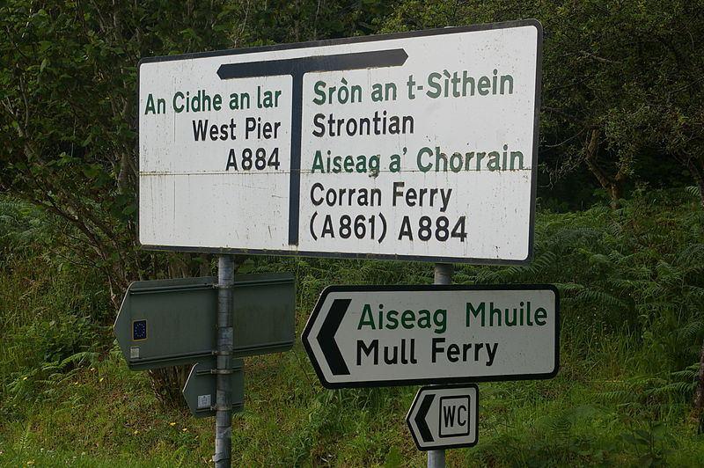
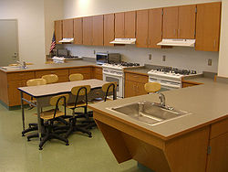
Rhai materion yn fwy lleol
Ieithoedd lleiafrifol
  Gaeleg (Yr Alban), Ffrangeg (Canada)
Prinderau mewn meysydd pwnc penodol (e.e. economeg y cartref yn yr Alban, ac ati)
Some issues are more localised
Minority languages
  Gaelic (Scotland), French (Canada)
Specific subject area shortages (e.g. home economics in Scotland etc.)

Slide 35

Materion sy’n benodol i Gymru
Issues particular to Wales
Angen gradd B mewn TGAU
GCSE B grade requirement
Cystadleuaeth o Loegr
Competition from England
85% o ANG mewn swyddi cyfnod penodol neu gyflenwi
85% of NQTs in fixed-term or supply positions
Materion sy’n destun gweithredu:
  Gwell rhaglenni AGA
  Hyrwyddo gyrfaoedd
Issues being addressed:
Improved ITE programmes
Promotion of careers
Nid yw cadw athrawon yn broblem yng Nghymru, ond nid felly mae hi mewn gwledydd eraill
Retention is not an issue in Wales but is elsewhere

Slide 36
Her fwyfwy amlwg
i bolisi
An increasingly prominent policy challenge
Lloegr – Strategaeth recriwtio a chadw’r Adran Addysg (2019)
England – DFE recruitment and retention strategy (2019)
Yr Alban – nodwyd bod recriwtio athrawon yn ‘Broblem Genedlaethol’
Scotland - teacher recruitment identified as ‘National Issue’
Iwerddon – Cynllun Gweithredu i fynd i’r afael â’u hargyfwng recriwtio athrawon (2018)
Ireland - Action Plan to tackle their teacher recruitment crisis (2018)
Byd eang – amrywiaeth o ymatebion polisi i wella recriwtio a chadw
Globally - range of policy responses to improve recruitment and retention

Slide 37


Beth yw’r prif ymatebion polisi?
Cymhellion
Llwybrau newydd i addysgu
Mynd i’r afael â baich gwaith
Dyfarniadau tâl
Mentrau’n canolbwyntio ar ardaloedd gwledig / difreintiedig
Gwell cymorth i ANG
Gwell llwybrau gyrfaol
Ymgyrchoedd hyrwyddo
Cynyddu amrywiaeth
Mentrau i hybu cadw staff
What are the main policy responses?
Incentives
New routes into teaching
Addressing workload
Pay awards
Initiatives focussed on rural / deprived areas
Better support for NQTs
Improved career pathways
Promotion campaigns
Increasing diversity
Initiatives to boost retention
£££

Slide 38
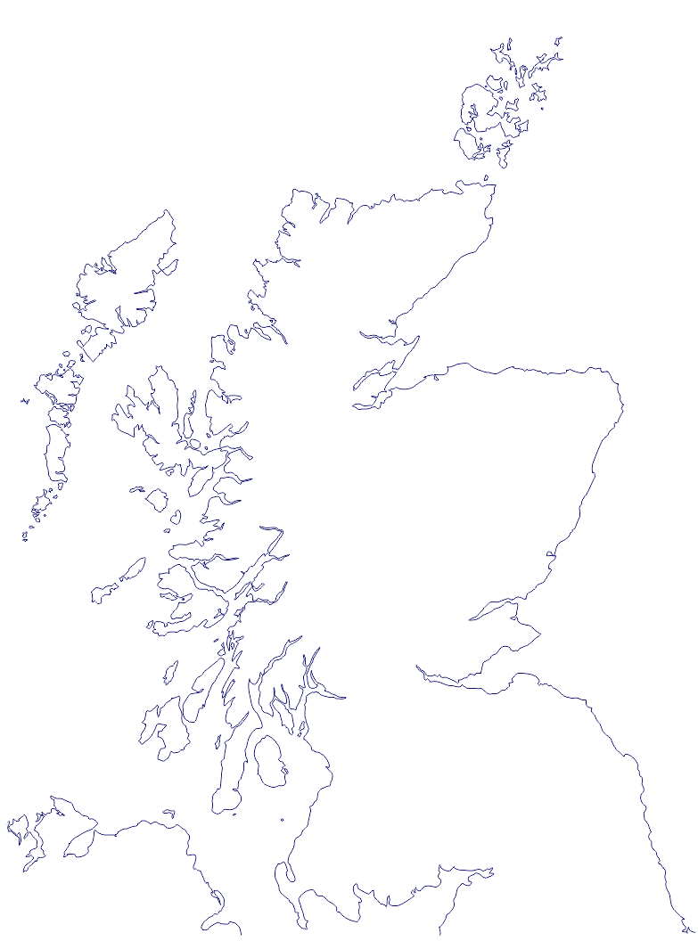
Beth sy’n gweithio?
Mae’r sail dystiolaeth yn gyfyngedig, ond yn yr Alban:
What works?
The evidence base is limited, but in Scotland:
  Mae niferoedd athrawon yn 2018-19 ar eu lefel uchaf er 2010
Teacher numbers at highest level since 2010 in 2018-19
  Bu cynnydd yn y nifer a gwblhaodd AGA mewn pynciau â phrinder athrawon ynddynt
Numbers completing ITE in shortage subjects increased
  Mae heriau’n parhau mewn ardaloedd gwledig
Ongoing challenges in rural areas

Slide 39
marchnata a hyrwyddo o ansawdd uchel
cyflogau deniadol
sicrwydd mewn swydd
cydbwysedd bywyd/gwaith
cymorth â gyrfa cynnar
datblygiad proffesiynol
dilyniant gyrfaol
gweithio hyblyg
high-quality marketing and promotion
attractive salaries
job security
work/life balance
early career support
professional development
career progression
flexible working
Beth am broffesiynau eraill?
Adnoddau a chymhellion a ddefnyddir yn nodweddiadol i ddenu graddedigion
What about other professions?
Tools and incentives typically used to attract graduates

Slide 40



Proffesiynau eraill – enghreifftiau penodol
Other professions – specific examples
Gofal Cymdeithasol
  gwerthoedd ac ymddygiadau
  deall ardaloedd lleol
  strategaethau recriwtio arloesol
  ynghyd â: hyfforddiant, amodau gwaith a thâl cystadleuol
Social Care
  values and behaviours
  understanding local areas Innovative recruitment strategies
  As well as: training, working conditions and competitive pay
Gofal iechyd
  hyfforddiant ac opsiynau gyrfa hyblyg
  cefnogi lles meddygon
  rheoleiddio mewn modd cydgysylltiedig
  adnoddau i gynorthwyo â chadw staff
  recriwtio tramor
Healthcare
  Flexible training and career options
  supporting doctors wellbeing
  joined-up approach to regulation
  resources to support retention
  Overseas recruitment
Y Fyddin
Army

Slide 41

Casgliadau: Beth yw’r gwersi allweddol i Gymru?
Conclusions: What are the key lessons for Wales?
Adolygu baich gwaith
Ehangu llwybrau i addysgu
Rhaglenni mwy hyblyg
Bwrsariaethau
Cymhellion ariannol
Preswyliadau athrawon
Llwybrau dilyniant / arweinyddiaeth
Fframwaith Achredu Cenedlaethol ar gyfer dysgu proffesiynol
Mentora
Review workload
Expand routes into teaching
More flexible programmes
Bursaries
Financial incentives
Teacher residencies
Mentoring
Progression / leadership pathways
National Accreditation Framework for professional learning

Slide 42
cymhwyster gradd Meistr newydd
new Masters qualification
Casgliadau: Beth yw’r gwersi allweddol i Gymru?
Cyfnodau sabothol
sabbaticals
Cyfleoedd dysgu proffesiynol mewn ysgolion eraill
professional learning opportunities in other schools
rhannu swydd / gweithio hyblyg
job-sharing / flexible working
cydnabyddiaeth a gwobrau
Conclusions: What are the key lessons for Wales?
recognition and reward
mwy o amrywiaeth
increased diversity
mesurau beiddgar ar gyfer
  Ardaloedd gwledig
  Pynciau y mae prinder ynddynt
  Cyfrwng Cymraeg
bold measures for
  rural areas
  shortage subjects
  Welsh medium
Mae codi statws y proffesiwn yn allweddol
Elevating the status of the profession is key

Slide 43
Developments in ITE in Wales
Datblygiadau yn AGA yng Nghymru
Dr. Hazel Hagger
Cadeirydd, Bwrdd Achredu Addysg Gychwynnol Athrawon CGA
Chair, EWC Initial Teacher Education Accreditation Board

Slide 44

Diwygio cwricwlwm yr ysgol/ School curriculum reform
Diwygio AGA/ ITE Reform
Cydweithredu/ Collaboration
Integreiddio/ Integration
Cydlynu/ Coherence
Athrawon dan hyfforddiant/ student teachers
athrawon ar ddechrau eu gyrfa/ early career teachers
athrawon sefydledig
/ established teachers

Slide 45

Prifysgolion/ Universities
Ysgolion/ Schools
Dysgwyr a dysgu/ Learners and learning
Athrawon dan hyfforddiant/ Student teachers
Myfyrwyr ysgol/ School students

Slide 46

Addysgu: proffesiwn gwerthfawr, sy’n ddewis cyntaf
Teaching: a first choice, valued profession
Prifysgolion ac ysgolion yn cydweithio i ddatblygu athrawon sy’n ymarferwyr beirniadol, annibynnol eu meddwl, sy’n ymroddedig i ddysgu, ac yn gallu parhau i ddysgu
Diwylliant dysgu mewn ysgolion sy’n cymryd dysgu’r bobl ifanc a’r oedolion ynddynt o ddifrif
Dysgwyr uchelgeisiol, athrawon uchelgeisiol
Universities and schools working together to develop teachers who are independent-minded, critical practitioners committed to and able to carry on learning
A learning culture in schools that takes very seriously the learning of both the young people and the adults within them
Ambitious learners, ambitious teachers

Slide 47







Partneriaethau AGA yng Nghymru
ITE Partnerships in Wales
7 Partneriaeth AGA yn cynnig 15 rhaglen achrededig ledled Cymru, o Fedi 2020 ymlaen:
  O 2019/20 - 4 partneriaeth, 11 rhaglen
  O 2020/21 - 3 partneriaeth ychwanegol, gan gynnwys llwybrau rhan-amser a chyflogedig
Rhaglenni BA israddedig a TAR ôl-raddedig ar gael, yn cwmpasu addysg gynradd ac uwchradd
Cynigir mwyafrif y rhaglenni trwy gyfrwng y Gymraeg
7 ITE Partnerships offering 15 accredited programmes across Wales, from September 2020:
  From 2019/20 - 4 partnerships, 11 programmes
  From 2020/21 - 3 additional partnerships, including part-time and salaried routes
BA undergraduate, and PGCE postgraduate programmes are available, and span both primary and secondary education
The majority of programmes are offered through the medium of Welsh

Slide 48

“Byddwn yn datblygu athrawon ac arweinwyr myfyriol a hynod effeithiol sydd ag ymrwymiad i’w twf proffesiynol eu hunain ac i dwf proffesiynol eu cydweithwyr.”
Kirsty Williams, 2017
“We will develop reflective and highly effective teachers and leaders who have a commitment to their own professional growth and that of their colleagues.”
Kirsty Williams, 2017
“...dysgu sy’n ymarferol drylwyr ac yn ddeallusol heriol ar yr un pryd.”
John Furlong, 2017
“...learning that is both rigorously practical and intellectually challenging at the same time.”
John Furlong, 2017
“Mae angen i ysgolion greu ffordd gyffredin o fyw sy’n cynnig cyfrwng i dyfu athrawon, oherwydd yn y pen draw, ni fydd twf myfyrwyr yn mynd dim pellach na thwf y rhai sy’n eu haddysgu.”
Elliot Eisner, 2002
“Schools need to create a shared way of life that provides a medium for growing teachers, for ultimately the growth of students will go no further than the growth of those who teach them.”
Elliot Eisner, 2002

Slide 49
Hyrwyddo Gyrfaoedd yn y proffesiynau cofrestredig
Promotion of Careers in the registered professions
Jerena Davies-Kumar
Rheolwr Hyrwyddo Gyrfaoedd, CGA
Promotion of Careers Manager, EWC

Slide 50
Promotion of Careers in the registered professions
Hyrwyddo Gyrfaoedd yn y proffesiynau cofrestredig
Cefndir
Gofynnodd Llywodraeth Cymru i CGA gymryd cyfrifoldeb am ymgyrch ‘Darganfod Addysgu’ ym mis Hydref 2018.
Comisiynodd CGA adroddiad ymchwil: ‘Ymchwil i ymagwedd strategol at recriwtio, cadw a hyrwyddo gyrfaoedd yn y sector addysg yng Nghymru.’
Amlygodd canfyddiadau allweddol ac argymhellion yr adroddiad angen am:
Frand newydd
Platfform digidol, dwyieithog newydd, ar sail gwasanaeth
Gwasanaeth recriwtio, eiriolaeth a chymorth
Background
Welsh Government requested that the EWC assume responsibility of the ‘Discover Teaching’ campaign in October 2018.
EWC commissioned a research report: ‘Research into a strategic approach to recruitment, retention and the promotion of careers in the education sector in Wales.’
Key findings and recommendations from the report highlighted a need for:
A new brand
A new bilingual service driven digital platform
A recruitment, advocacy and support service
.

Slide 51

Brand newydd
New brand

Slide 52
Gwasanaeth recriwtio, eiriolaeth a chymorth
A recruitment, advocacy and support service
Nod y gwasanaeth newydd yw darparu cymorth i ysgolion, gwaith ieuenctid, addysg bellach a dysgu seiliedig ar waith.
Mae’r tîm Hyrwyddo Gyrfaoedd wedi bod yn gweithio gyda’r sector i hyrwyddo gyrfaoedd yn y proffesiynau addysg. Mae gwaith wedi cynnwys:
Datblygu a chyflwyno digwyddiadau hyrwyddo a recriwtio ar gampysau
Datblygu adnoddau digidol a chyflwyno digwyddiadau ar-lein yn sgil COVID-19
Datblygu ymgyrchoedd recriwtio targedig ar gyfer recriwtio pobl BAME ac ym meysydd STEM a’r Gymraeg
Sefydlu grŵp llywio cenedlaethol – Fforwm Recriwtio Addysg
Gweithio gyda phartneriaid i gynllunio digwyddiadau a gweithgareddau ar gyfer tymor y gwanwyn
The new service aims to provide support for schools, youth work, further education and work-based learning.
The Promotion of Careers team have been working with the sector to promote careers in the education professions. Work has included:
Developing and delivering on campus promotional and recruitment events
Developing digital resources and delivering online events in light of COVID-19
Developing targeted recruitment campaigns for BAME, STEM and Welsh language recruitment
Establishing a national steering group – Education Recruitment Forum
Working with partners to plan events and activity for the spring term
Addysgwyr Cymru | Educators Wales

Slide 53

A bilingual service driven digital platform
Platfform digidol, dwyieithog, ar sail gwasanaeth
Platfform digidol i Addysgwyr, Darparwyr a Chyflogwyr
Argymhellwyd bod y platfform digidol newydd, ar sail gwasanaeth, yn ateb tri phrif ddiben:
Porth gyrfaoedd – darparu gwybodaeth am yrfaoedd mewn addysg
Porth swyddi – i ddefnyddwyr chwilio am waith ac i gyflogwyr hysbysebu’u swyddi gwag
Porth hyfforddiant – i ddefnyddwyr chwilio am hyforddiant i ymuno â’r proffesiwn, ynghyd â dysgu proffesiynol
Mae’r tîm wrthi’n profi’r platfform digidol newydd yn derfynol a byddant yn dechrau profi allanol ym mis Hydref 2020.
Bydd y brand a’r platfform digidol newydd yn lansio ym mis Chwefror 2021.
A digital platform for Educators, Providers and Employers
It was recommended that the new service driven digital platform serve three main purposes:
A Careers portal – providing information on careers in education
A jobs portal – for users to search for employment and for employers to advertise their vacancies
A training portal – for users to search for training to enter the profession as well as professional learning
The team are currently finalising internal testing of the new platform and will begin external testing in October 2020.
The new brand and digital platform will launch in February 2021.
Addysgwyr Cymru | Educators Wales

Slide 54

I gael rhagor o wybodaeth am y brand, y gwasanaeth eiriolaeth neu’r platfform digidol newydd, cysylltwch â’r Tîm Hyrwyddo Gyrfaoedd. Hefyd, caiff cyflogwyr a darparwyr hyfforddiant eu hannog i drefnu bod y platfform digidol newydd yn cael ei arddangos iddynt.
For further information on the new brand, advocacy service or digital platform please contact the Promotion of Careers team. Employers and training providers are also encouraged to book a demonstration of the new digital platform.
Manylion cyswllt
Contact information
gwybodaeth@addysgwyr.cymru
information@educators.wales

