Slide 1
Education Workforce Statistics
Stakeholder briefing
Lisa Winstone – Interim Chief Executive
David Browne – Director of Regulation
Nia Griffith – Data Manager

Slide 2
Introduction
The Register of Education Practitioners
The 2025 Annual Education Workforce Statistics Report
Further insights
Initial Teacher Education
Newly qualified school teachers
Supply school teachers and school learning support workers
School teachers and leaders
Data cleaning

Slide 3
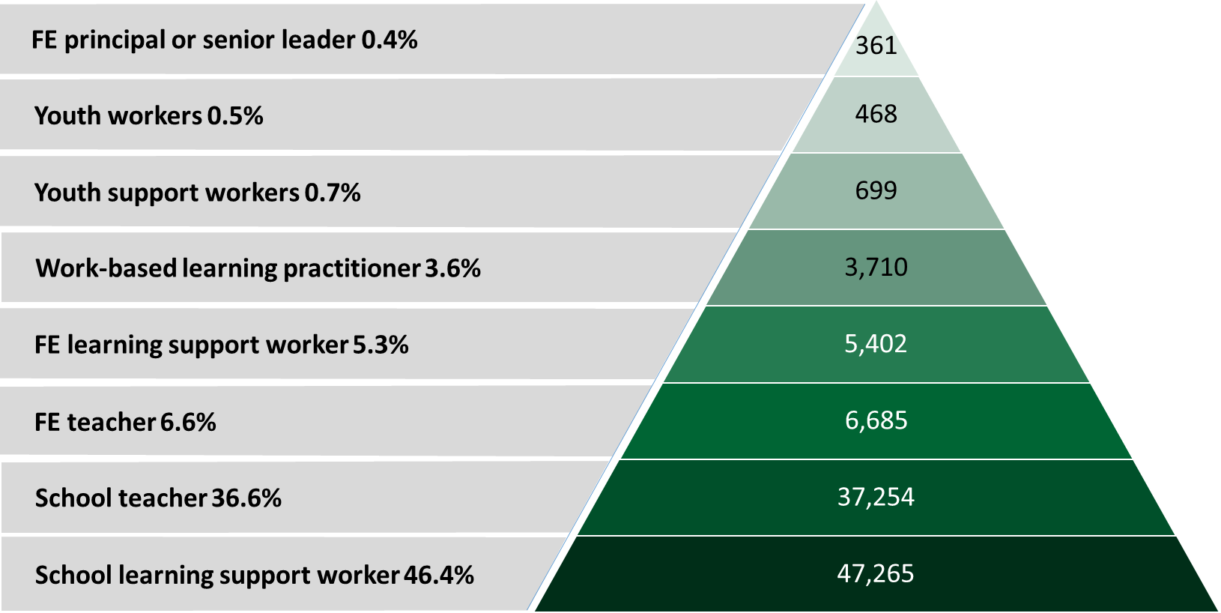
Registrants – March 2025
Notes:
¹School learning support workers figure also includes independent school learning support worker.
²School teachers figure also includes independent school teachers.
³Further education teachers figure also includes independent special post-16 institution teachers.
⁴Further education learning support workers figure also includes independent special post-16 institution learning support workers.
⁵Work-based learning practitioner figure also includes adult learning practitioners.

Slide 4
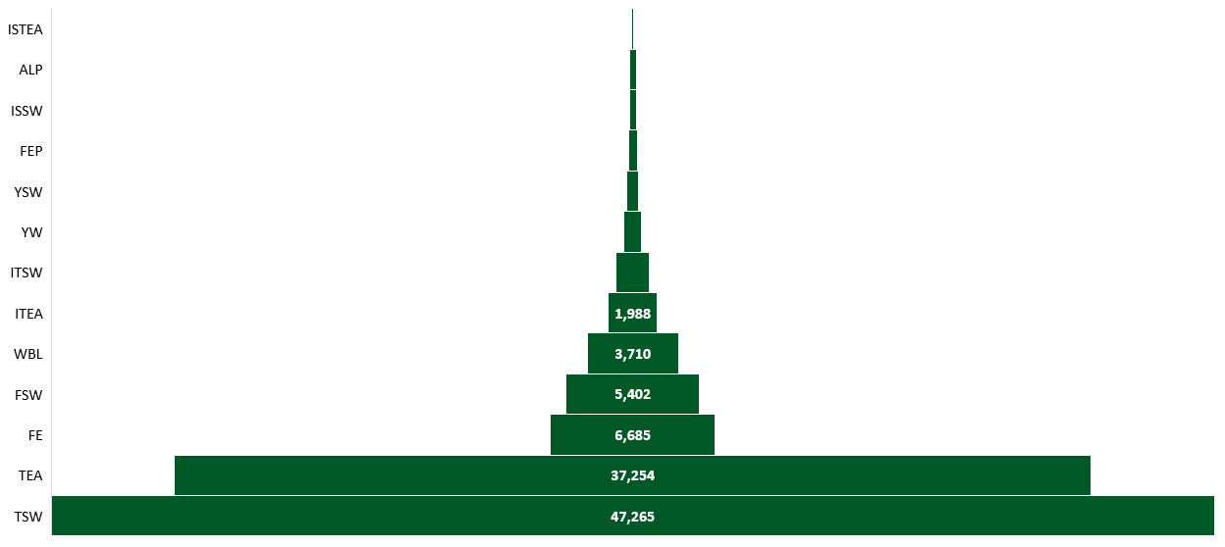
Registrants – March 2025
97
284
285
361
468
699
1,378

Slide 5
Single and multiple registrations two-way matrix
Registrant categories | Code | TEA | SLSW | FE | FELSW | FEL | ALP | WBL | YW | YSW | ITEA | ITSW | ISTEA | ISSW
School teachers | TEA | 30,401 | 3,697 | 1,164 | 329 | 26 | 13 | 195 | 8 | 12 | 261 | 28 | 8 | 3
School learning support workers | SLSW | 3,697 | 40,161 | 935 | 1,580 | 6 | 15 | 294 | 24 | 85 | 97 | 277 | 15 | 39
Further education teachers | FE | 1,164 | 935 | 3,274 | 1,484 | 210 | 16 | 830 | 41 | 17 | 80 | 19 | 26 | 12
Further education learning support workers | FELSW | 329 | 1,580 | 1,484 | 2,273 | 61 | 8 | 583 | 12 | 17 | 24 | 59 | 12 | 39
Further education principals and senior leaders | FEL | 26 | 6 | 210 | 61 | 120 | 0 | 48 | 1 | 1 | 0 | 0 | 0 | 0
Adult learning practitioners | ALP | 13 | 15 | 16 | 8 | 0 | 237 | 11 | 0 | 1 | 0 | 0 | 1 | 0
Work-based learning support workers | WBL | 195 | 294 | 830 | 583 | 48 | 11 | 2,150 | 11 | 14 | 16 | 15 | 9 | 9
Qualified youth workers | YW | 8 | 24 | 41 | 12 | 1 | 0 | 11 | 367 | 43 | 0 | 0 | 0 | 0
Qualified youth support workers | YSW | 12 | 85 | 17 | 17 | 1 | 1 | 14 | 43 | 555 | 1 | 1 | 0 | 0
Independent school teachers | ITEA | 261 | 97 | 80 | 24 | 0 | 0 | 16 | 0 | 1 | 1,627 | 62 | 9 | 6
Independent school learning support workers | ITSW | 28 | 277 | 19 | 59 | 0 | 0 | 15 | 0 | 1 | 62 | 1,052 | 8 | 24
Independent special post-16 institution teachers | ISTEA | 8 | 15 | 26 | 12 | 0 | 1 | 9 | 0 | 0 | 9 | 8 | 56 | 17
Independent special post-16 institution learning support workers | ISSW | 3 | 39 | 12 | 39 | 0 | 0 | 9 | 0 | 0 | 6 | 24 | 17 | 220

Slide 6
Total registered - trend data

Slide 7
Gender
Categories | Female | Male | Not specified
School teachers (TEA) | 26,735 | 8,518 | 13
School learning support workers (SLSW) | 39,196 | 6,641 | 50
Principals and senior leaders (FEL) | 198 | 125 | 38
Further education teachers (FE) | 3,910 | 2,673 | 5
Further education learning support workers (FELSW) | 3,385 | 1,720 | 12
Adult learning practitioners (ALP) | 225 | 52 | 7
Work-based learning practitioners (WBL) | 2,135 | 1,290 | 1
Qualified youth workers (YW) | 331 | 136 | 1
Qualified youth support workers (YSW) | 490 | 208 | 1
Independent school teachers (ITEA) | 1,286 | 702 | 0
Independent school learning support workers (ITSW) | 979 | 396 | 3
Independent special post-16 institution teacher (ISTEA) | 73 | 23 | 1
Independent special post-16 institution learning support worker (ISSW) | 214 | 69 | 2
Total | 79,157 | 22,553 | 134
All registrants by gender in 2025
All categories by gender in 2025

Slide 8
Age
Categories | Under 30 | 30 to 39 | 40 to 49 | 50 to 59 | 60+
School teachers (TEA) | 5,308 | 9,949 | 10,216 | 7,898 | 1,895
School learning support workers (SLSW) | 14,607 | 10,118 | 9,122 | 8,396 | 3,644
Principals and senior leaders (FEL) | 1 | 39 | 138 | 136 | 47
Further education teachers (FE) | 380 | 1,328 | 1,809 | 1,964 | 1,107
Further education learning support workers (FELSW) | 856 | 1,127 | 1,166 | 1,161 | 807
Adult learning practitioners (ALP) | 12 | 40 | 62 | 94 | 76
Work-based learning practitioners (WBL) | 286 | 811 | 968 | 856 | 505
Qualified youth workers (YW) | 63 | 133 | 136 | 103 | 33
Qualified youth support workers (YSW) | 166 | 206 | 174 | 108 | 45
Independent school teachers (ITEA) | 153 | 486 | 610 | 543 | 196
Independent school learning support workers (ITSW) | 395 | 335 | 280 | 222 | 146
Independent special post-16 institution teacher (ISTEA) | 7 | 30 | 30 | 19 | 11
Independent special post-16 institution learning support worker (ISSW) | 61 | 90 | 63 | 48 | 23
Total | 22,295 | 24,692 | 24,774 | 21,548 | 8,535
All registrants by age in 2025
All categories by age in 2025

Slide 9
Ethnic Group
Categories | White | Mixed / multiple | Asian / Asian British | Black/African/ Caribbean/ Black British | Other | Does not wish to record | Unknown
School teachers (TEA) | 32,699 | 250 | 302 | 109 | 74 | 426 | 1,406
School learning support workers (SLSW) | 36,226 | 595 | 1,785 | 859 | 440 | 564 | 5,418
Principals and senior leaders (FEL) | 262 | 3 | 2 | 0 | 2 | 5 | 87
Further education teachers (FE) | 5,318 | 58 | 111 | 61 | 42 | 183 | 815
Further education learning support workers (FELSW) | 4,257 | 70 | 164 | 87 | 43 | 139 | 357
Adult learning practitioners (ALP) | 166 | 1 | 0 | 0 | 2 | 5 | 110
Work-based learning practitioners (WBL) | 2,989 | 22 | 32 | 20 | 12 | 75 | 276
Qualified youth workers (YW) | 375 | 6 | 5 | 6 | 1 | 13 | 62
Qualified youth support workers (YSW) | 564 | 8 | 6 | 4 | 2 | 16 | 99
Independent school teachers (ITEA) | 1,704 | 26 | 35 | 15 | 15 | 65 | 128
Independent school learning support workers (ITSW) | 1,145 | 20 | 43 | 40 | 9 | 22 | 99
Independent special post-16 institution teacher (ISTEA) | 80 | 1 | 4 | 1 | 1 | 1 | 9
Independent special post-16 institution learning support worker (ISSW) | 202 | 3 | 12 | 20 | 1 | 1 | 46
Total | 85,987 | 1,063 | 2,501 | 1,222 | 644 | 1,515 | 8,912
All categories by ethnicity in 2025

Slide 10
National Identity
Categories | Welsh | British | English | Scottish, Irish and Northern Irish | Other | Does not wish to record | Unknown
School teachers (TEA) | 22,683 | 8,353 | 1,845 | 261 | 527 | 264 | 1,333
School learning support workers (SLSW) | 21,377 | 13,336 | 2,661 | 203 | 2,586 | 337 | 5,387
Principals and senior leaders (FEL) | 154 | 86 | 24 | 4 | 3 | 3 | 87
Further education teachers (FE) | 3,198 | 1,807 | 382 | 49 | 222 | 112 | 818
Further education learning support workers (FELSW) | 2,360 | 1,665 | 323 | 40 | 277 | 91 | 361
Adult learning practitioners (ALP) | 106 | 56 | 7 | 1 | 5 | 0 | 109
Work-based learning practitioners (WBL) | 1,757 | 1,017 | 241 | 30 | 48 | 54 | 279
Qualified youth workers (YW) | 252 | 105 | 22 | 8 | 2 | 16 | 63
Qualified youth support workers (YSW) | 402 | 148 | 22 | 7 | 9 | 12 | 99
Independent school teachers (ITEA) | 742 | 718 | 248 | 34 | 92 | 28 | 126
Independent school learning support workers (ITSW) | 537 | 425 | 181 | 16 | 106 | 14 | 99
Independent special post-16 institution teacher (ISTEA) | 43 | 28 | 9 | 2 | 6 | 0 | 9
Indpendent special post-16 institution learning support worker (ISSW) | 100 | 75 | 26 | 3 | 35 | 0 | 46
Total | 53,711 | 27,819 | 5,991 | 658 | 3,918 | 931 | 8,816
All categories by national identity in 2025

Slide 11
Disability
Categories | Yes | No
School teachers (TEA) | 431 | 34,835
School learning support workers (SLSW) | 1,440 | 44,447
Principals and senior leaders (FEL) | 8 | 353
Further education teachers (FE) | 271 | 6,317
Further education learning support workers (FELSW) | 286 | 4,831
Adult learning practitioners (ALP) | 18 | 266
Work-based learning practitioners (WBL) | 125 | 3,301
Qualified youth workers (YW) | 38 | 430
Qualified youth support workers (YSW) | 54 | 645
Independent school teachers (ITEA) | 63 | 1,925
Independent school learning support workers (ITSW) | 77 | 1,301
Independent special post-16 institution teacher (ISTEA) | 9 | 88
Independent special post-16 institution learning support worker (ISSW) | 22 | 263
Total | 2,842 | 99,002
All registrants by disability in 2025
All categories by disability in 2025

Slide 12
Welsh language
 | Ability to speak Welsh |  |  | Ability to work in Welsh
Categories | Yes | No | Unknown | Yes | No | Unknown
School teachers (TEA) | 11,786 | 22,687 | 793 | 9,479 | 24,977 | 810
School learning support workers (SLSW) | 9,623 | 32,331 | 3,933 | 8,218 | 33,693 | 3,976
Principals and senior leaders (FEL) | 78 | 206 | 77 | 59 | 225 | 77
Further education teachers (FE) | 1,241 | 4,663 | 684 | 902 | 4,998 | 688
Further education learning support workers (FELSW) | 863 | 3,936 | 318 | 583 | 4,217 | 317
Adult learning practitioners (ALP) | 26 | 152 | 106 | 11 | 165 | 108
Work-based learning practitioners (WBL) | 550 | 2,687 | 189 | 417 | 2,819 | 190
Qualified youth workers (YW) | 73 | 352 | 43 | 49 | 375 | 44
Qualified youth support workers (YSW) | 132 | 499 | 68 | 105 | 526 | 68
Independent school teachers (ITEA) | 195 | 1,725 | 68 | 68 | 1,851 | 69
Independent school learning support workers (ITSW) | 131 | 1,199 | 48 | 50 | 1,279 | 49
Independent special post-16 institution teacher (ISTEA) | 17 | 76 | 4 | 10 | 83 | 4
Independent special post-16 institution learning support worker (ISSW) | 22 | 250 | 13 | 7 | 264 | 14
Total | 24,737 | 70,763 | 6,344 | 19,958 | 75,472 | 6,414
All registrants by Welsh language ability in 2025
All Welsh speakers and those able to work in Welsh for all categories in 2025
Notes:
Points of interest:
Welsh speaking vs working in Welsh = SLSW has the smallest difference between Welsh speaking and Welsh working with 3.1% of Welsh speaking registrants stating not able or confident to work in Welsh. On the other hand, ISTEA has the highest difference with 7.2% of Welsh speaking registrants declaring not able to work in Welsh.

Slide 13
Qualifications
Categories | Level 1 | Level 2 | Level 3 | Level 4 | Level 5 | Level 6 | Level 7 | Level 8 | Unknown
School learning support workers (SLSW) | 185 | 4,124 | 4,460 | 1,891 | 953 | 6,987 | 5,616 | 84 | 21,587
Principals and senior leaders (FEL) | 0 | 0 | 8 | 15 | 15 | 63 | 161 | 4 | 95
Further education teachers (FE) | 2 | 57 | 130 | 65 | 356 | 1,253 | 4,058 | 122 | 545
Adult learning practitioners (ALP) | 0 | 1 | 22 | 1 | 9 | 45 | 92 | 2 | 112
Work-based learning practitioners (WBL) | 2 | 191 | 491 | 316 | 239 | 634 | 921 | 13 | 619
Qualified youth workers (YW) |  |  |  |  | 87 | 299 | 82 | 0 | 0
Qualified youth support workers (YSW) |  | 173 | 330 | 43 | 13 | 97 | 43 | 0 | 0
Independent school teachers (ITEA) | 0 | 0 | 0 | 0 | 10 | 218 | 1,003 | 0 | 757
Independent school learning support workers (ITSW) | 7 | 111 | 151 | 25 | 36 | 186 | 135 | 3 | 724
Independent special post-16 institution teacher (ISTEA) | 0 | 0 | 4 | 2 | 3 | 9 | 40 | 0 | 39
Independent special post-16 institution learning support worker (ISSW) | 0 | 23 | 17 | 3 | 7 | 30 | 21 | 0 | 184
Categories by highest qualification level 5+ in 2025

Slide 14
Retention – 5 Year Trend
 | 2021 |  | 2022 |  | 2023 |  | 2024 |  | 2025
Categories | Number | % | Number | % | Number | % | Number | % | Number | %
School teachers (TEA) | -405 | -1.2% | 490 | 1.4% | 581 | 1.6% | 28 | 0.1% | -599 | -1.7%
School learning support workers (SLSW) | 74 | 0.2% | 3,917 | 10.1% | 6,795 | 16.0% | -2,418 | -4.9% | -1,075 | -2.3%
Further education teachers (FE) | -151 | -2.2% | 97 | 1.5% | 83 | 1.2% | -83 | -1.2% | -114 | -1.7%
Further education learning support workers (FELSW) | -164 | -3.0% | 313 | 6.0% | 626 | 11.3% | 30 | 0.4% | -1,095 | -17.6%
Work-based learning practitioners (WBL) | -219 | -6.2% | -2 | -0.1% | 8 | 0.2% | 206 | 5.8% | -107 | -3.0%
Qualified youth workers (YW) | 4 | 0.9% | -8 | -1.8% | 22 | 5.2% | -6 | -1.4% | 45 | 10.6%
Qualified youth support workers (YSW) | 15 | 2.2% | -28 | -4.0% | 11 | 1.6% | 12 | 1.7% | 0 | 0.0%
School sector
Further education sector
Qualified youth sector

Slide 15
Retention – 2020 Cohort in 2025
Categories | Still registered | Not registered | Registered in another category | Total
School teachers (TEA) | 26,700 | 7,738 | 733 | 35,171
School learning support workers (SLSW) | 19,356 | 15,331 | 3,907 | 38,594
Further education teachers (FE) | 4,105 | 2,290 | 361 | 6,756
Further education learning support workers (FELSW) | 2,399 | 2,260 | 748 | 5,407
Work-based learning practitioners (WBL) | 1,648 | 1,672 | 220 | 3,540
Qualified youth workers (YW) | 264 | 139 | 26 | 429
Qualified youth support workers (YSW) | 333 | 263 | 93 | 689

Slide 16
Initial Teacher Education - passes
Secondary subject trained | Passed in Welsh | Passed in English
Art | 2 | 7
Art and design | 2 | 12
Biology | 1 | 16
Business studies | 0 | 0
Chemistry | 0 | 0
Combined/general science | 5 | 13
Computer science | 0 | 1
Design and technology | 1 | 23
Drama | 1 | 16
English | 2 | 36
French | 1 | 2
Geography | 3 | 5
History | 4 | 32
Information technology | 0 | 4
Mathematics | 2 | 17
Modern foreign languages | 3 | 6
Modern languages | 0 | 1
Music | 0 | 11
Outdoor activities | 0 | 6
Physical education | 5 | 49
Physics | 2 | 7
Religious education | 9 | 11
Spanish | 0 | 1
Welsh | 10 | 6
Total | 53 | 282
Female ITE passes in 2024/2025
Male ITE passes in 2024/2025
ITE passes by age in 2024/2025
ITE passes trend by primary and secondary trained

Slide 17
Open University - passes
OU passes by age in 2024/2025
Female OU passes in 2024/2025
Male OU passes in 2024/2025
OU passes trend by primary and secondary trained
Secondary subject trained | Passed in Welsh | Passed in English
Mathematics | 2 | 3
Science | 3 | 9
Welsh | 5 | 1
English | 2 | 11
Computing | 1 | 2
Design and technology | 4 | 0
Total | 17 | 26

Slide 18
Newly qualified school teachers
10 year trend of registered NQTs
Country trained | Ability to speak Welsh |  |  | Ability to work through the medium of Welsh
 | Yes | No | Total | Yes | No | Total
Trained in Wales | 327 | 657 | 984 | 261 | 723 | 984
Trained in England | 28 | 143 | 171 | 17 | 154 | 171
Total | 355 | 800 | 1,155 | 278 | 877 | 1,155
NQTs trained in Wales by Welsh language ability in 2025
NQTs trained in England by Welsh language ability in 2025
Notes:
Points of interest:
Number registered = Despite a peak during the pandemic, registered NQT numbers have lowered back to similar numbers seen pre-pandemic.
Welsh speaking vs working in Welsh = The difference between registered Welsh speakers and working in Welsh is similar to all school teachers. There is an average of a 6.6% difference between Welsh speaking and working in Welsh, where all school teachers have a difference of 6.5%. Coincidentally, all school teachers have the second highest difference between Welsh speakers and working in Welsh.

Slide 19
Newly qualified school teachers (continued)
NQTs and teachers employment in 2025
 | 2021 | 2022 | 2023 | 2024 | 2025
Supply NQTs | 392 | 315 | 385 | 456 | 409
NQTs employed full time* | 609 | 933 | 742 | 634 | 555
All supply school teachers | 4,222 | 4,058 | 3,867 | 4,051 | 4,021
All school teachers employed full time* | 26,739 | 27,033 | 27,588 | 27,233 | 26,341
* Full time NQTs and teachers refers to those employed in primary, middle, secondary, pupil referral unit and special phases.

Slide 20
Supply: school teachers
10 year trend of the percentage of registered supply school teachers against all school teachers
Supply school teachers and all school teachers by gender in 2025
Supply school teachers by age
Notes:
Points of interest:
Number registered = Over the last ten years there has been an overall small decline in the percentage of supply teachers registered. Having decreased by 1.5% since 2016.
Gender = Although gender percentages between supply teachers and all school teachers are very similar, there is a slight increase of 2.9% in females employed on supply basis in 2025.
Age = Over the last 5 years there has been an increase in the proportion of under 30 year olds employed as supply. Having increased by 4.7% since 2021. The proportion of 30 to 39 year olds employed as supply has also increased though not as significantly by 0.7%. The proportion of 40 to 60+ age groups has decreased since 2021, with 40 to 49 year olds having the largest decrease in this time frame of 2.3%.
Ethnic group = Although ethnic minorities make up a small percentage of the total supply figure, (i.e Mixed 1.3%, Asian 2.6%, Black 1.0% and Other 0.6%) similar percentages that are seen of ethnic minorities in relation to all school teachers. What is perhaps also insightful is the proportion of ethnic minorities working as supply. For example, of the 735 registrants making up all ethnic minority groups, 223 of these work in supply, which is 30.3%. Whereas registrants declared as White make up 11.3%.
Ability to speak Welsh = Despite the proportion of school teachers being able to speak Welsh staying roughly the same between 2021 and 2025, the proportion of Welsh speakers in supply have decreased by 2% in the same timeframe.
Ability to work in Welsh = Largely the same has happened for the proportion of Welsh working registrants. All school teachers have largely maintained the same proportion of registrants being able to work in Welsh, whereas the proportion of supply teachers has decreased by 2.1% in the last 5 years.
Welsh speaking vs Welsh working = Conversely, the difference between Welsh speaking and Welsh working between all school teachers and supply teachers is roughly the same. Supply teachers have on average a 6.1% decrease in the proportion of registrants able to work in Welsh compared to Welsh speakers between 2021 and 2025, whereas all school teachers has an average of 6.5% difference.

Slide 21
Supply: school teachers (continued)
Supply school teachers by Welsh language ability
All school teachers by Welsh language ability
 | Supply school teachers |  | All school teachers
 | Number | % | Number | %
White | 3,690 | 11.3 | 32,703 | 100
Mixed or multiple ethnic groups | 51 | 20.4 | 250 | 100
Asian or Asian British | 106 | 35.1 | 302 | 100
Black, African, Caribbean or Black British | 42 | 38.5 | 109 | 100
Other ethnic group | 24 | 32.4 | 74 | 100
Does not wish to record ethnic group | 63 | 14.8 | 425 | 100
Unknown | 45 | 3.2 | 1,403 | 100
Total | 4,021 | 11.4 | 35,266 | 100
Percentage of ethnic groups working as supply school teachers in 2025

Slide 22
Supply: school learning support workers
10 year trend of the percentage of registered supply school learning support workers against all school learning support workers
Supply school learning support workers and all school learning support workers by gender in 2025
Supply school learning support workers by age

Slide 23
Supply: school learning support workers (continued)
Supply school learning support workers by Welsh language ability
All school learning support workers by Welsh language ability
 | Supply school learning support workers |  | All school learning support workers
 | Number | % | Number | %
White | 9,986 | 27.5 | 36,248 | 100
Mixed or multiple ethnic groups | 228 | 38.3 | 595 | 100
Asian or Asian British | 794 | 44.5 | 1,786 | 100
Black, African, Caribbean or Black British | 504 | 58.7 | 859 | 100
Other ethnic group | 193 | 43.9 | 440 | 100
Does not wish to record ethnic group | 162 | 28.6 | 566 | 100
Unknown | 63 | 1.2 | 5,393 | 100
Total | 11,930 | 26.0 | 45,887 | 100
Percentage of ethnic groups working as supply school learning support workers in 2025

Slide 24
School teachers
Phase | Female | Male | Not specified | Total
Nursery | 26 | 3 | 0 | 29
Primary | 10,589 | 2,064 | 1 | 12,654
Middle | 1,212 | 488 | 1 | 1,701
Secondary | 7,202 | 3,555 | 2 | 10,759
Special | 741 | 232 | 0 | 973
Pupil referral unit | 152 | 73 | 0 | 225
Supply | 3,166 | 854 | 1 | 4,021
Others in service | 557 | 129 | 0 | 686
Others out of service | 3,090 | 1,120 | 8 | 4,218
Total | 26,735 | 8,518 | 13 | 35,266
School teachers by gender in 2025
School teacher by phase and gender in 2025
Notes:
Points of interest:
Phase by gender = Keeping in mind the gender split of 75.8% female and 24.2% male for all school teachers, it’s interesting to look into phase by gender. Nursery, Primary and Supply all have more females than the 75.8% across all teachers. Nursery has the highest amount of female teachers with 89.7%. Male teachers are consistently lower than 50% in all phases however, we do see more than the 24.2% average male teachers in Middle, Secondary, Special and PRU sectors. The highest proportion of male teachers is in the Secondary sector with 33.0%.
Ability to speak Welsh = The highest proportion of Welsh speakers are in the Middle sector with 51.3% of all registrants employed in this sector with an ability to speak Welsh. Alternatively the lowest proportion of Welsh speakers is in the Special sector with 19.7%.
Welsh speaking vs Welsh working = The Middle sector also has the lowest difference between Welsh speakers and registrants able to work in Welsh with 4.5% less registrants able to work in Welsh compared to speaking Welsh. The largest difference is in the Nursery sector which has a 17.2% lower proportion of registrants able to work in Welsh (24.1%) compared to registrants able to speak Welsh (41.4%).

Slide 25
School teachers (continued)
School teachers by Welsh language ability in 2025
School teachers by phase and Welsh language ability in 2025
 | Ability to speak Welsh |  |  | Ability to work in Welsh
Phase | Yes | No | Unknown | Yes | No | Unknown
Nursery | 12 | 17 | 0 | 7 | 22 | 0
Primary | 4,704 | 7,631 | 319 | 3,752 | 8,573 | 329
Middle | 872 | 788 | 41 | 796 | 864 | 41
Secondary | 3,371 | 7,110 | 278 | 2,751 | 7,728 | 280
Special | 192 | 757 | 24 | 129 | 819 | 25
Pupil referral unit | 58 | 165 | 2 | 37 | 185 | 3
Supply | 994 | 2,988 | 39 | 742 | 3,240 | 39
Others in service | 266 | 405 | 15 | 200 | 469 | 17
Others out of service | 1,317 | 2,827 | 74 | 1064 | 3,079 | 75
Total | 11,786 | 22,688 | 792 | 9,478 | 24,979 | 809

Slide 26
Leadership
Leadership and all school teachers by gender in 2025
Leadership and all school teachers by Welsh language ability in 2025
 | Ability to speak Welsh |  |  | Ability to work in Welsh
 | Yes | No | Unknown | Yes | No | Unknown
Headteachers | 547 | 725 | 71 | 461 | 810 | 72
Deputy headteachers | 341 | 639 | 49 | 262 | 717 | 50
Assistant headteachers | 329 | 546 | 42 | 269 | 606 | 42
All school teachers | 11,786 | 22,688 | 792 | 9,478 | 24,979 | 809
Notes:
Points of interest:
Gender = Despite the proportion of all female school teachers being 75.8% in 2025, female headteachers make up 61.7%. That’s a 14.1% difference between female school teachers and female headteachers.
Welsh language ability = The proportion of headteachers that have an ability to speak Welsh is roughly 7% higher than that of all school teachers. Similarly, the proportion of headteachers that have an ability to work in Welsh is also approximately 7% higher than all school teachers.
NPQH = Of the 11.6% (156) of headteachers with no NPQH held, Powys has the highest percentage of headteachers with 22.9%.

Slide 27
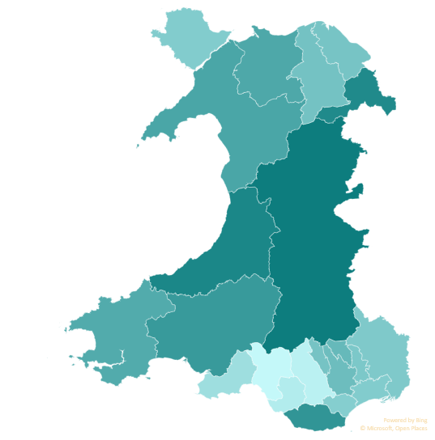
Leadership (NPQH)
NPQH | Headteacher | Deputy headteacher | Assistant headteacher
Held | 1,187 | 385 | 132
Not held | 156 | 644 | 785
Total | 1,343 | 1,029 | 917
Headteachers without NPQH by local authority in 2025
Local Authority | Headteachers without NPQH
Powys | 22.9%
Ceredigion | 21.2%
Wrexham | 20.6%
The Vale of Glamorgan | 18.8%
Carmarthenshire | 17.9%
Gwynedd | 15.8%
Conwy | 15.4%
Pembrokeshire | 14.9%
Blaenau Gwent | 12.5%
Caerphilly | 11.8%
Denbighshire | 10.9%
Merthyr Tydfil | 10.7%
Flintshire | 10.5%
Torfaen | 10.0%
Monmouthshire | 9.7%
Isle of Anglesey | 9.3%
Newport | 9.3%
Cardiff | 8.9%
Swansea | 6.1%
Bridgend | 3.8%
Rhondda Cynon Taf | 2.8%
Neath Port Talbot | 1.6%

Slide 28
Data cleaning: multiples project – minimising registration of multiple categories
In autumn 2024, we contacted 2,984 registrants who were registered in more than 1 category, but had no record of employment in the other category/categories they were registered in.
Of the 2,984 registrants we contacted, we’ve noted that 2,822 registrants have reduced the number of categories they are registered in by 2,923.
2,723 individuals reduced the number of categories they were registered in by 1, 97 individuals reduced the number of categories by 2, equalling a reduction of 194 categories, and finally 2 registrants reduced their registered categories by 3 making a reduction of 6 categories.
Categories | Number reduced | % Reduced
School learning support workers (SLSW) | 1,826 | 62.5
Further education learning support workers (FELSW) | 613 | 21.0
School teachers (TEA) | 316 | 10.8
Qualified youth support workers (YSW) | 75 | 2.6
Independent school learning support workers (ITSW) | 44 | 1.5
Work-based learning practitioners (WBL) | 30 | 1.0
Independent school teachers (ITEA) | 15 | 0.5
Indpendent special post-16 institution learning support worker (ISSW) | 2 | 0.1
Qualified youth workers (YW) | 2 | 0.1
Total | 2,923 | 100
Percentage reduction of multiple registrations in each category in 2024

Slide 29
Data Cleaning: Data Capture Project – Minimising Unknowns
Ethnic group
Nationality
Welsh speaking
Welsh medium working

Slide 30
Some take-aways
School learning support staff remain the largest group in the education workforce
Education workforce predominantly female especially in school learning support worker category
Retention challenges persist, especially in learning support across all categories and all FE sectors, especially work-based learner practitioners
Minority ethnic groups continue to be under represented compared to national averages
Very little change in Welsh-medium related data
Strong ITE pass rates, but fewer entrants overall, especially in secondary
Supply staff continue to move between registration categories
EWC continue to work on the accuracy of the data quality
Notes:
Updated with Hayden’s comments

