Slide 1



Datblygu’r system addysg a arweinir yn broffesiynol yng Nghymru: Arwain gwelliant addysgol yn ystod y pandemig a thu hwnt
Mewn partneriaeth ag Ysgol Addysg – Prifysgol Abertawe
In partnership with School of Education – Swansea University
Developing the professionally-led education system in Wales: Leading educational improvement during and beyond the pandemic
Dr. Carol Campbell
Ontario Institute for Studies in Education, University of Toronto
Dr. Carol Campbell
Ontario Institute for Studies in Education, Prifysgol Toronto
@carolcampbell4 @ewc_cga @educationsu

Slide 2

Diolch! Rydych chi’n bwysig.
Thank you! You matter.

Slide 3





Slide 4
Tair thema:
Three themes:
Effaith COVID-19 ar y proffesiwn addysg ac ar fyfyrwyr
Datblygu system addysg a arweinir yn broffesiynol
Arweinyddiaeth a dysgu proffesiynol yn ystod y pandemig a thu hwnt
The impact of COVID-19 for the education profession and students
Developing a professionally-led education system
Leadership and professional learning during and beyond the pandemic

Slide 5
1. Effaith COVID-19 ar y proffesiwn addysg ac ar fyfyrwyr
1. The impact of COVID-19 for the education profession and students

Slide 6
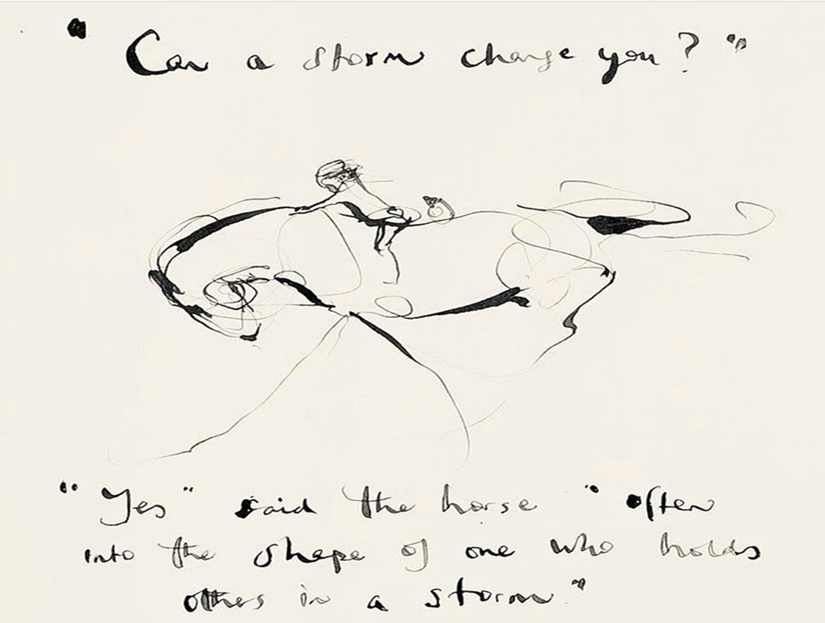
Charlie Mackesy

Slide 7


Beth fu effaith COVID-19 ar fyfyrwyr ac ar addysgwyr? Ychydig o dystiolaeth o Ganada
What has been the impact of COVID-19 for students and educators? Some Canadian evidence

Slide 8
Tegwch i fyfyrwyr
Student equity
Grwpiau o fyfyrwyr y nododd addysgwyr eu bod yn cael ymdrin â dysgu ar-lein yn negyddol neu’n negyddol iawn yn ystod gwanwyn 2020:
Myfyrwyr sy’n byw mewn tlodi (80% o ymatebwyr);
Myfyrwyr ag eithriadoldeb (76% o ymatebwyr);
Myfyrwyr o deuluoedd rhiant sengl (74% o ymatebwyr);
Myfyrwyr sy’n dysgu siarad Saesneg (60% o ymatebwyr).
    (CTF, 2020, t.6)
Student groups who educators identified as experiencing negative or very negative handling online learning during Spring 2020:
Students living in poverty (80% respondents);
Students with exceptionalities (76% respondents);
Students in single parent households (74% respondents);
English language learners (60% respondents).
    (CTF, 2020, p.6)

Slide 9
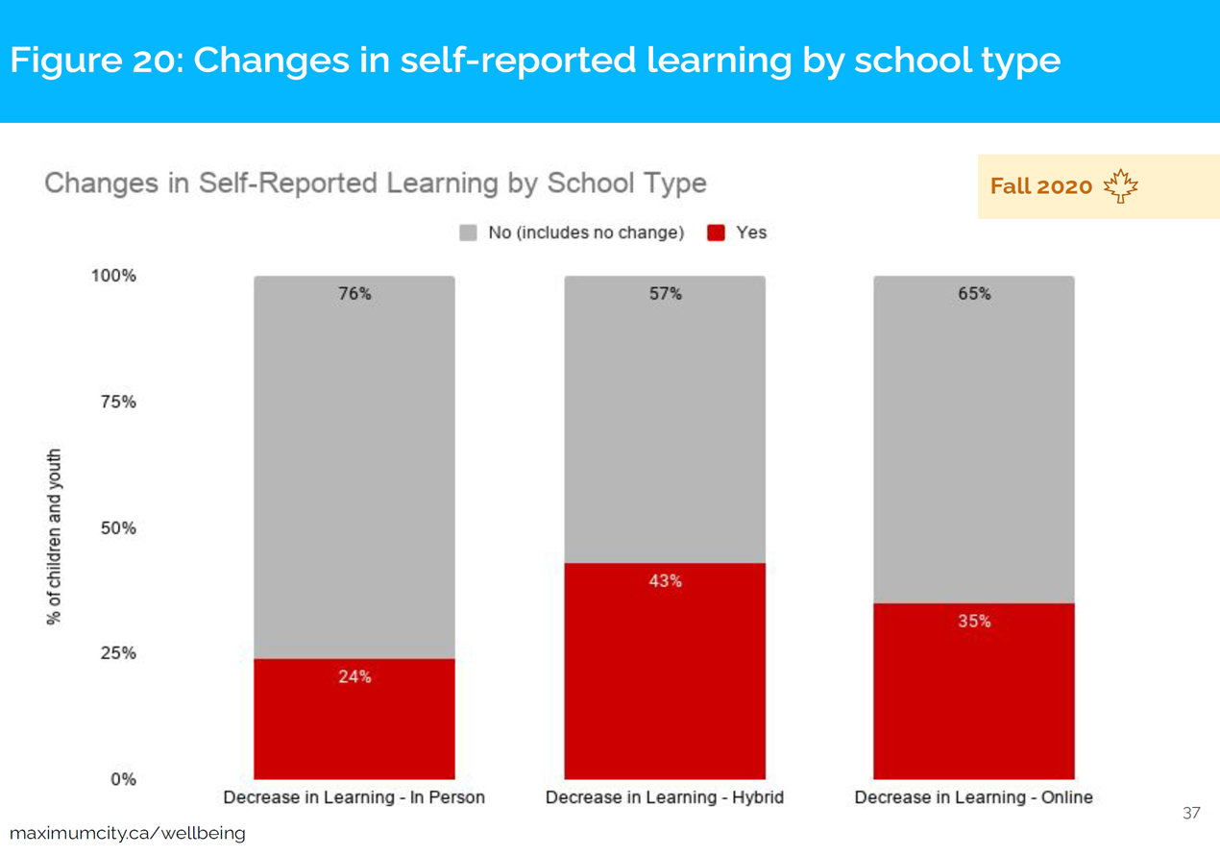
Dysgu gan fyfyrwyr
Student learning
Maximum City, 2021, t. 37

Slide 10
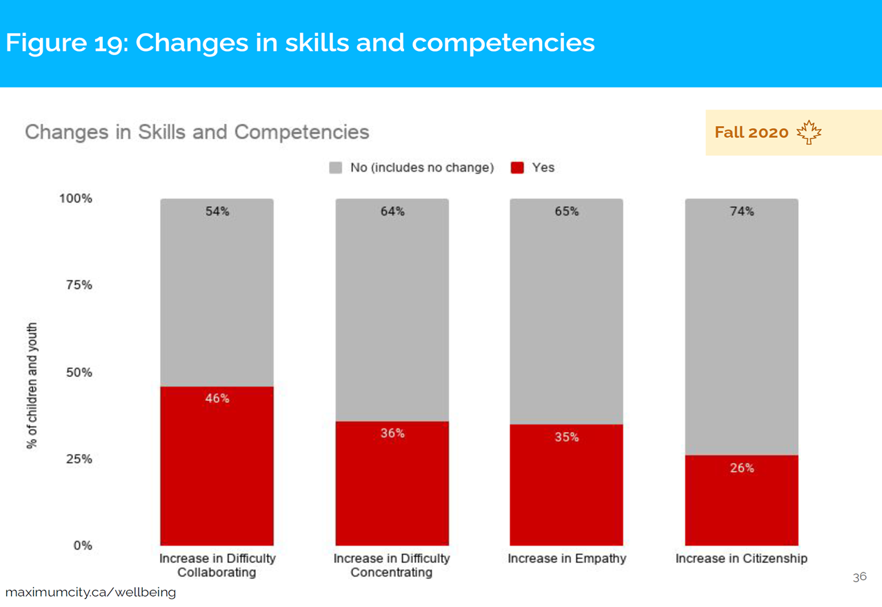
Dysgu gan fyfyrwyr
Student learning
Maximum City, 2021, t.36

Slide 11
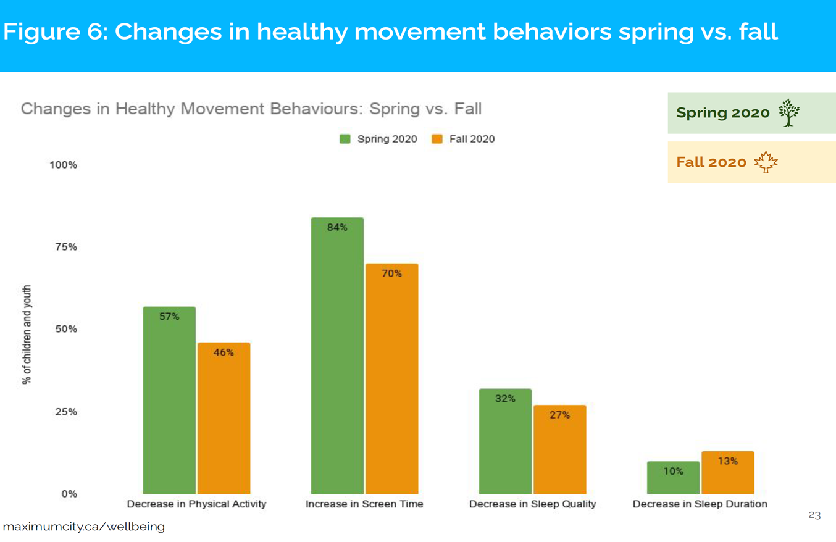
Iechyd corfforol myfyrwyr
Student physical health
Maximum City, 2021, t.23

Slide 12
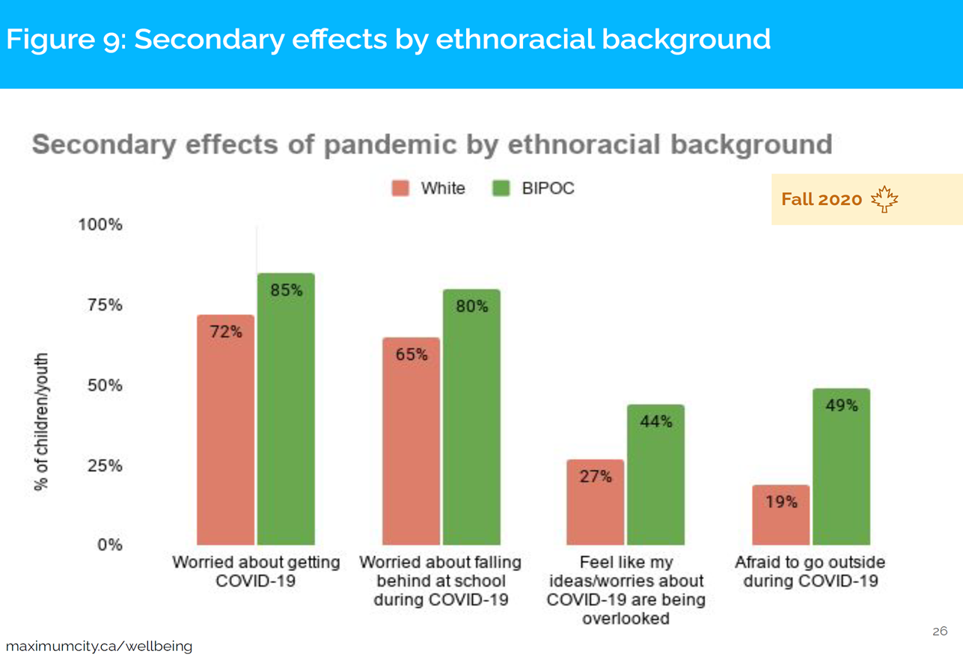
Iechyd meddwl myfyrwyr
Student mental health
Maximum City, 2021, t. 26

Slide 13
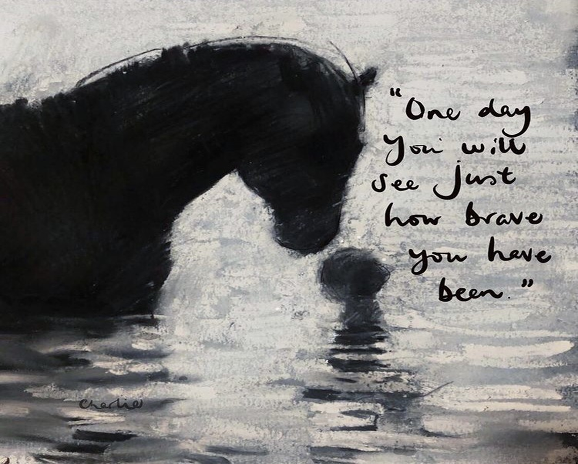
Ar raddfa o 0 i 100, faint o straen mae eich swydd yn peri ar hyn o bryd?
On a scale of 0-100, how stressful is your job right now?
Charlie Mackesy

Slide 14
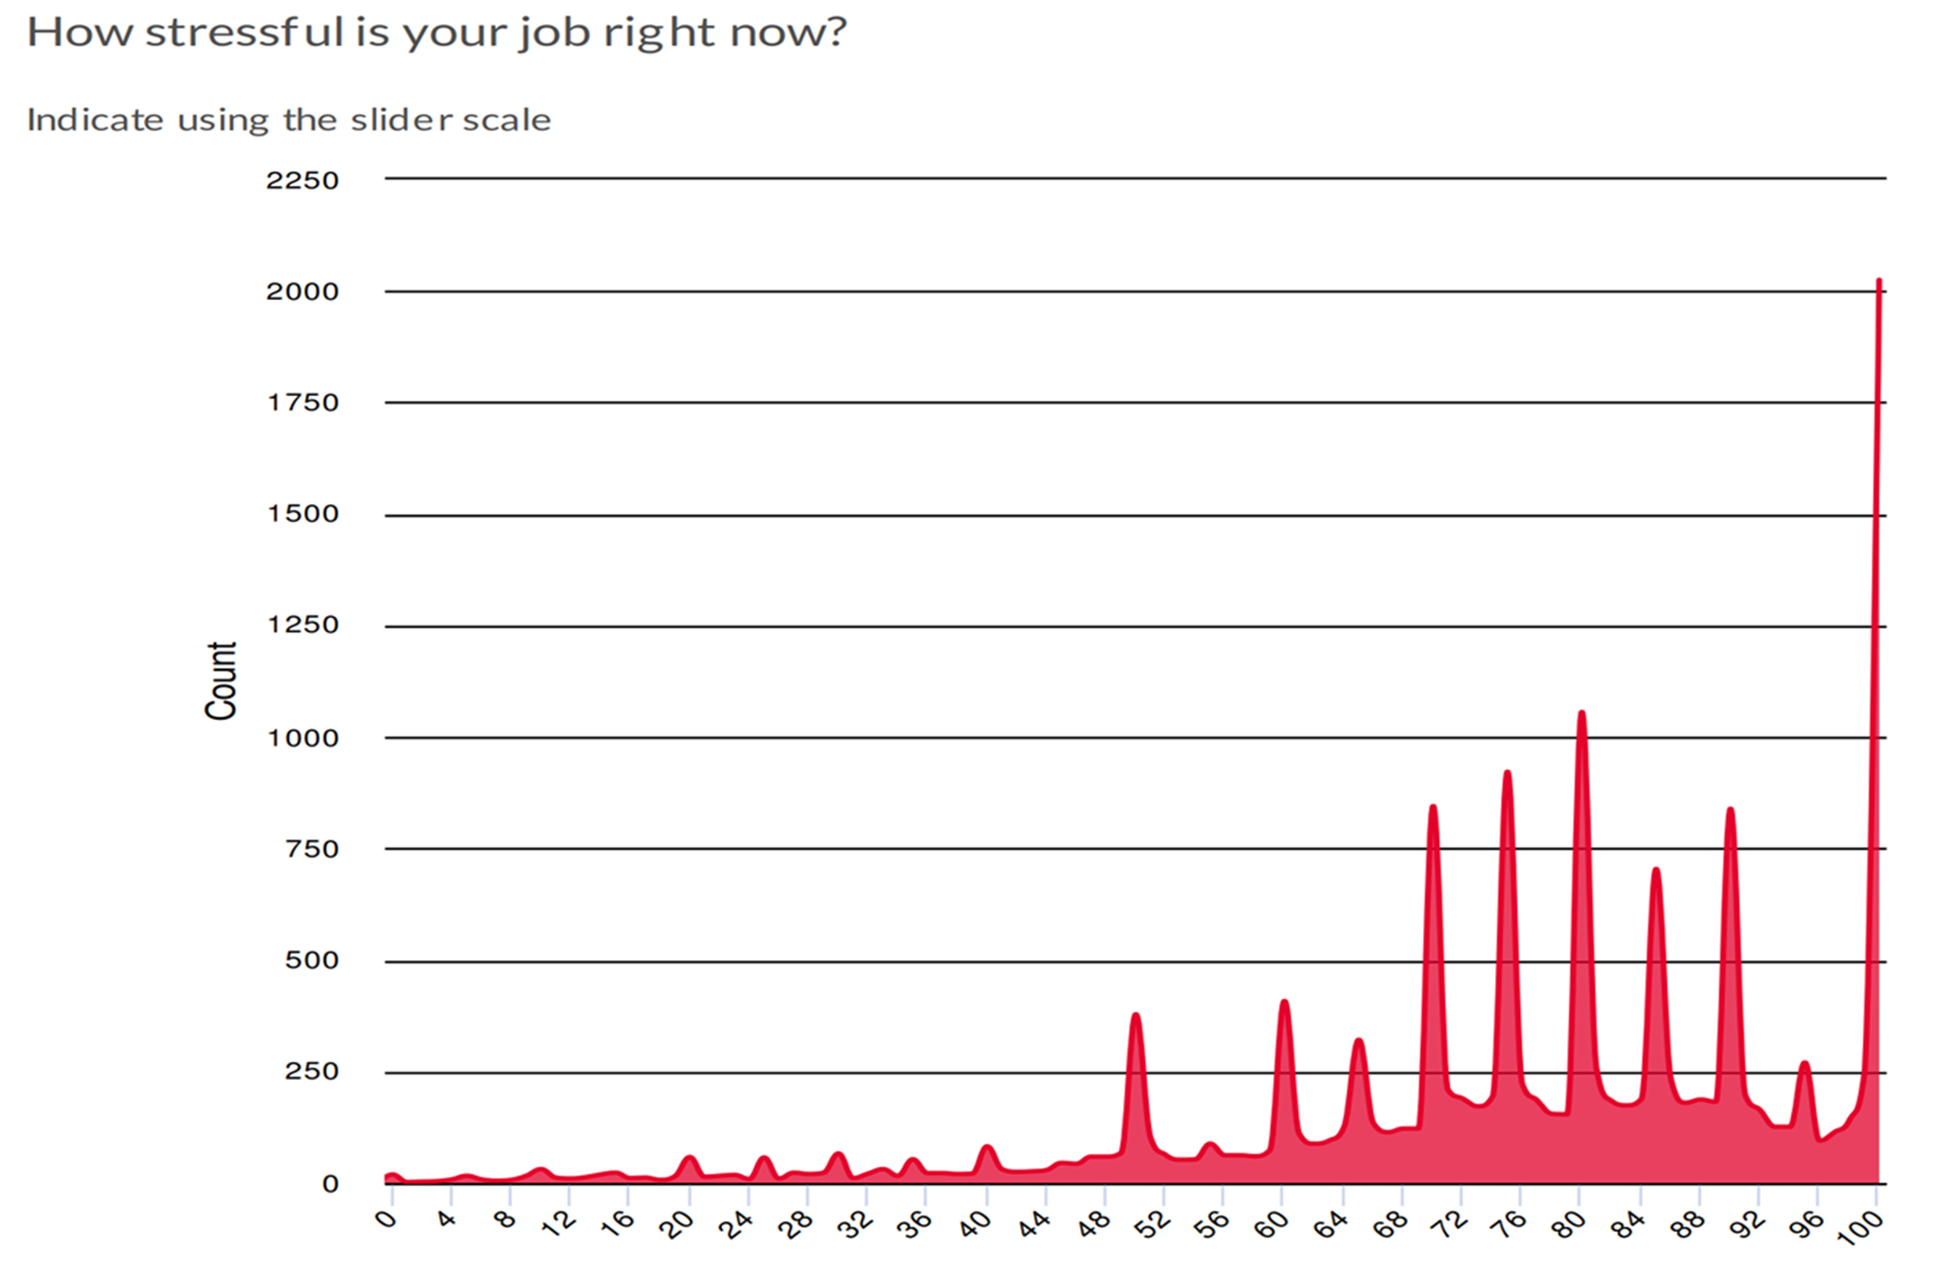
Ffynhonnell: Canadian Teachers Federation (2020). Teacher Mental Health Check-In Survey, t. 7
Source: Canadian Teachers Federation (2020). Teacher Mental Health Check-In Survey, p. 7

Slide 15
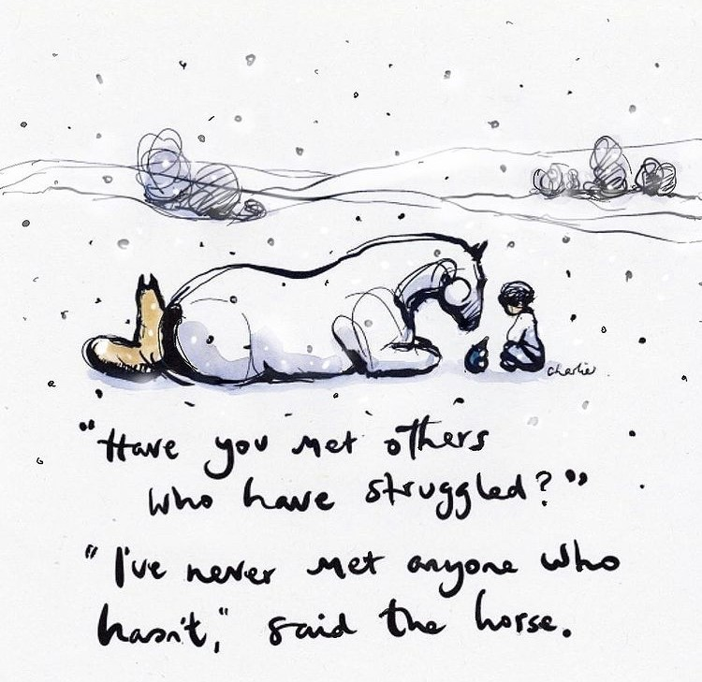
Pa mor dda ydych chi’n ymdopi â straen dyddiol addysgu ar hyn o bryd?
How well are you coping with the daily stresses of teaching right now?
Charlie Mackesy

Slide 16
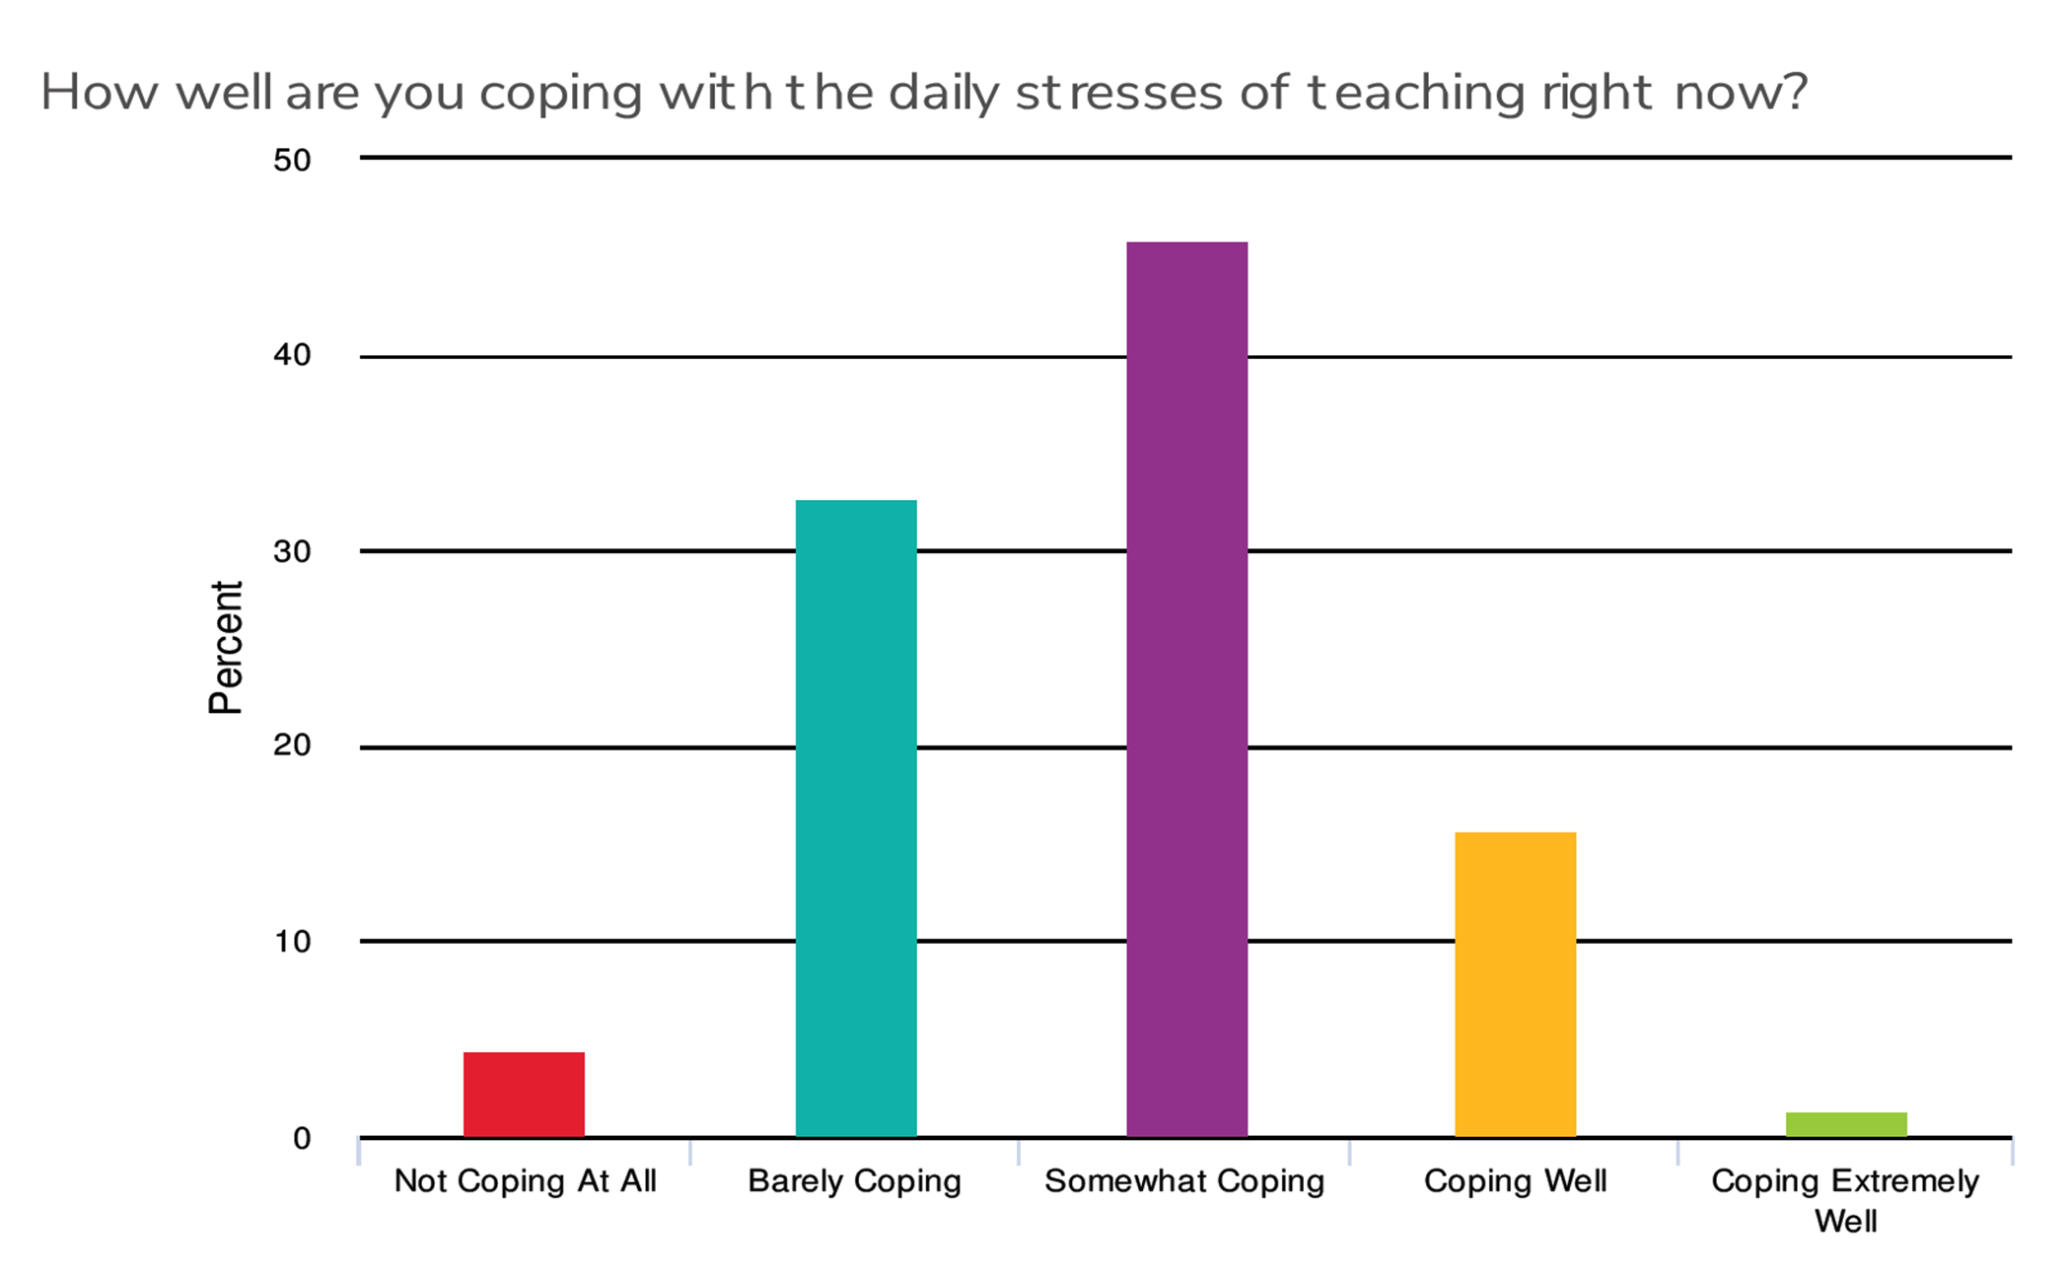
Ffynhonnell: Canadian Teachers Federation (2020). Teacher Mental Health Check-In Survey, t. 11
Source: Canadian Teachers Federation (2020). Teacher Mental Health Check-In Survey, p. 11

Slide 17
Ymatebwyr a ddywedodd fod y grwpiau canlynol yn eu cefnogi i raddau, yn fawr neu yn fawr iawn:
  Cydweithwyr 94%
  Teulu/Ffrindiau 94%
  Rhieni/Gwarcheidwaid Myfyrwyr 79%
  Gweinyddwyr 76%
  Cymdeithas Broffesiynol/Undeb 71%
  (CTF, 2020)
Respondents reporting feeling somewhat, very or extremely supported by the following groups:
  Colleagues 94%
  Family/Friends 94%
  Students’ Parents/Guardians 79%
  Administrators 76%
  Professional Association/Union 71%
  (CTF, 2020)

Slide 18
Trafodaeth grŵp 1
Breakout discussion 1
Yn eich profiad a’ch cyd-destun, beth fu prif effeithiau’r ymatebion i bandemig COVID-19 i’r proffesiwn addysg?
In your experience and context, what have been the main impacts of the responses to the COVID-19 pandemic for the education profession?

Slide 19

Datblygu system addysg a arweinir yn broffesiynol
Developing a professionally-led education system

Slide 20
Datblygu system addysg a arweinir yn broffesiynol
Developing a professionally-led education system

Slide 21
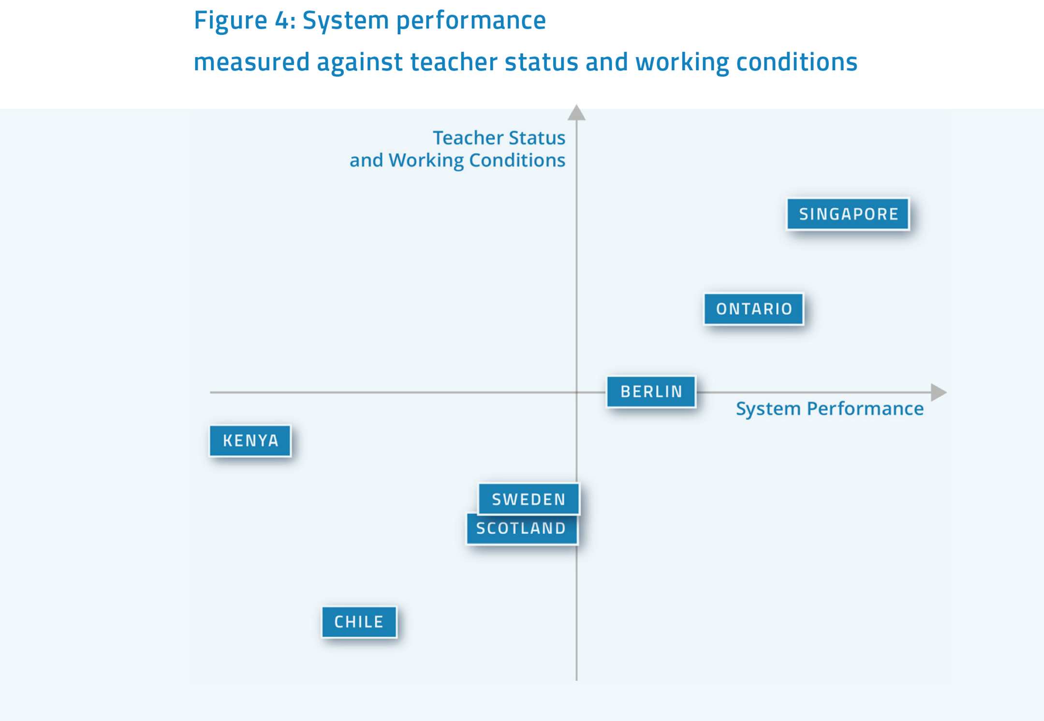
Ffynhonnell: Cordingley et al. (2018) Constructing Teachers’ Professional Identities. Education International, t. 31
Source: Cordingley et al. (2018) Constructing Teachers’ Professional Identities. Education International, p. 31

Slide 22
Cyd-destun y System
System Context
Cysylltiadau cadarnhaol â llwybrau gyrfaol a’r cyflenwad athrawon
Y rhyngweithio rhwng gwelliant lefel system â hunaniaeth broffesiynol yr athrawon
Polisïau penodol ar gyfer codi statws y proffesiwn
Positive links to career paths and teacher supply
The interaction between system level improvement and teachers’ professional identities
Explicit policies for raising the status of the profession

Slide 23
Rolau a Gwerthoedd Athrawon
Teachers’ Roles and Values
Parch tuag at addysg a pharch tuag at athrawon ac addysgu
Disgwyliadau am gydbwysedd amser a chydbwysedd rhwng bywyd a gwaith
Gosod proffesiynoldeb a gogwydd athrawon tuag at fyfyrwyr o fewn y diwygio
Respect for education and respect for teachers and teaching
Expectations about time and work life balance
Positioning professionalism and teachers’ orientation to students within reform

Slide 24
Ymreolaeth Athrawon
Teacher Autonomy
Systemau addysg wedi’u harwain gan athrawon
Ymddiriedaeth
Arweinyddiaeth athrawon
Teacher led education systems
Trust
Teacher leadership

Slide 25
Dysgu a Datblygiad Proffesiynol Parhaus
Continuing Professional Learning and Development
Blaenoriaethu DPP a chefnogaeth iddo
Ymagweddau at DPP a’i alinio â dyheadau o ran llwyddiant myfyrwyr
Cynnal dysgu proffesiynol
Prioritisation of and support for CPD
Approaches to CPD and alignment with aspirations for student success
Sustaining professional learning

Slide 26
Sesiwn Grŵp 2
Breakout Session 2
Beth yw’r blaenoriaethau ar gyfer blwyddyn ysgol 2021-22 o ran datblygu system addysg a arweinir yn broffesiynol?
  Cyd-destun y system
  Rolau a gwerthoedd addysgwyr
  Ymreolaeth broffesiynol ac arweinyddiaeth
  Dysgu a datblygiad proffesiynol parhaus
What are priorities for 2021-22 school year for developing a professionally-led education system?
  System context
  Educators’ roles and values
  Professional autonomy and leadership
  Continuing professional learning and development

Slide 27



Arweinyddiaeth a dysgu proffesiynol yn ystod y pandemig a thu hwnt
Leadership and professional learning during and beyond the pandemic

Slide 28

Nodweddion Dysgu Proffesiynol Effeithiol
Features of Effective Professional Learning

Slide 29
Cynnwys o Ansawdd Da
Quality Content
Defnyddio tystiolaeth, ymholi a barn broffesiynol i lywio polisïau ac arferion dysgu proffesiynol
Nodi anghenion blaenoriaethol athrawon o ran pynciau/cynnwys dysgu proffesiynol yn gysylltiedig ag anghenion myfyrwyr
Canolbwyntio ar amrywiaeth eang o ddeilliannau dysgu myfyrwyr a gweithwyr proffesiynol
Cydbwysedd priodol o gyfleoedd am ddysgu proffesiynol hunangyfeiriedig a systemgyfeiriedig
Use of evidence, inquiry and professional judgement to inform professional learning policies and practices
Identify teachers’ priority needs for professional learning topics/content linked to students’ needs
Focus on a broad range of students’ and professionals’ learning outcomes
Appropriately balance of opportunities for system-directed and self-directed professional learning

Slide 30
Dylunio a Gweithredu Dysgu
Learning Design & Implementation
Gallu ymroi i amryfal gyfleoedd dysgu proffesiynol wedi’u gwahaniaethu yn ôl anghenion proffesiynol
Gall profiadau dysgu cydweithredol o fewn ysgolion ac mewn rhwydweithiau proffesiynol allanol fod yn werthfawr
Mae angen dysgu proffesiynol perthnasol ac ymarferol yn gysylltiedig â gwaith addysgwyr (wedi’i wreiddio yn y swydd yn yr ysgol a, hefyd, yn cysylltu ag arbenigedd allanol)
Be able to engage in multiple professional learning opportunities differentiated to professional needs
Collaborative learning experiences within schools and in external professional networks can be valuable
Relevant and practical professional learning linked to educators’ work is needed (both job-embedded in school and also linking to external expertise)

Slide 31
Cymorth a Chynaliadwyedd
Support & Sustainability
Angen amser ar gyfer dysgu proffesiynol cronnus, parhaus, wedi’i integreiddio â bywyd gwaith addysgwyr
Mae angen talu sylw i fynediad teg at adnoddau ar gyfer dysgu proffesiynol
Mae gan arweinwyr systemau ac ysgolion rolau pwysig o ran cefnogi dysgu proffesiynol i’w hunain ac i’w staff
Need for time for sustained, cumulative professional learning integrated within educators’ work lives is needed
Equitable access to resources for professional learning requires attention
System and school leaders have important roles in supporting professional learning for themselves and for their staff

Slide 32
Rhaglen Dysgu ac Arweinyddiaeth Athrawon Ontario
Ontario’s Teacher Learning & Leadership Program
1. Cefnogi athrawon profiadol sy’n ymgymryd â datblygiad proffesiynol uwch hunangyfeiriedig yn gysylltiedig â gwell dysgu a datblygiad myfyrwyr.
2. Helpu athrawon ystafell ddosbarth i ddatblygu sgiliau arweinyddiaeth er mwyn rhannu dysgu ac arferion rhagorol ar sail bwrdd a/neu dalaith.
3. Hwyluso cyfnewid gwybodaeth i ledaenu a chynnal arferion effeithiol ac arloesol.
1. To support experienced teachers who undertake self-directed advanced professional development related to improved student learning and development.
2. To help classroom teachers develop leadership skills for sharing learning and exemplary practices on a board-wide and/or provincial basis.
3. To facilitate knowledge exchange for the spread and sustainability of effective and innovative practices.

Slide 33
Mathemateg ‘UP’
UP Mathematics
I ddechrau, 17% o fyfyrwyr oedd yn cyflawni’r safon daleithiol mewn Mathemateg Gymhwysol Gradd 9; erbyn 2016-17, roedd 73% o fyfyrwyr yn ei chyflawni.
TLLP 1: Defnyddio cyfarwyddyd diagnostig Mathemateg seiliedig ar Gontinwwm, wedi’i wahaniaethu, a Dysgu Ymholi Cydweithredol mewn Mathemateg (cyd-gynllunio, arsylwi gan athrawon, dadansoddi gwersi).
TLLP 2: Adolygu ymchwil, canolbwyntio ar feddylfryd ac agweddau, ac integreiddio iPads ar gyfer cadw dyddlyfr ac Apiau Mathemateg.
PKE: Cwrs Mathemateg ‘UP’, 21 diwrnod o ddiolch a dilyniant mewn mathemateg yn canolbwyntio ar y myfyriwr.
Initially 17% of students achieving provincial standard in Grade 9 Applied Mathematics; by 2016-17, 73% of students.
TLLP 1: Use of Continuum-Based Math diagnostic, differentiated instruction, and Collaborative Inquiry Learning in Mathematics (co-planning, teacher observation, lesson analysis).
TLLP 2: Research review, focus on mindset and attitudes, plus integration of iPads for journaling and Math Apps.
PKE: UP Mathematics course, 21 days of gratitude plus student-centred mathematics progression.

Slide 34

NORCAN
NORCAN
Sut gall rhwydwaith rhyngwladol o ysgolion ac addysgwyr sy’n ymroi i arweinyddiaeth ystyrlon helpu i amlygu’r hyn sy’n rhwystro myfyrwyr rhag dysgu mathemateg a helpu i ddatblygu strategaethau ar gyfer cyflawni llwyddiant?
How can an international network of schools and educators committed to mindful leadership help to identify obstacles to students’ mathematics learning and develop strategies for attaining success?

Slide 35

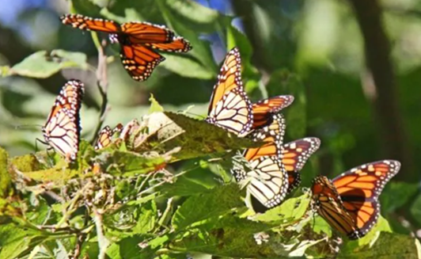
“Aethom i’r lleuad ac, o ganlyniad, gwelom y ddaear yn wahanol.”
- Leanne Oliver
“We went to the moon and, as a result, we saw the earth differently.”
Leanne Oliver

Slide 36
Datblygu System Addysg a Arweinir yn Broffesiynol
Developing a Professionally-Led Education System
Arweinyddiaeth ffurfiol ac anffurfiol gan ddefnyddio barn broffesiynol, arbenigedd a phrofiad.
Ymroi i ddysgu proffesiynol a chydweithredu, a’u harwain – beth y mae arnoch angen ei ddysgu a sut byddwch chi’n dysgu?
Datbreifateiddio arferion – gyda phwy y byddwch chi’n rhannu’ch gwybodaeth, eich arferion a’ch dysgu a beth fyddwch chi’n ei rannu?
Defnyddio gwybodaeth – sut byddwch chi’n rhannu’ch dysgu ac yn dysgu gan eraill?
Formal and informal leadership using professional judgement, expertise and experience.
Engaging in and leading professional learning and collaboration – what do you need to learn and how will you learn?
De-privatization of practices - who will you share your knowledge, practices and learning with and what will you share?
Knowledge mobilization – how will you share your learning and learn from others?

Slide 37
Sesiwn Grŵp 3
Breakout Session 3
Gan edrych ymlaen at y flwyddyn ysgol nesaf, beth yw eich blaenoriaethau dysgu proffesiynol (i chi’ch hun a/neu i’ch tîm)?
Pa un cam arwain fyddwch chi’n ei gymryd i helpu i ddatblygu’r proffesiwn addysg?
Looking to next school year, what are your professional learning priorities (for yourself and/or your team)?
What is one leadership action you will take to support developing the education profession?

Slide 38
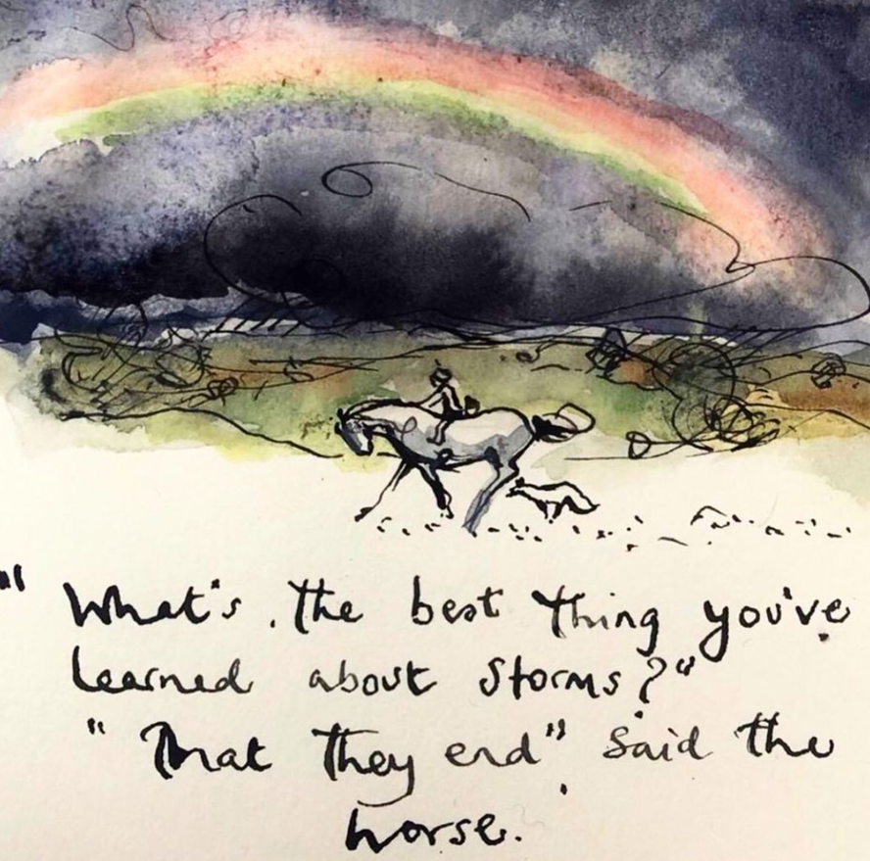
Diolch!
Thank you!
Charlie Mackesy

