Slide 1




Siarad yn Broffesiynol 2019
Professionally Speaking 2019
#SiaradProff19 @ewc_cga #ProfSpeak19

Slide 2

Sarah Stewart
Cyfarwyddwr TAR, Y Brifysgol Agored yng Nghymru
Director of PGCE, The Open University in Wales
#SiaradProff19 #ProfSpeak19

Slide 3
Kirsty Williams AC/AM
Gweinidog Addysg
Minister for Education
#SiaradProff19 #ProfSpeak19

Slide 4
Yr Athro Andy Hargreaves
Tegwch, hunaniaeth a chynhwysiant: yr her fawr nesaf i newid addysgol
@hargreavesBC
Professor Andy Hargreaves
Equity, identity and inclusion: the next big challenge for educational change
#SiaradProff19 #ProfSpeak19

Slide 5
Dwy Oes Newid
Two Ages of Change

Slide 6
2000-2015 Oes Cyflawniad ac Ymdrech
2000-2015 The Age of Achievement & Effort

Slide 7
Sut ydym yn dod yn ein blaenau?
Sut ydyn ni’n gwybod hynny?
Sut gallwn ni wella?
Sut gall hyn fod o fudd i bawb?
How are we doing?
How do we know?
How can we improve?
How can this benefit everyone?

Slide 9
OECD – April 2014
Safle yn lle Gweledigaeth
Safon Athrawon yn Dirywio
Cyfalaf Arweinyddiaeth Gwael
Her Uchel, Cymorth Isel
Cydweithredu Dryslyd
Asesu Anghydlynol
Ranking instead of Vision
Declining Teacher Quality
Weak Leadership Capital
High Challenge, Low Support
Confusing Collaboration
Incoherent Assessment

Slide 10
Dibenion newydd
New Purposes

Slide 11

CYMRU
WALES
Dysgwyr uchelgeisiol, galluog
Cyfranwyr mentrus, creadigol
Dinasyddion egwyddorol, gwybodus
Unigolion iach, hyderus
Ambitious, capable learners
Enterprising, creative contributors
Ethical, informed citizens
Healthy, confident individuals
Notes:
Lee Kuan Yew- Founding Prime Minister
Food- Variety due to multiracial society
Old Singapore
Singapore Changi Airport- one of the best in the world

Slide 12

NORWY
NORWAY
Gwybodaeth bynciol
Dysgu a metawybyddiaeth
Cyfathrebu, cydweithredu, cymryd rhan
Archwilio, ymchwilio, creu
Subject knowledge
Learning and metacognition
Communicate, collaborate, participate
Explore, inquire, create
Notes:
Lee Kuan Yew- Founding Prime Minister
Food- Variety due to multiracial society
Old Singapore
Singapore Changi Airport- one of the best in the world

Slide 13

YR ALBAN
SCOTLAND
Dysgwyr llwyddiannus
Unigolion hyderus
Cyfranwyr effeithiol
Dinasyddion cyfrifol
Successful learners
Confident individuals
Effective contributors
Responsible citizens
Notes:
Lee Kuan Yew- Founding Prime Minister
Food- Variety due to multiracial society
Old Singapore
Singapore Changi Airport- one of the best in the world

Slide 14
Cyflawni Rhagoriaeth
Achieving Excellence
Achieving Excellence
Ensuring Equity
Promoting Well-being
Enhancing Public Confidence
Cyflawni Rhagoriaeth
Sicrhau Tegwch
Hyrwyddo Llesiant
Cynyddu Hyder y Cyhoedd

Slide 15

Mudiad addysg byd-eang sy’n datblygu tegwch, rhagoriaeth fras, cynhwysiant, llesiant, democratiaeth a hawliau dynol o fewn systemau o safon uchel sy’n cael eu rheoli’n broffesiynol.
A global educational movement that advances equity, broad excellence, inclusion, wellbeing, democracy & human rights in high quality, professionally run systems
www.atrico.org

Slide 16
2015 - Oes Hunaniaeth, Ymgysylltu a Llesiant
2015 - The Age of Identity, Engagement & Wellbeing

Slide 17
Pwy ydym ni?
Pa beth a ddaw ohonom?
Pwy fydd yn penderfynu?
Who are we?
What will become of us?
Who will decide?

Slide 18

Sefydliad Polisi Ymfudo
Migration Policy Institute

Slide 19
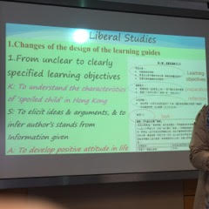
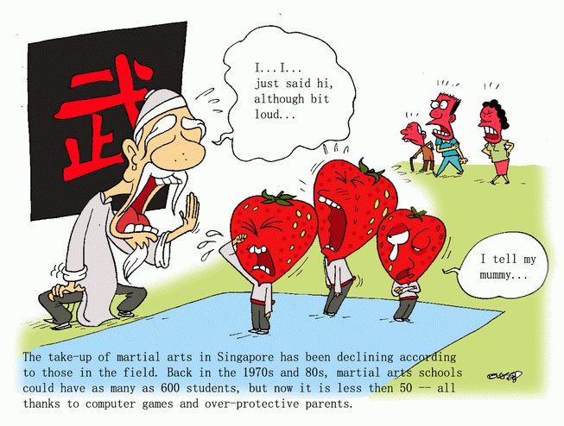
Plentyn maldodus

Slide 20

Rydym yn siarad gyda llawer o fyfyrwyr am y ffaith eich bod yn gofalu’n well am eich ffôn nad ydych amdanoch chi’ch hun.
We talk to students a lot about you take better care of your phone than you do of yourself.

Slide 21
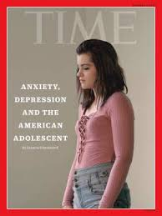

Slide 22



Mae hunanaddolwyr yn “dioddef chwant diddiwedd” am “gydnabyddiaeth, sylw, bri, gwobrau”
Narcissists are “afflicted with a bottomless appetite” for “recognition, attention, glory, rewards”
Notes:
PISA has a specific focus for each cycle
The next slide shows Norway’s position for each of the core areas vis-à-vis other countries

Slide 23
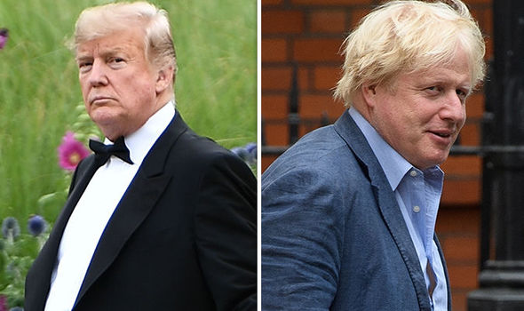

Slide 24
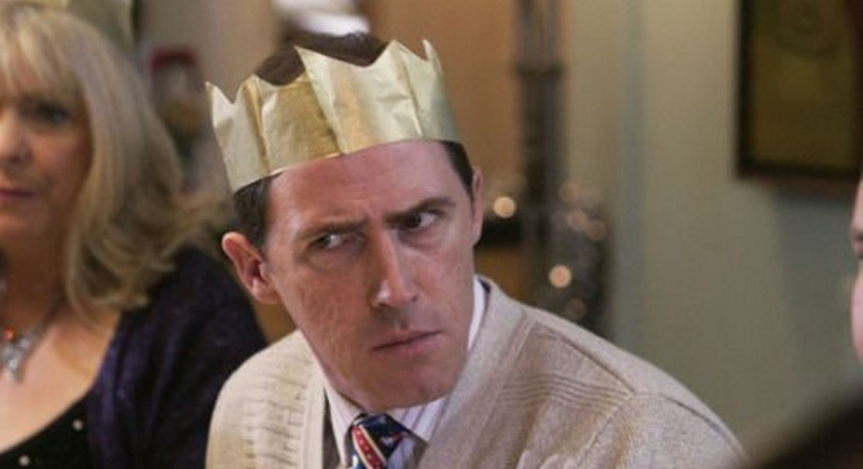
Dw i newydd ddiweddaru’r MySpace
17 ffrind sydd gen i erbyn hyn.
Dw i’n boddi
I’ve just been updating the MySpace
I’ve got 17 friends now.
I’m snowed under
Uncle Bryn

Slide 25
1. Tegwch a Meritocratiaeth
1. Equity and Meritocracy

Slide 26


Slide 27
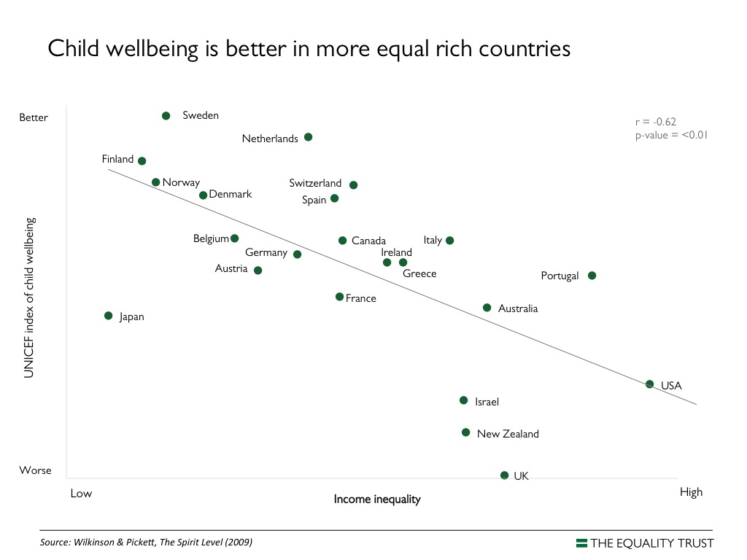

Slide 28
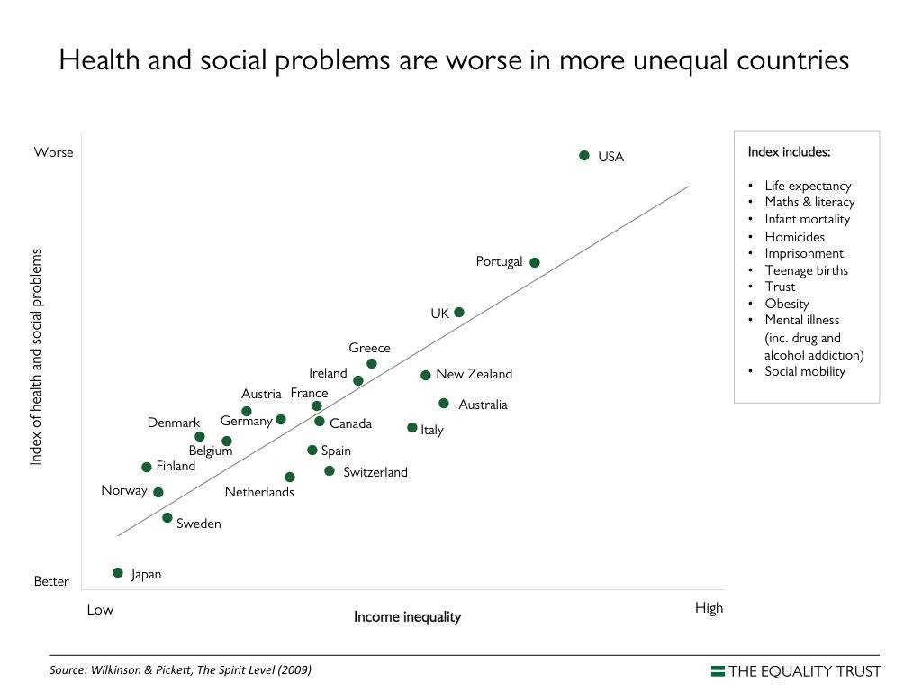

Slide 29
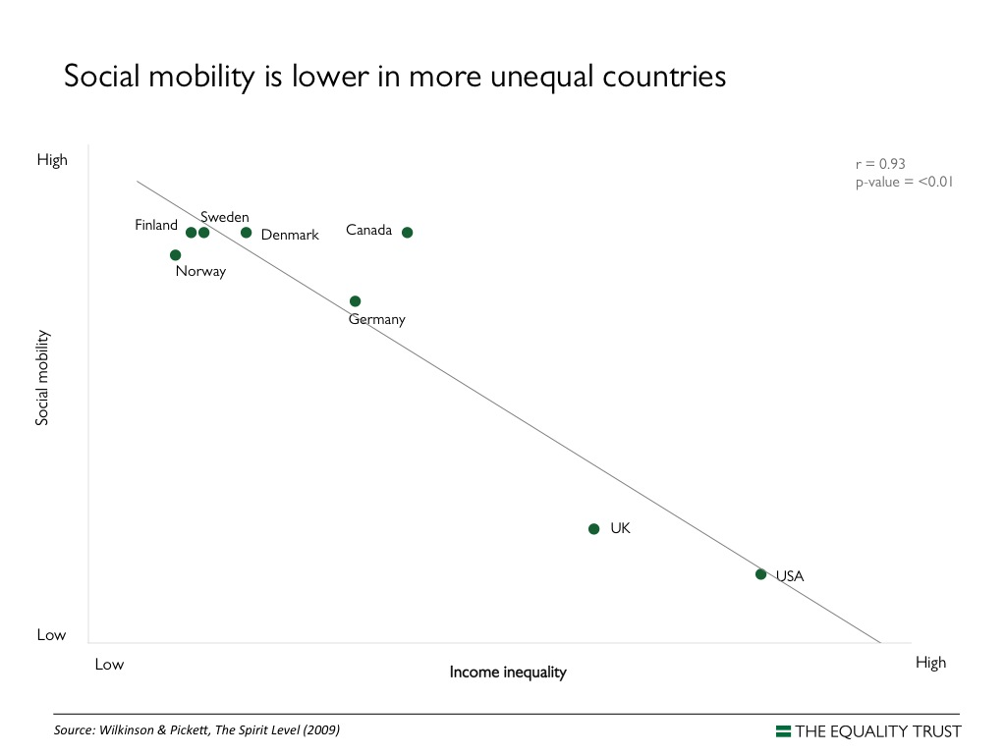

Slide 30

Meritocratiaeth
Meritocracy
Cymdeithas wedi’i llywodraethu gan y bobl fwyaf galluog:
Nid pendefigaeth geni,
Nid pliwtocratiaeth cyfoeth,
Ond gwir feritocratiaeth o ddoniau”
A society governed “by the cleverest people:
Not an aristocracy of birth,
Not a plutocracy of wealth,
But a true meritocracy of talent”

Slide 31
Meritocratiaeth
Meritocracy
“Am bob dyn sy’n cael ei fywiogi gan ragoriaeth, caiff deg eu lleddfu gan gyffredinedd”
“For every man enlivened by excellence, ten are deadened by mediocrity”

Slide 32
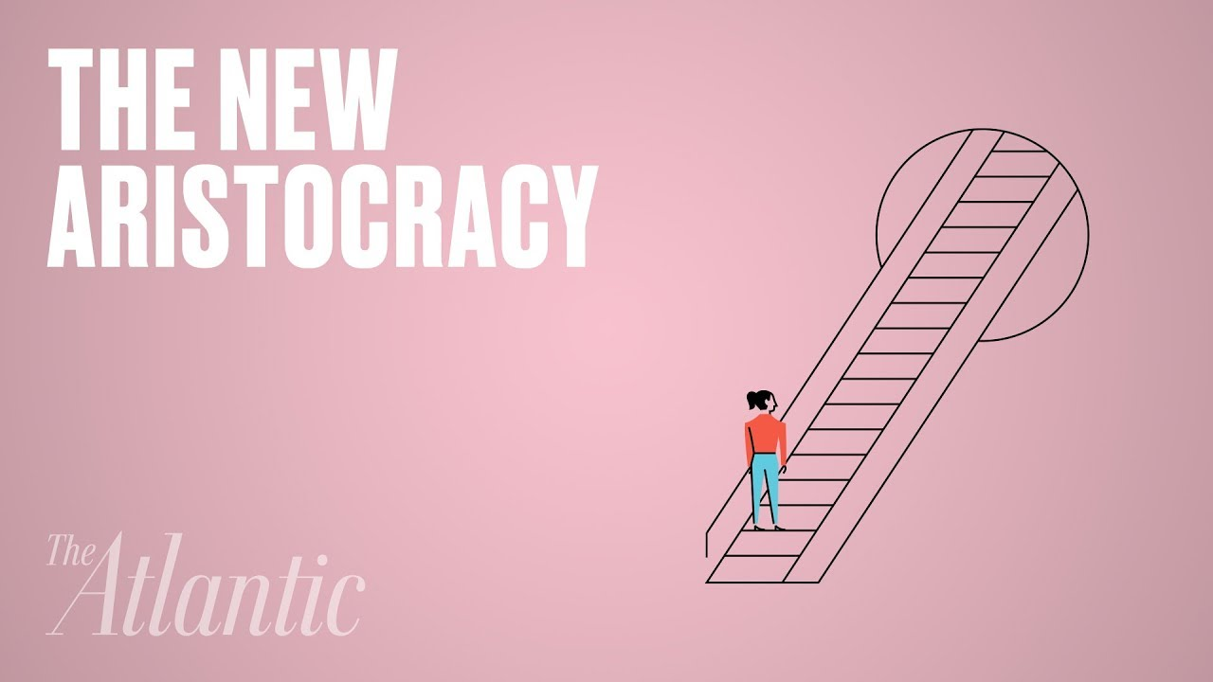
Mae’r dosbarth meritocrataidd wedi meistroli’r hen gast o gydgrynhoi cyfoeth a throsglwyddo braint ar draul plant pobl eraill
The meritocratic class has mastered the old trick of consolidating wealth and passing privilege along at the expense of other people’s children
Matthew Stewart 2019

Slide 33

Ras arfau addysgol
An educational arms race

Slide 34
Nid yw symud rhwng dosbarthiadau cymdeithasol yn ddewis arall i fwy o degwch.
Mae’n un o ganlyniadau mwy o degwch.
Social mobility is not an alternative to greater equity.
It’s the consequence of greater equity.

Slide 35
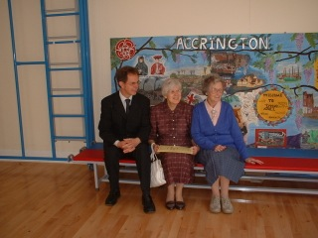
Notes:
PISA has a specific focus for each cycle
The next slide shows Norway’s position for each of the core areas vis-à-vis other countries

Slide 36
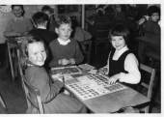
Money and Maths
ARIAN A MATHEMATEG
Notes:
PISA has a specific focus for each cycle
The next slide shows Norway’s position for each of the core areas vis-à-vis other countries

Slide 37
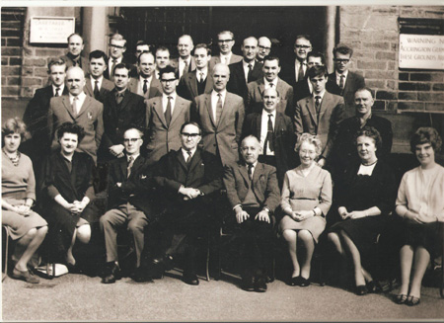
Notes:
PISA has a specific focus for each cycle
The next slide shows Norway’s position for each of the core areas vis-à-vis other countries

Slide 38
Mae symud rhwng dosbarthiadau cymdeithasol yn mynnu newid o ran gwerthoedd ac ymddygiad ymhlith y bobl elitaidd sydd ar y brig;
yn hytrach na mwy o blwc a gwydnwch gan y rhai sydd oddi tanynt.
Social mobility requires changes in values & behaviours among elites at the top;
Not just more grit and resilience from those below.

Slide 39
Ehangu’r hyn sy’n cyfrif fel cyfalaf diwylliannol
Rhoi mwy o glod i bobl ifanc o godau post tlawd
Edrych heibio i chwithigrwydd ymhlith pobl ifanc ddawnus a’i oresgyn
Ailystyried sut olwg sydd ar CV da
Cyfyngu interniaethau i sianeli addysgol ffurfiol
Ailfuddsoddi mewn sefydliadau cyhoeddus
Buddsoddi mewn llwybrau sector cyhoeddus
Gwrthdroi’r cynnydd mewn anghydraddoldeb economaidd
Broaden what counts as cultural capital
Give young people from poor postcodes extra credit
Overlook & overcome awkwardness among young people with talent
Rethink what a good CV looks like
Restrict internships to formal educational channels
Reinvest in public institutions
Invest in public sector pathways
Reverse increases in economic inequality

Slide 40
2. Llesiant
2. Wellbeing

Slide 41
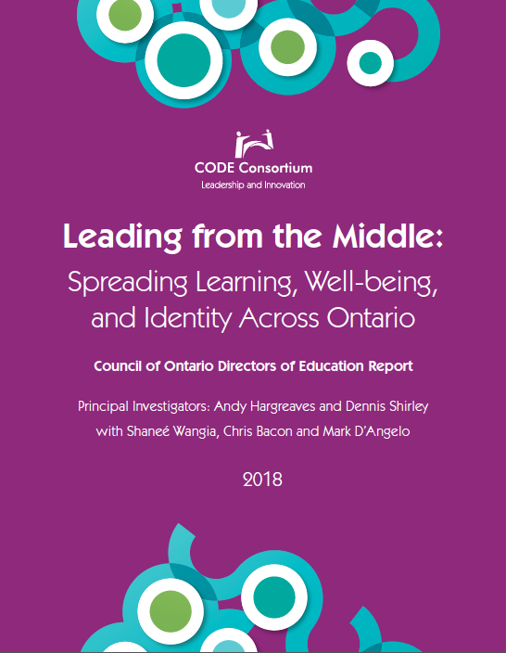

Slide 42
“Gofalu am bobl; gofalu am bopeth”
“Take care of people; take care of everything”

Slide 43
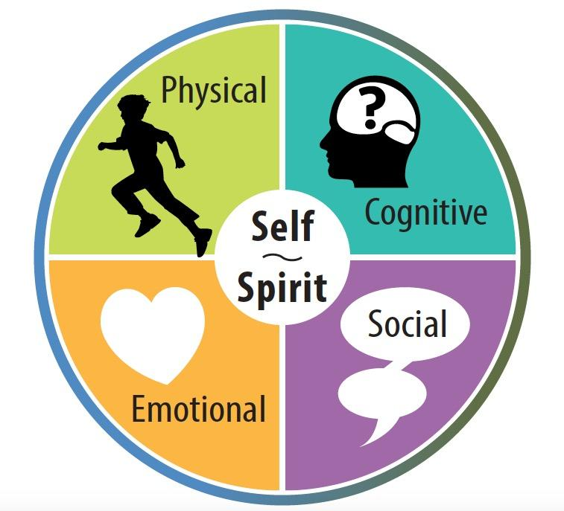

Slide 44
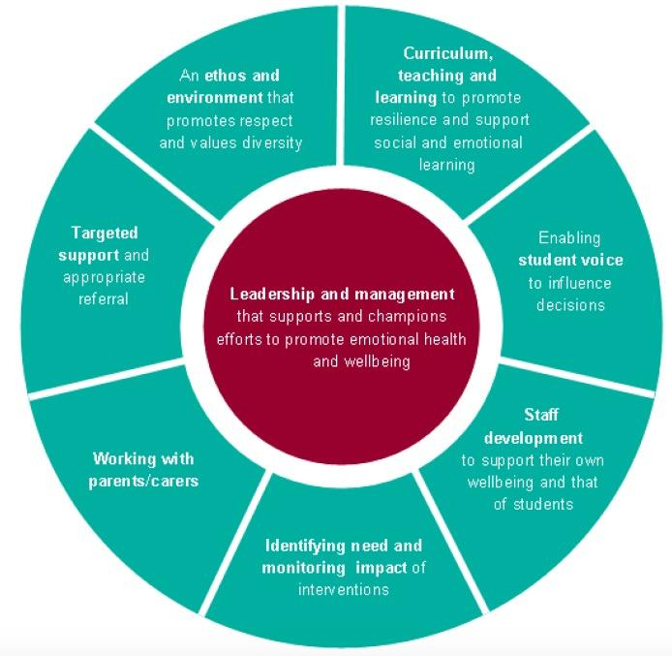
Wyth Egwyddor Llesiant Lloegr
England’s Eight Principles
Of Well-Being

Slide 45
1. Mae llesiant gwell yn cynyddu cyflawniad
1. Improved Wellbeing Increases Achievement

Slide 47
2. Mae cyflawniad academaidd yn hanfodol ar gyfer llesiant
2. Academic Achievement is Crucial for Wellbeing

Slide 48
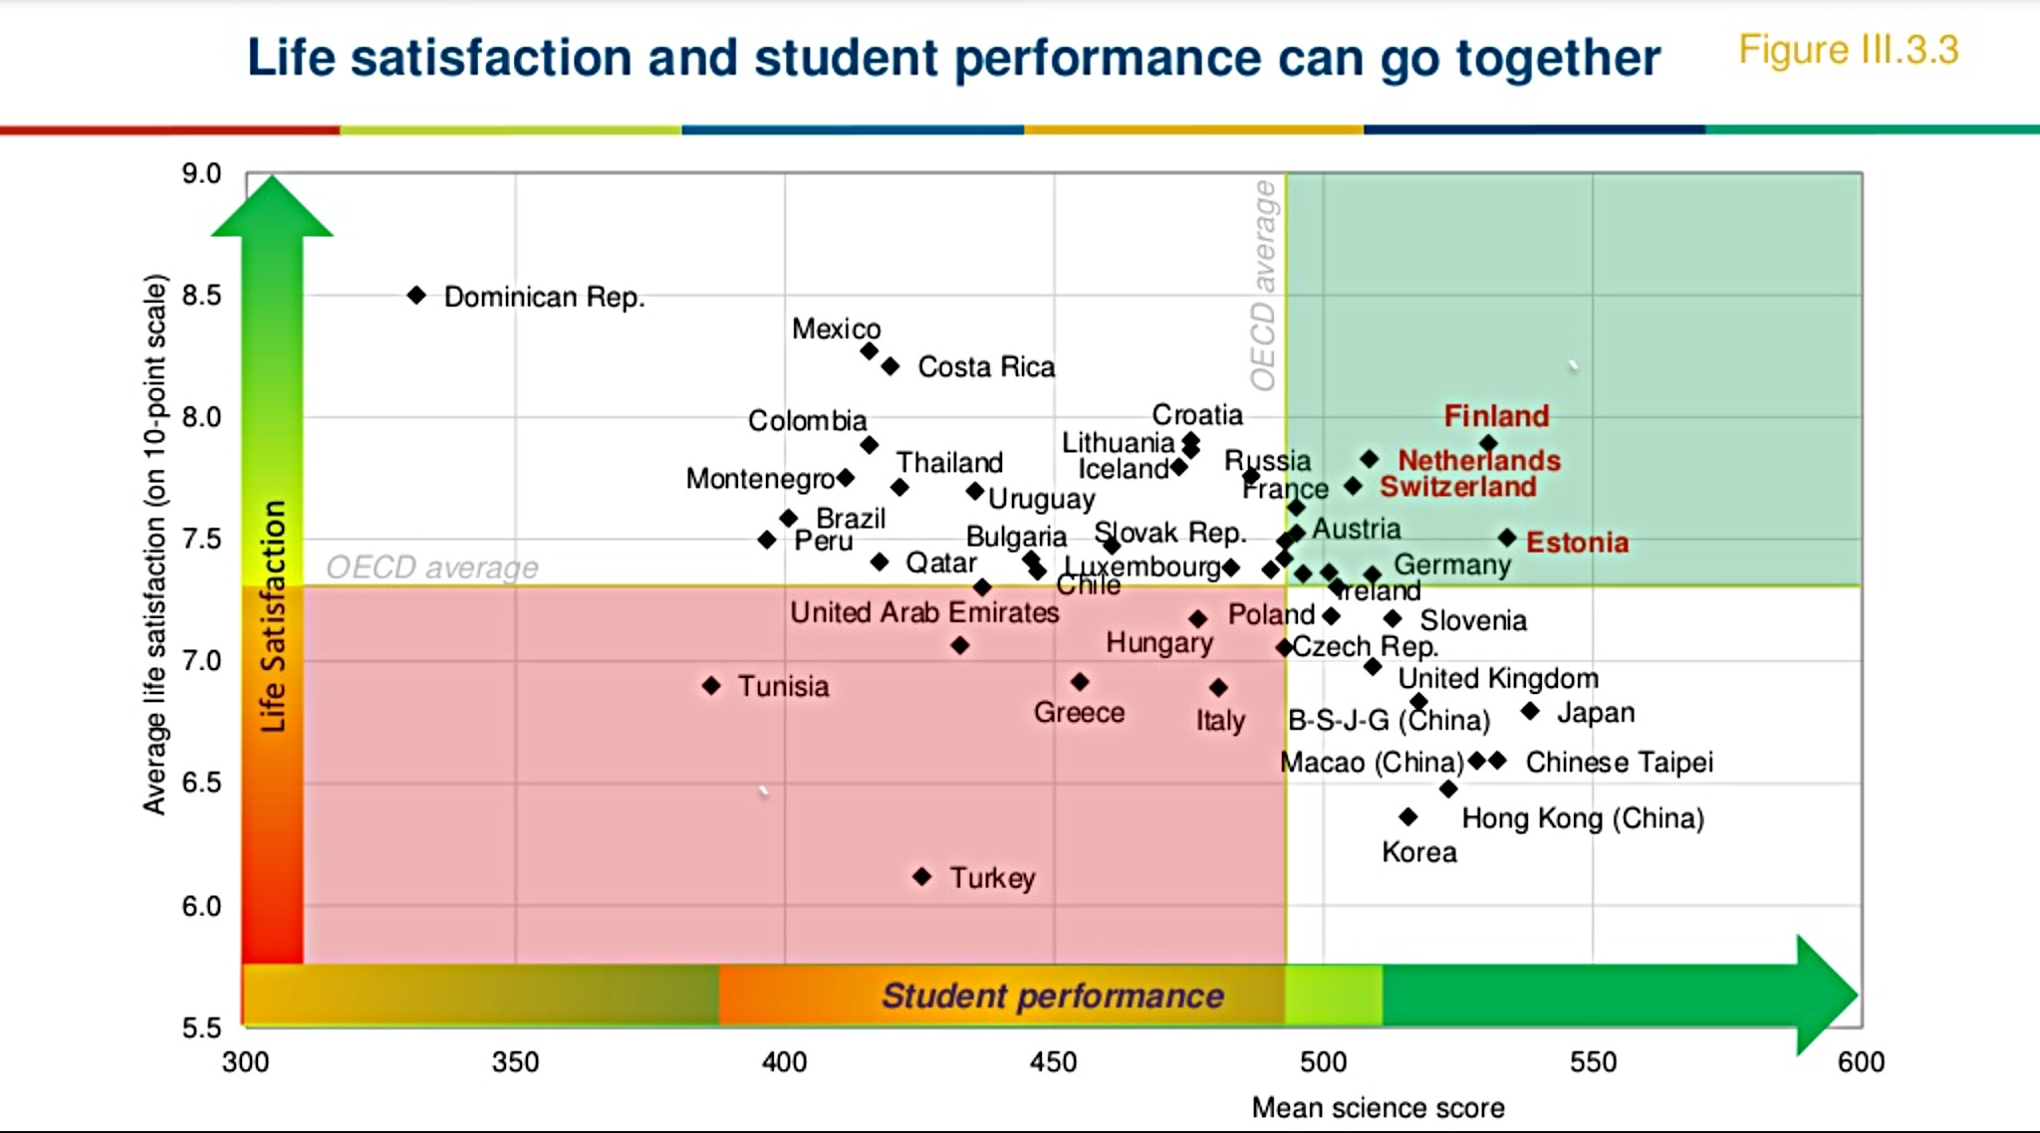

Slide 49
“Gall agenda cyflawniad a lles integredig a chydlynol gael ei thanseilio gan ddyfalwch gyda ffurf gyfredol yr asesiadau safonedig ar raddfa fawr.”
“An integrated and coherent achievement and well-being agenda can be undermined by persistence with the current form of large-scale, standardized assessments.”

Slide 50
3. Hunaniaeth
3. Identity

Slide 51
Mae cynhwysiant yn hanfodol ar gyfer tegwch.
Os na allwch weld eich hun yn cael eich cynrychioli a’ch parchu yn niwylliant a chwricwlwm yr ysgol, byddwch yn cael trafferth llwyddo.
Inclusion is essential to equity.
If you cannot see yourself represented & respected in the culture & curriculum of the school, you’ll find it hard to be successful.

Slide 52


Notes:
PISA has a specific focus for each cycle
The next slide shows Norway’s position for each of the core areas vis-à-vis other countries

Slide 53
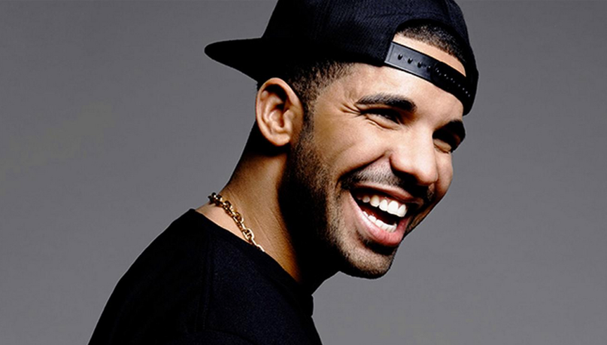

Slide 54
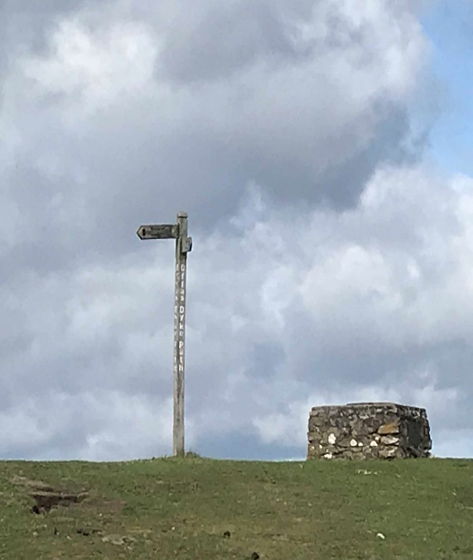
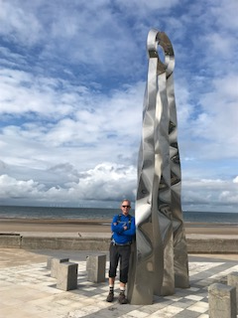
O rwystr amddiffynnol i ffinagored
From defensive barrier to open border

Slide 55
Intersectionality of Identity
RHYNGBLETHIAD HUNANIAETH
Rydym yn dechrau clywed y sgwrs gyda’n staff sydd am wybod mwy am hunaniaeth ein myfyrwyr, rhyngblethiad yr hunaniaeth honno ac fel mai rhodd ydyw, on’d ydym?
Ond nid fel rhywbeth y mae’n rhaid i ni ddarparu ar ei gyfer, nid fel rhywbeth y mae angen i ni ei ystyried, sut rydym yn mynd i weithio â’r bobl hyn, beth rydym yn mynd i’r wneud…
Na, mae’n ymwneud â phwy ydyn nhw.
(Uwch-arolygydd Rhanbarthol)
We're starting to hear that conversation with our staff wanting to know more about the identity of our students, the intersectionality of that identity, and how it's a gift, right?
Not something that we need to accommodate for, not something that we need to figure out how are we going to work with these people, what are we going to do…
No, it's who they are.
(District Superintendent)

Slide 56
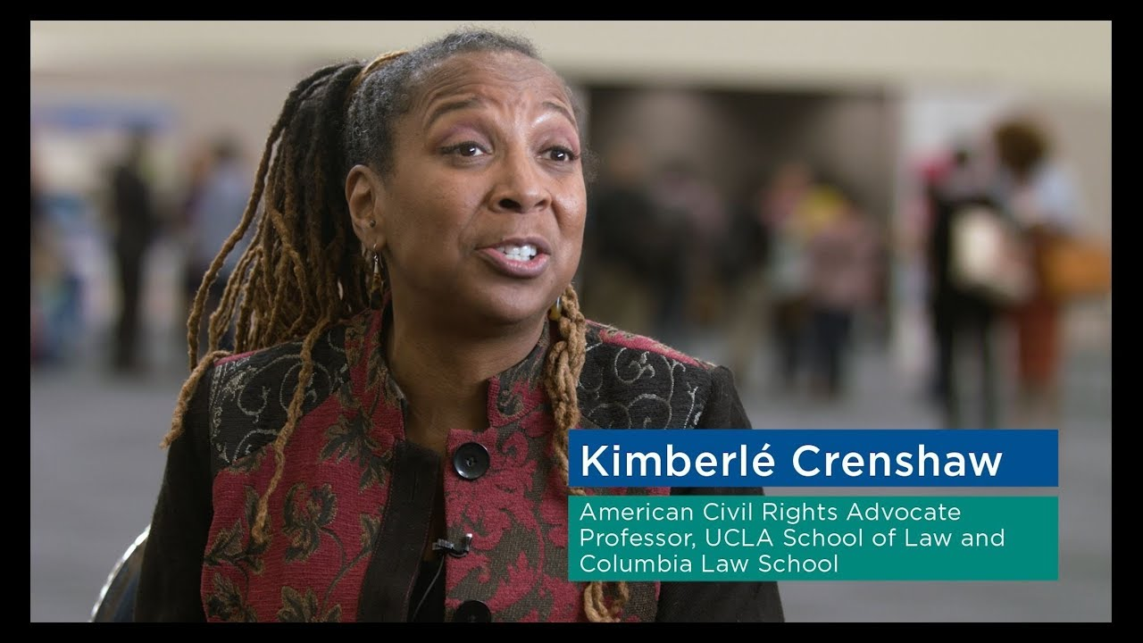
Notes:
PISA has a specific focus for each cycle
The next slide shows Norway’s position for each of the core areas vis-à-vis other countries

Slide 57
Hunaniaeth Ontario Ffrengig
Mae hunaniaeth yn fwy pwysig na chyflawniad
Mae Animation culturelle “yn hyrwyddo cyflawniad academaidd a datblygiad diwylliannol myfyrwyr trwy osod dysgu o fewn cyd-destun ystyrlon lle mae’r iaith a’r diwylliant Ffrengig yn dod yn berthnasol i’r myfyriwr.”
Gweinyddiaeth Addysg Ontario
Franco-Ontarian Identity
Identity is more important than achievement
Animation culturelle “promotes the students’ academic achievement & cultural development by placing learning in a meaningful context where the French language & culture become relevant in the student’s eyes.” Ontario MOE

Slide 58

“Rydych chi’n gwybod ac mae’r dosbarth yn gwybod fy mod i’n bwysig – mae hynny’n golygu rhywbeth i mi.
Mae’n sicrhau’r un amodau i bawb, hyd yn oed os yw hynny ond am funud.”
“You know and the class knows I matter—that means something to me.
Athro Gradd 3
It levels the playing field, even if just for one minute”
Grade 3 teacher

Slide 59
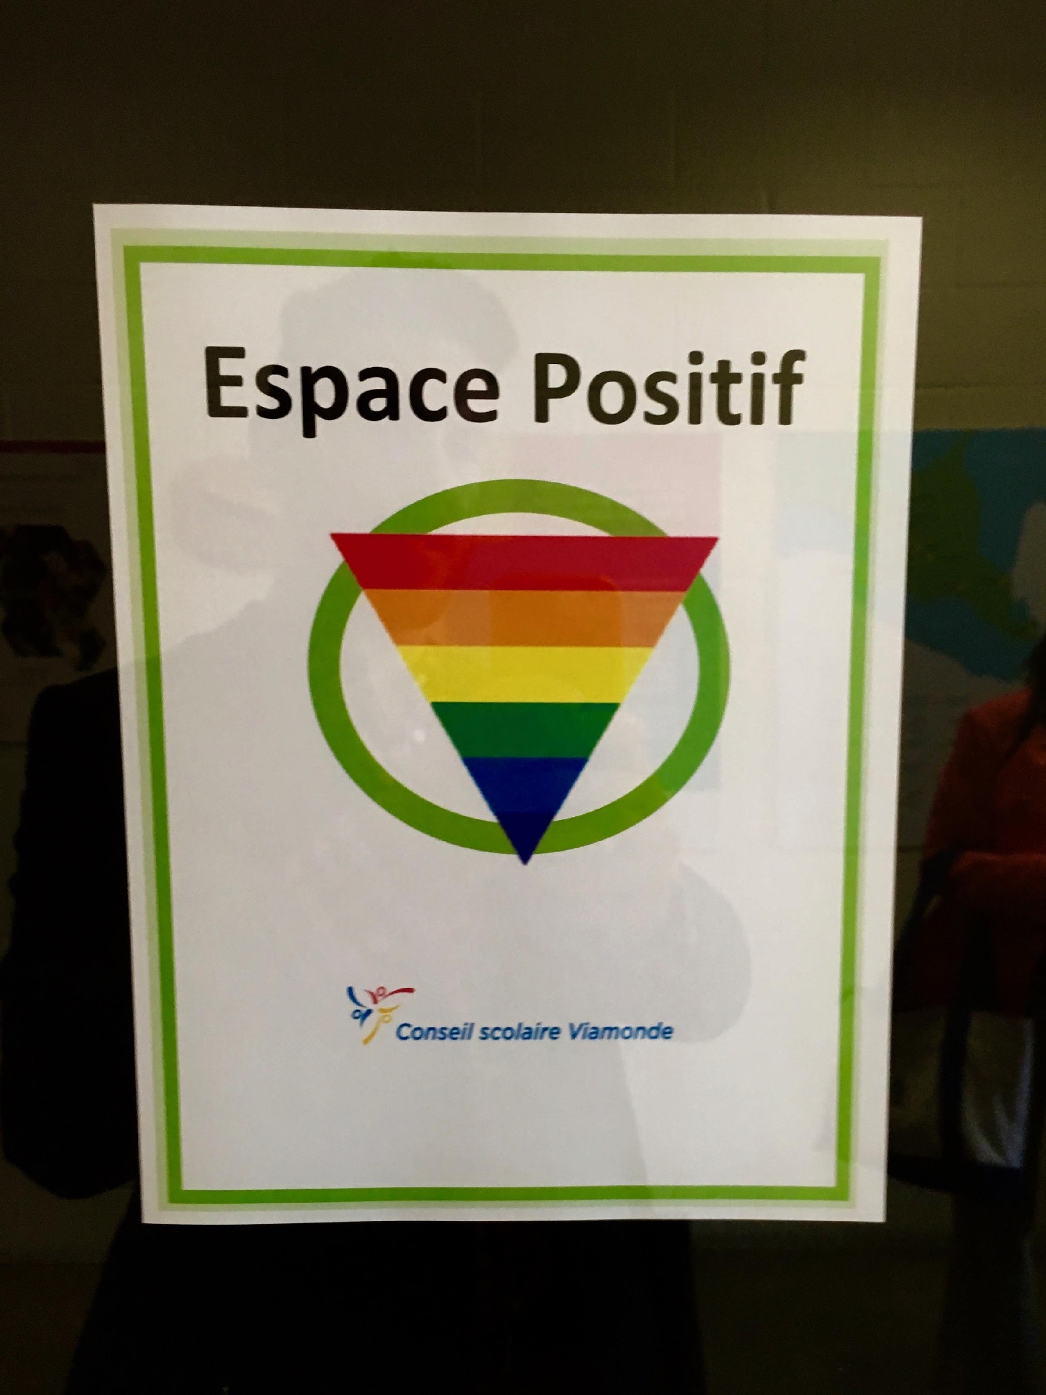
LGBTQ+
Identities
HUNANIAETHAU
LGBTQ+
Deddf Ysgolion Diogel a Derbyngar… yn yr hanfod, mae’n dweud bod yr ysgol yn gyfrifol am ddarparu hinsawdd ddiogel a derbyngar ar gyfer dysgu. Nid oes unrhyw un arall yn gyfrifol; cyfrifoldeb yr ysgol ydyw, mewn gwirionedd.
Mae hefyd yn rhestru rhai elfennau, er enghraifft pethau sy’n ymwneud â rhywedd neu dueddfrydau amrywiol.
The Safe and Accepting Schools Act…basically says it is the school's responsibility to provide a safe and accepting climate for learning. It's not anybody else's responsibility, it's really the school's responsibility.
…it actually lists also some of the elements, for example things to do with gender or diversity of orientations.

Slide 60

Hunaniaethau Coll
Missing Identities
Notes:
PISA has a specific focus for each cycle
The next slide shows Norway’s position for each of the core areas vis-à-vis other countries

Slide 61

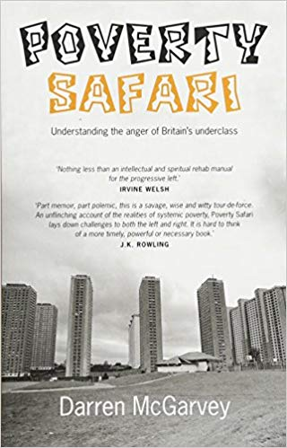

Slide 62
4. Ymgysylltu
4. Engagement

Slide 63
Nid oes llawer o gyflawniad heb ymgysylltiad
There is little achievement without engagement

Slide 64
Dysgu → Ymgysylltu → Cyflawni
NID
Profi → Cyflawni → Dysgu
Learning → Engagement → Achievement
NOT
Testing → Achievement → Learning

Slide 65
Nid yw ymgysylltu’n ymwneud â mwy o berthnasedd, technoleg na hwyl.
Mae’n ymwneud ag adnabod eich myfyrwyr, ymgysylltu â’u diddordebau a’u cyflwyno i rai newydd.
Engagement isn’t simply about more relevance, technology, or fun.
It’s about knowing your students, connecting with their interests, and introducing them to new ones.

Slide 66
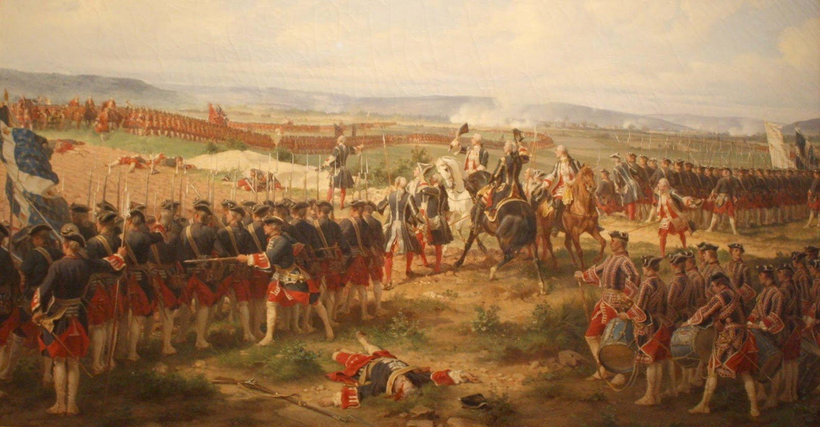
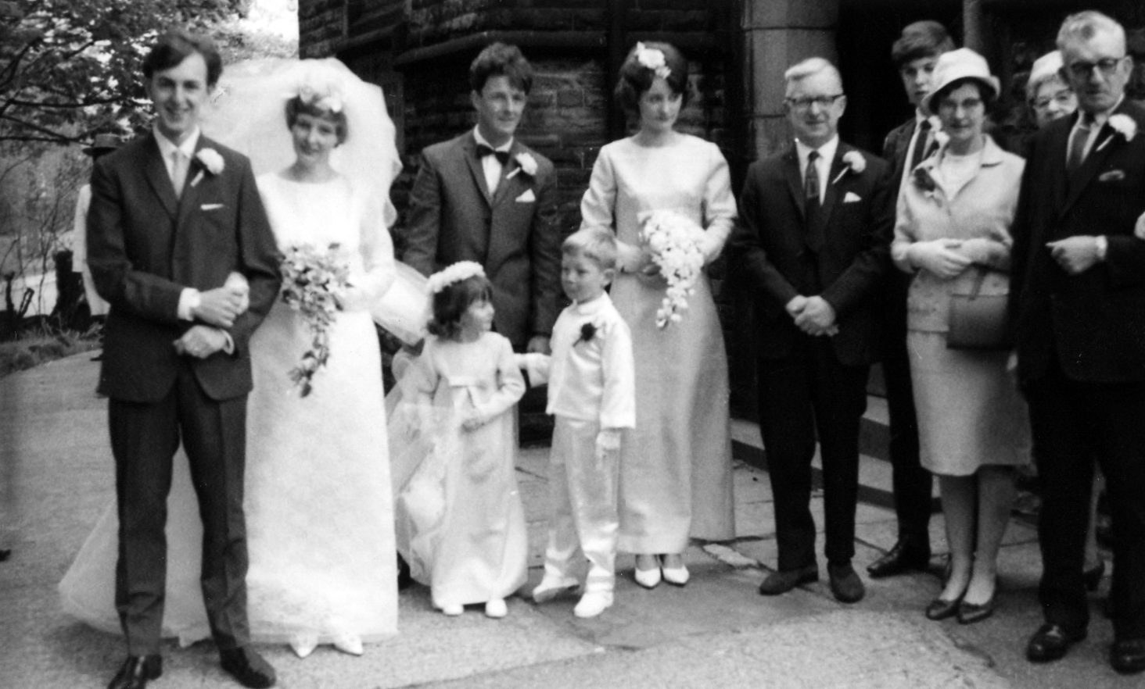
“Terms of Engagement”
Brwydr neu ymladd rhwng byddinoedd neu lyngesau
Y sefyllfa o fod wedi ymrwymo i briodi (dyweddïo)
State of having entered into a promise of marriage
A battle or fight between armies or fleets

Slide 67
Three Dimensions of Student Engagement
TRI DIMENSIWN
YMGYSYLLTU Â MYFYRWYR
Emosiynol
Gwybyddol
Ymddygiadol
Emotional
Cognitive
Behavioural

Slide 68
Five Forms of Engagement
PUM MATH O YMGYSYLLTIAD
Cynhenid
Intrinsic
Pwysig
Defnyddiol
Important
Useful
Gwerth yr Ymdrech
Worth the Effort
Mastery
Mastery
Meistrolaeth
Mastery

Slide 69

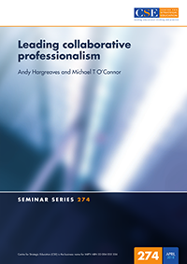

Slide 70
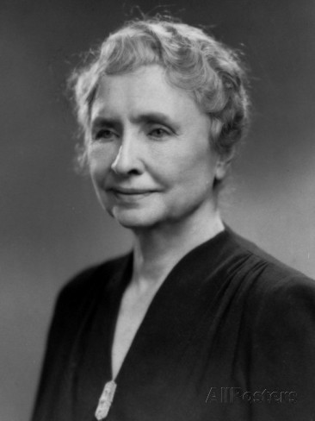
“Mae cerdded gyda ffrind yn y tywyllwch
yn well na cherdded ar eich pen eich hun yn y goleuni.”
“Walking with a friend in the dark
is better than walking alone in the light.”
Helen Keller

Slide 71
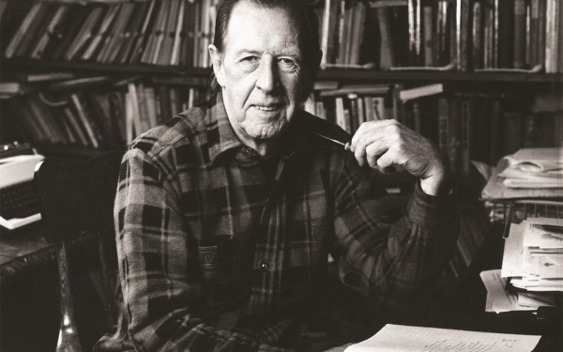
“Mae bod yn wirioneddol radical yn ymwneud â gwneud gobaith yn bosibl yn hytrach na gwneud anobaith yn anochel.”
“To be truly radical is to make hope possible rather than despair inevitable.”
Raymond Williams

Slide 72
Diolch
Thank you

Slide 73
Angela Jardine
Cadeirydd, Cyngor y Gweithlu Addysg
Chairperson, Education Workforce Council
#SiaradProff19 #ProfSpeak19

Slide 74
Diolch
Thank you
#SiaradProff19 #ProfSpeak19

