Slide 1



Quality Teaching Rounds Empowering teachers to enhance professional practice and student learning
Laureate Professor Jennifer Gore
The University of Newcastle
Presentation for Education Workforce Council Wales | May 22, 2018

Slide 2
QUALITY TEACHING MODEL
Comprehensive pedagogical model, knowledge base for teaching, shared language for teachers
Quality Teaching
QT
QTR

Slide 3
QUALITY TEACHING MODEL
Comprehensive pedagogical model, knowledge base for teaching, shared language for teachers
QUALITY TEACHING
ROUNDS
PD approach, collaborative analysis of lessons, builds confidence and relationships, enhances teaching culture
Quality Teaching
QT
QTR

Slide 4
QUALITY TEACHING MODEL
Comprehensive pedagogical model, knowledge base for teaching, shared language for teachers
QUALITY TEACHING
ROUNDS
PD approach, collaborative analysis of lessons, builds confidence and relationships, enhances teaching culture
Quality Teaching
QT
RANDOMISED
CONTROLLED TRIAL
192 teachers, 24 schools, 1,073 observations, and 164 interviews
Impact on teaching and morale, at all career stages

Slide 5
QUALITY TEACHING MODEL
Comprehensive pedagogical model, knowledge base for teaching, shared language for teachers
QUALITY TEACHING
ROUNDS
PD approach, collaborative analysis of lessons, builds confidence and relationships, enhances teaching culture
Quality Teaching
QT
QTR
RANDOMISED
CONTROLLED TRIAL
192 teachers, 24 schools, 1,073 observations, and 164 interviews
Impact on teaching and morale, at all career stages
NEXT
QUESTIONS
Impact on student outcomes
Sustainability
Translatability

Slide 6
Improving teaching: global solutions
Recruiting ‘better’ quality teachers
Measuring/evaluating the quality of teaching
Enhancing professional learning
  To teach well, teachers need to know what constitutes quality
  PD processes are not enough

Slide 7
Complex field of professional learning
DESIGN
Design of approach to professional development
PROCESSES
IMPACT
Support such as protocols, leadership, facilitation
Teacher learning, teaching practice, student outcomes

Slide 8
We have worked, collectively and separately, in dozens of school districts where there was no common point of view on instruction, where ten educators from the same district could watch a fifteen-minute classroom video and have ten different opinions about its quality, ranging the full gamut from high praise to excoriation. Gaining an explicit and widely held view of what constitutes good teaching and learning in your setting is a first step toward any systematic efforts to scaling up quality.
City et al. (2009, p. 173)

Slide 9
Politely refraining from critique and challenge, teachers have no forum for debating and improving their understandings. To the extent that teaching remains a smorgasbord of alternatives … there is no basis for comparing or choosing from among alternatives, no basis for real and helpful debate. This lack impedes the capacity to grow.
Ball (1994)

Slide 10
Quality Teaching model
Antecedents were Authentic Pedagogy and Productive Pedagogy
Not just about teaching practices, but about ‘the practice of teaching’
Implemented initially in NSW (NSW DET, 2003, 2005) and the ACT
Applicable across all year levels and subject areas

Slide 11
Quality Teaching model
3 dimensions and 18 elements
Intellectual Quality | Quality Learning Environment | Significance
Deep knowledge | Explicit quality criteria | Background knowledge
Deep understanding | Engagement | Cultural knowledge
Problematic knowledge | High expectations | Knowledge integration
Higher order thinking | Social support | Inclusivity
Metalanguage | Students’ self-regulation | Connectedness
Substantive communication | Student direction | Narrative

Slide 12
Example QT coding scale
DEEP KNOWLEDGE To what extent does the knowledge addressed in the lesson focus on a small number of key concepts and the relationships between them?
1 | Almost all of the content knowledge of the lesson is shallow because it does not deal with significant concepts or ideas.
2 | Some key concepts and ideas are mentioned or covered by the teacher or students, but only at a superficial level.
3 | Knowledge is treated unevenly during instruction. A significant idea may be addressed as part of the lesson, but in general the focus on key concepts and ideas is not sustained throughout the lesson.
4 | Most of the content knowledge of the lesson is deep. Sustained focus on central concepts or ideas is occasionally interrupted by superficial or unrelated ideas or concepts.
5 | Knowledge is deep because focus is sustained on key ideas or concepts throughout the lesson.
(NSW DEC, 2003)

Slide 13
Quality Teaching model
.
Instructional Rounds
Professional Learning Community
Quality Teaching Rounds

Slide 14
Quality Teaching
A lens through which to comprehensively notice and assess what is happening in any lesson – both for the teacher and for the students
A tool for the systematic and specific analysis of lesson quality
A focus on the lesson rather than the teacher
A framework from which to commence analytical conversations

Slide 15
Quality Teaching Rounds: the process
Reading discussion – to develop shared knowledge base and build sense of professional community
Observation – one PLC member teaches a lesson observed by the others
Individual coding – by all participants, including the teacher
Discussion – of the observed lesson, and of teaching in general, drawing on the language and concepts of the Quality Teaching model and working towards a shared view for each element

Slide 16
Quality Teaching Rounds: essential features
At least three teachers in each PLC
Full participation; all members ‘host’ a round
Focus on teaching ‘regular’ lessons
Entire lesson to be observed
Time for individual coding and analysis (30 mins)
Discussion in which each member provides codes, evidence and justification in relation to QT Classroom Practice Guide (1–2 hrs)
Commitment to confidentiality

Slide 17
It’s good to have a professional conversation. … If you are talking to somebody else … in the school [you’re] usually not talking about your professional practice, you’re talking about that [kid] has done this, or we’ve got to get that marking done, or reports are due, or ‘oh, your playground duty’. It’s all work related, not practice related. So it was good to have a professional practice related conversation, not just work.
“
– Allana, secondary teacher of 4 to 6 years

Slide 18
The process of having the professional reading, the observation and the coding immediately afterwards I think is a very good process and you get to think about the elements and then you actually discuss and see if your interpretation of the elements is the same as the other people in your group and that then enables you to reflect more on what you’re doing in your classroom for every lesson, I think.
“
– Michelle, secondary teacher of more than 24 years

Slide 19
So I remember the conversation afterwards and, to be honest with you, I can’t even remember how the lesson was coded. But I remember the positive feeling of at the end of the day, driving home thinking, wow, I didn’t feel threatened. I didn’t feel that there was any negativity. I didn’t feel criticised. Yet, my lesson was critiqued but I didn’t feel criticised. It was all very positive.
”
– Michael, secondary teacher of 13 to 15 years

Slide 20
I know there’s no turning back, I’d never go back to the way I was teaching, even though I thought it was fine and getting good results and that. It wasn’t as exciting as teaching is now. Like now I guess I’ve been re-energised to teach in a different way…You know, it’s a big awakening too, just cruising along the way I was, which was getting through to them and doing the things you had to do and following the syllabus and all this kind of thing, but it wasn’t exciting. And now I’m excited about it. It’s not the humdrum, it’s great stuff all the time.
”
– Emma, primary teacher of 16 to 18 years

Slide 21
How is QTR different to other PD?
Broader scope of inquiry, addressing the multi-dimensional nature of teaching through the QT model
Comparatively less sustained time commitment necessary to achieve substantial learning
Observation of whole lessons for deeper and more critical analysis
All PLC members code lessons, including the host teacher, as a precursor to discussion

Slide 22
A randomised controlled trial
Two lesson observations per teacher for 192 teachers in 24 schools before QT Rounds, at 6 months following the intervention, at 12 months as indication of sustainability (1,073 lesson observations)
Supplemented by survey, interview and case study data on how participation in QT Rounds impacts on teachers’ identities, teaching culture and teachers’ career commitments

Slide 23
All schools that wanted to participate (n = 243)
Primary schools
SECTOR
Secondary schools
Urban
Rural
LOCATION
Urban
Rural
Low SES
High SES
All
SES
SES
Low SES
Mid
SES
High SES
All
SES
Mid
SES
QTR-SET
QTR-CHOICE
CONTROL
QTR-S
n = 4
QTR-C
n = 4
Control
n = 4
QTR-S
n = 4
QTR-C
n = 4
Control
n = 4
Notes:
School sample stratification
Note. The number of schools in the final row is the final study sample n = 24.

Slide 24
Control
No QT Rounds until study completion
.
QTR-Choice
1 set of QT Rounds
Choice in PLC size
QTR-Set
2 sets of QT Rounds
4 teachers per PLC
Group randomisation

Slide 25
Representative teachers
75% female
9% from language backgrounds other than English
Average age 38 years
20% < four years of teaching experience
25% > 16 years of teaching experience

Slide 26
Diverse schools
Primary and secondary, urban and rural
Students with language backgrounds other than English – 2% to 92%
Indigenous students – 0% to 62%
School index of relative socio-educational advantage – 766 to 1209

Slide 27
Quality Teaching by group allocation
d = 0.5
d = 0.4
d = 0.4
d = 0.2
QTR Set
QTR Choice
Control

Slide 28
Quality Teaching by group allocation
per protocol
d = 0.5
d = 0.5
d = 0.5
d = 0.4
QTR Set
QTR Choice
Control

Slide 29
Quality Teaching by years of experience

Slide 30
Impact on morale
School Organisational Health Questionnaire (Hart et al., 2000)
Consisted of 5 items on a 5 point scale where 1 = ‘Strongly disagree’ and 5 = ‘Strongly agree’
Includes questions on issues such as:
  Team spirit
  Enthusiasm for work
  Energy in the school
  Pride within the school

Slide 31
Teacher morale by group allocation
d = 0.6
d = 0.4
Control
QTR Set
QTR Choice
d = 0.4
d = 0.1

Slide 32
Impact on appraisal and recognition
School Organisational Health Questionnaire (Hart et al., 2000)
Consisted of 5 items on a 5 point scale where 1 = ‘Strongly disagree’ and 5 = ‘Strongly agree’
Includes questions on issues such as:
  Receiving feedback on performance
  Opportunities to discuss performance
  Recognition of good work
  Receiving encouragement

Slide 33
Appraisal and recognition by group allocation
d = 0.5
Control
d = 0.4
d = 0.4
d = 0.3
QTR Set
QTR Choice

Slide 34
Underlying mechanisms
Structures the knowledge base for teaching
Flattens power hierarchies to enhance collaboration
Enhances relationships to build a culture of learning among teachers

Slide 35
And it’s good to work with people that I don’t normally work with. …I’ve got to know one lady … I didn’t even realise she was a teacher here before… I thought she was just a parent that didn’t leave! … I’ve actually been involved in her lessons and got to know her through this, and her passion – it’s been good.
“
– Tessa, primary teacher of 10 to 12 years

Slide 36
They did not like me, and I did not like them, and it was only on hearsay and reputation alone…. But when I was in the room with them and working with them, I respected them and I learned to trust them and I learned who they really were.
“
– Karen, secondary teacher of 19 to 21 years

Slide 37
Quality Teaching Rounds
QT Rounds conceptualises “the problem” in teacher development as one of an inadequate knowledge base which contributes to feelings of insecurity, vulnerability, and a lack of confidence among teachers. Such feelings mitigate their growth and both their opportunity and their capacity to engage in collaborative critical analytical work. In effect, without greater guidance, we too often ask people in schools to do what they don’t know how to do.

Slide 38
Outcomes
Teachers reported:
Increasing confidence in their own and each other’s capacities
Higher levels of responsibility for student learning
Feeling (re)energized to teach through their experience of QT Rounds
Notes:
Added from Julie’s thesis (if needed)

Slide 39
Initial Teacher Education
The QT model provides concepts and language with which to envisage, discuss and plan for good teaching. It provides a “structure,” for organising teachers’ knowledge and guiding their learning.
QT Rounds position beginning teachers as knowledge holders, as contributing members of a group, and as individuals from whom other teachers can learn.

Slide 40
Transitioning to the workforce
QT Rounds helped beginning teachers to transition from seeing themselves as new teachers to becoming colleagues in a profession in which everyone is still learning.

Slide 41
Continuing Professional Development
The problem of uptake among experienced teachers may lie less in ageist assumptions about their resistance to change, than in the nature of the CPD on offer.
When CPD is perceived as relevant and meaningful, experienced teachers will eagerly engage.

Slide 42
A more appropriate solution?
Improving teaching in order to improve pupils’ learning depends, in large part, on teachers’ confidence in themselves and each other and not only on public confidence (or lack thereof) in teachers, borne of greater accountability.

Slide 43
Complex field of professional learning
DESIGN
Design of approach to professional development
PROCESSES
IMPACT
Quality Teaching Rounds
Teacher learning, teaching practice, student outcomes
✓

Slide 44
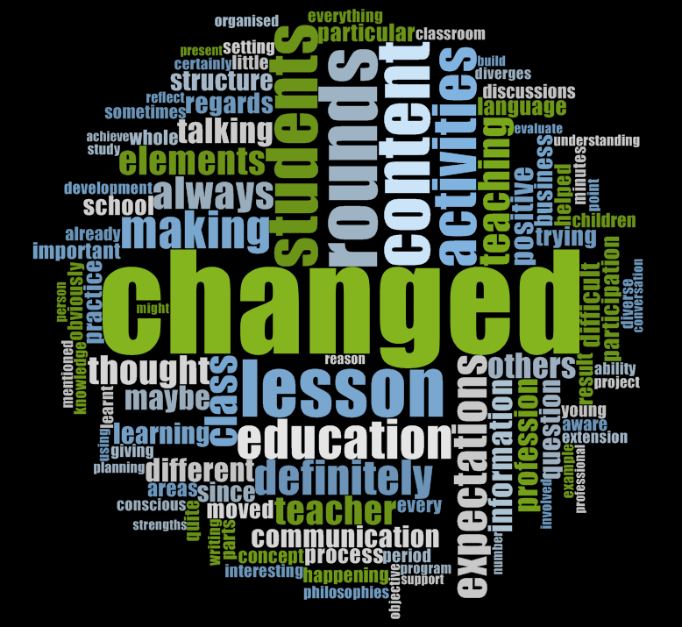
Impact of QTR
Notes:
Chart is animated.
Minimum score = 1, maximum score = 6, Midpoint = 3.5
Black p values indicate the significant outcomes of post hoc hypothesis testing between groups at 6 months and 12 months.
Coloured p and Cohen’s d refer to within group effects.
Group-by-time p value is the overall group effect over time (if significant there is a significant overall group effect over the duration of the study)
Cronbach α = .93
The Control group exhibited a significant decline in morale means over time.
QTR Set and Choice intervention were significantly higher morale than the control group from B to 12

Slide 45
Laureate Professor Jennifer Gore
Director, Teachers and Teaching Research Centre
Editor-in-Chief, Teaching and Teacher Education (Elsevier)
School of Education, Faculty of Education and Arts
The University of Newcastle, Australia
www.newcastle.edu.au/profile/jenny-gore
jenny.gore@newcastle.edu.au
Connect with us on Twitter! @UON_TTRC
Email us at QTR@newcastle.edu.au

