Slide 1

Successful Futures through Outdoor Learning
Natural Resources Wales

Slide 2
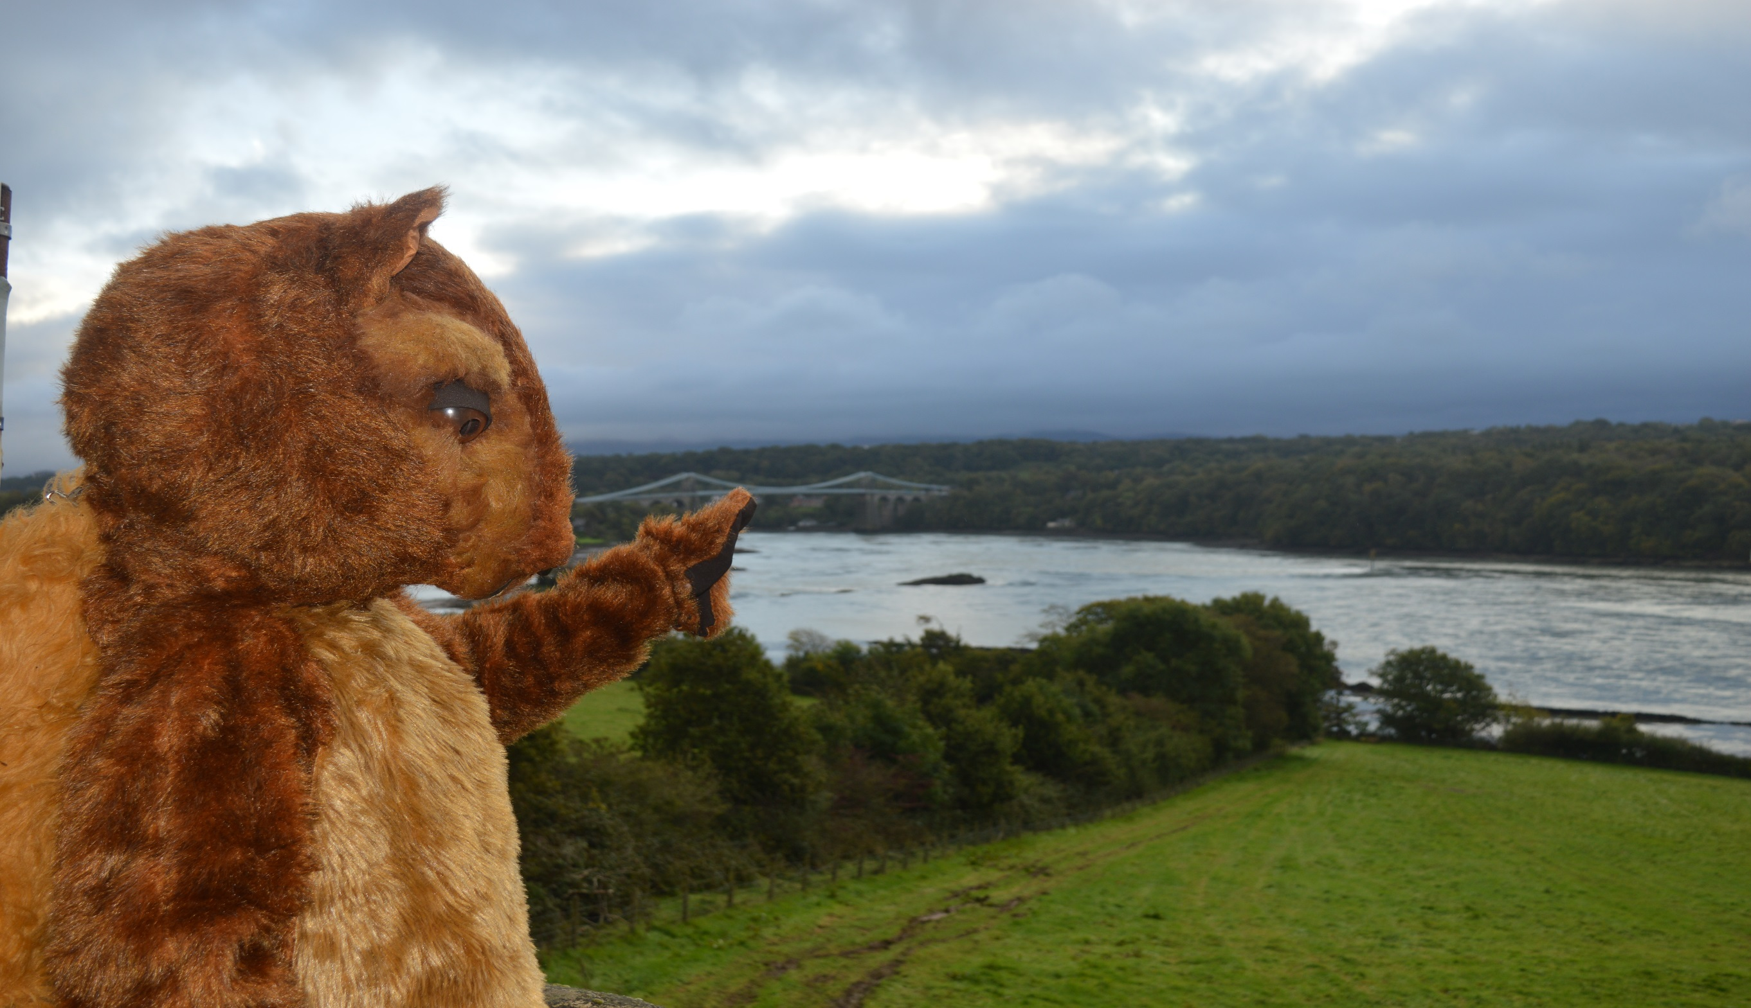
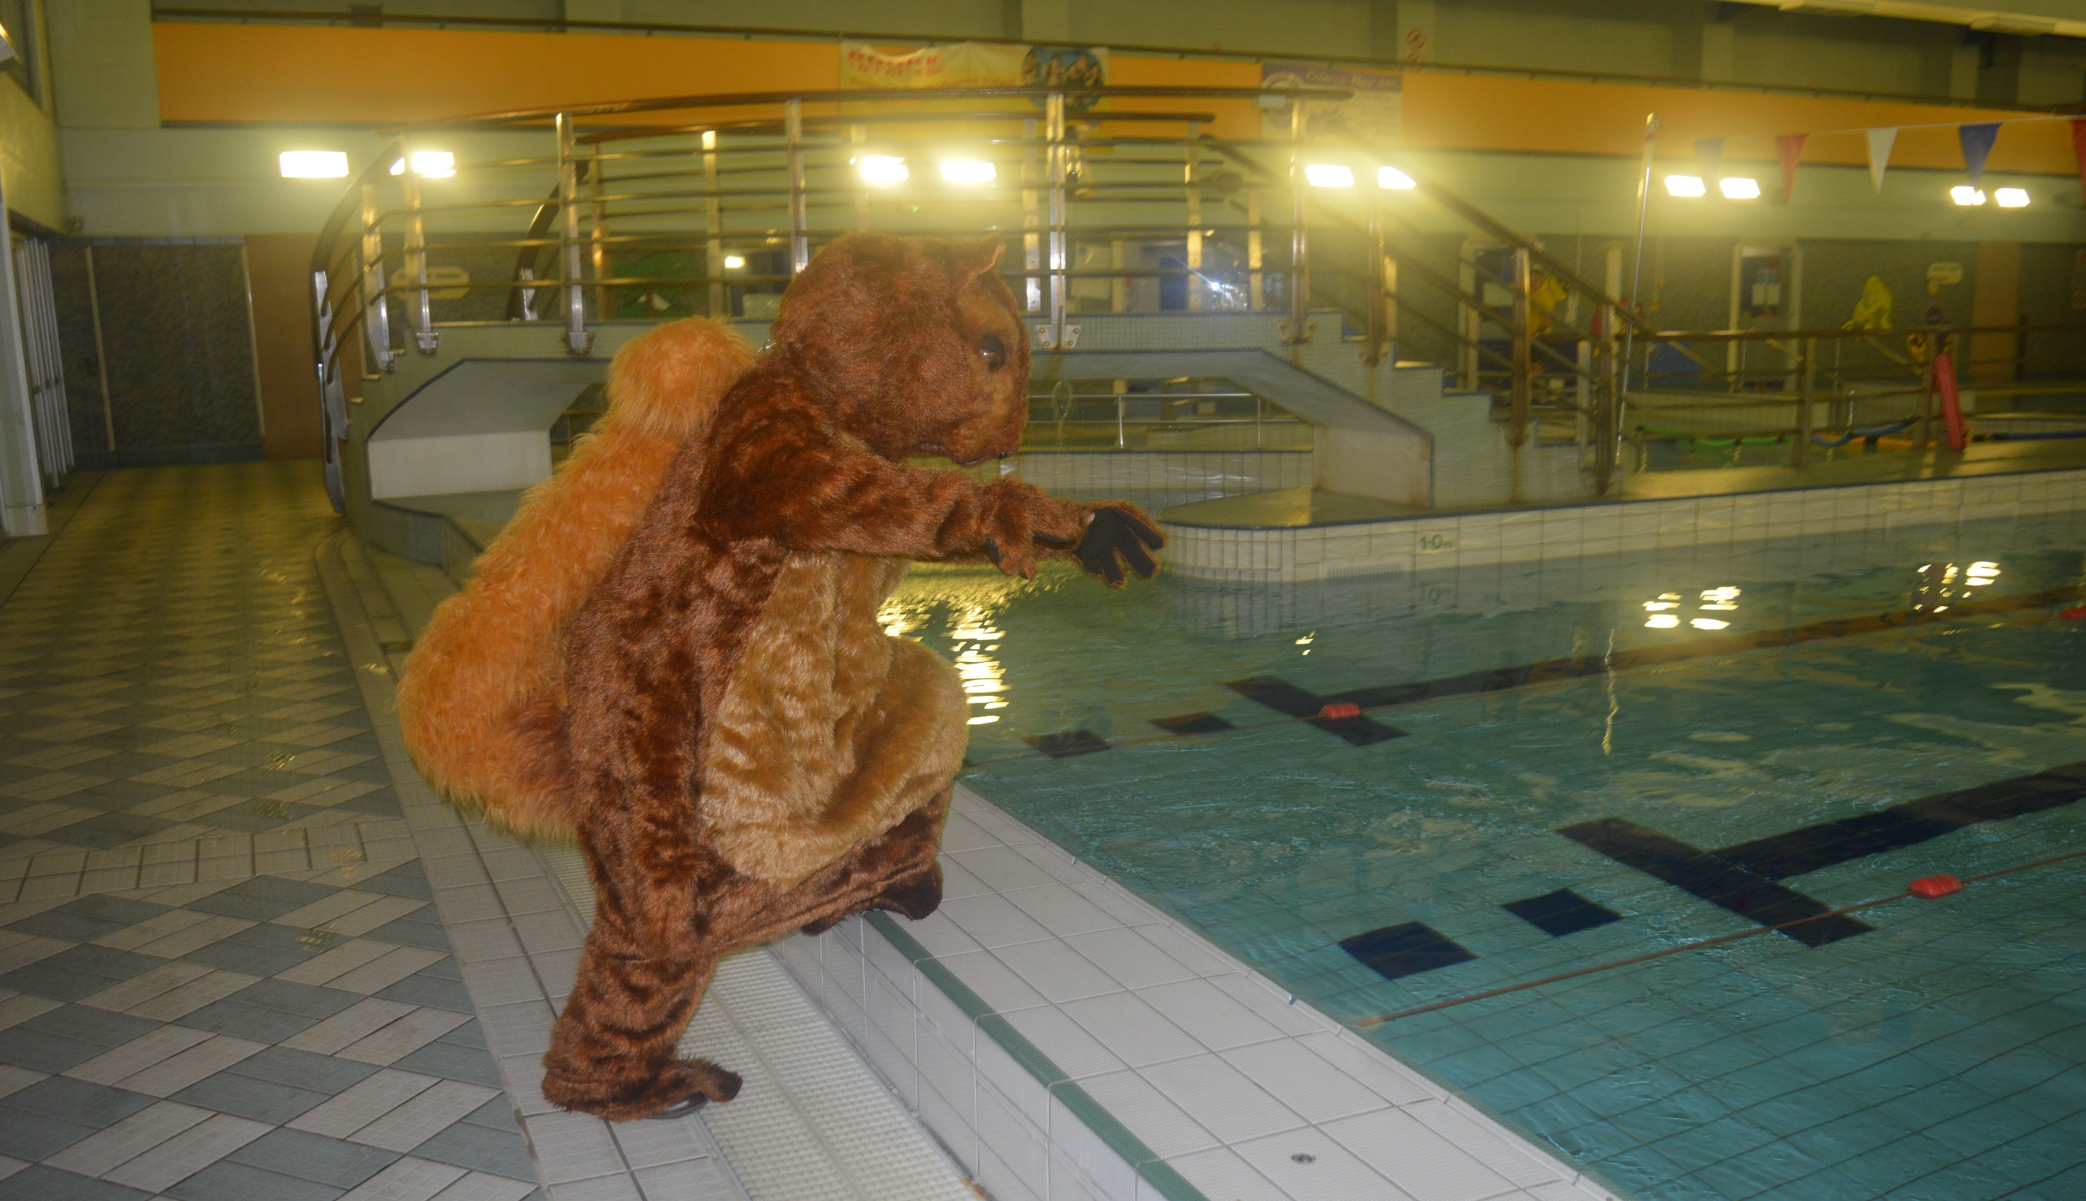
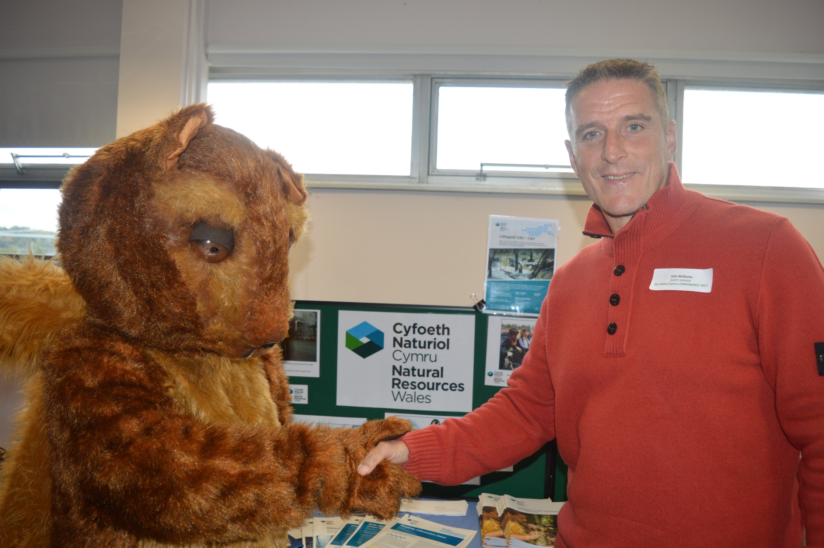

Slide 3
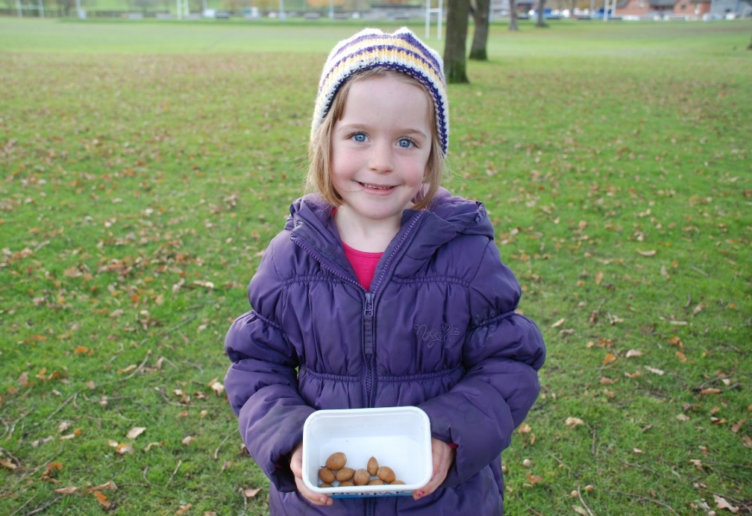
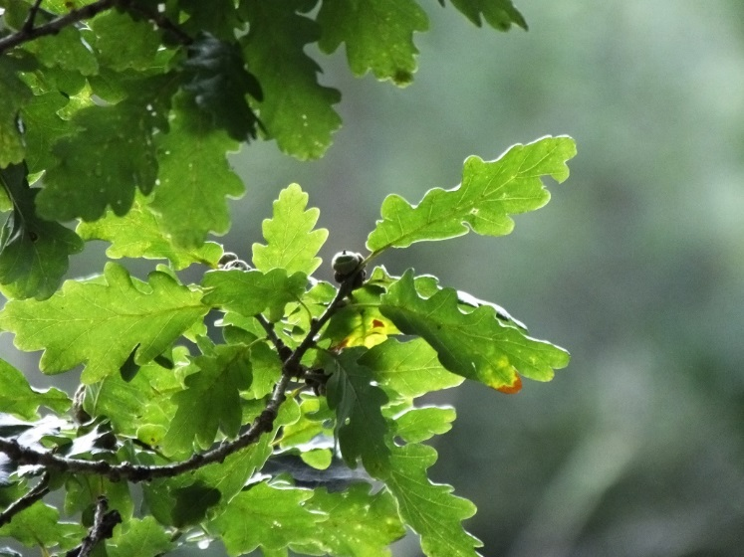
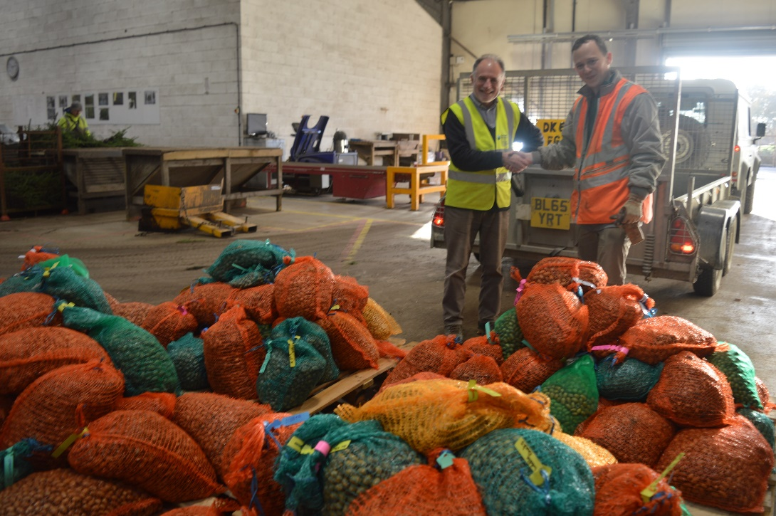
Acorn Antics 2018

Slide 5
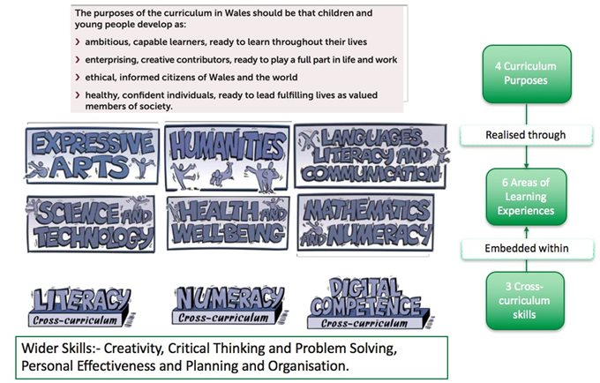

Successful Futures

Slide 6
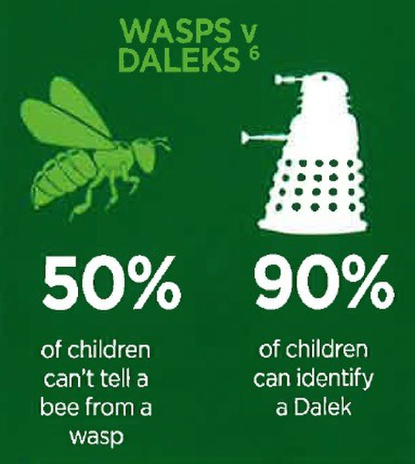

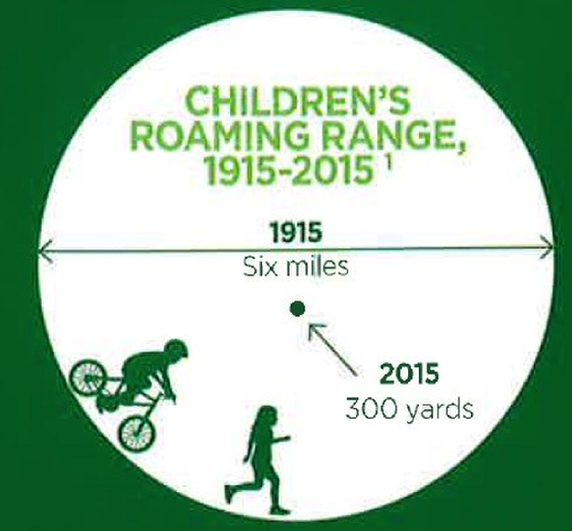

The Damage of Disconnection
A Connection to Nature provides multiple life long benefits

Slide 7
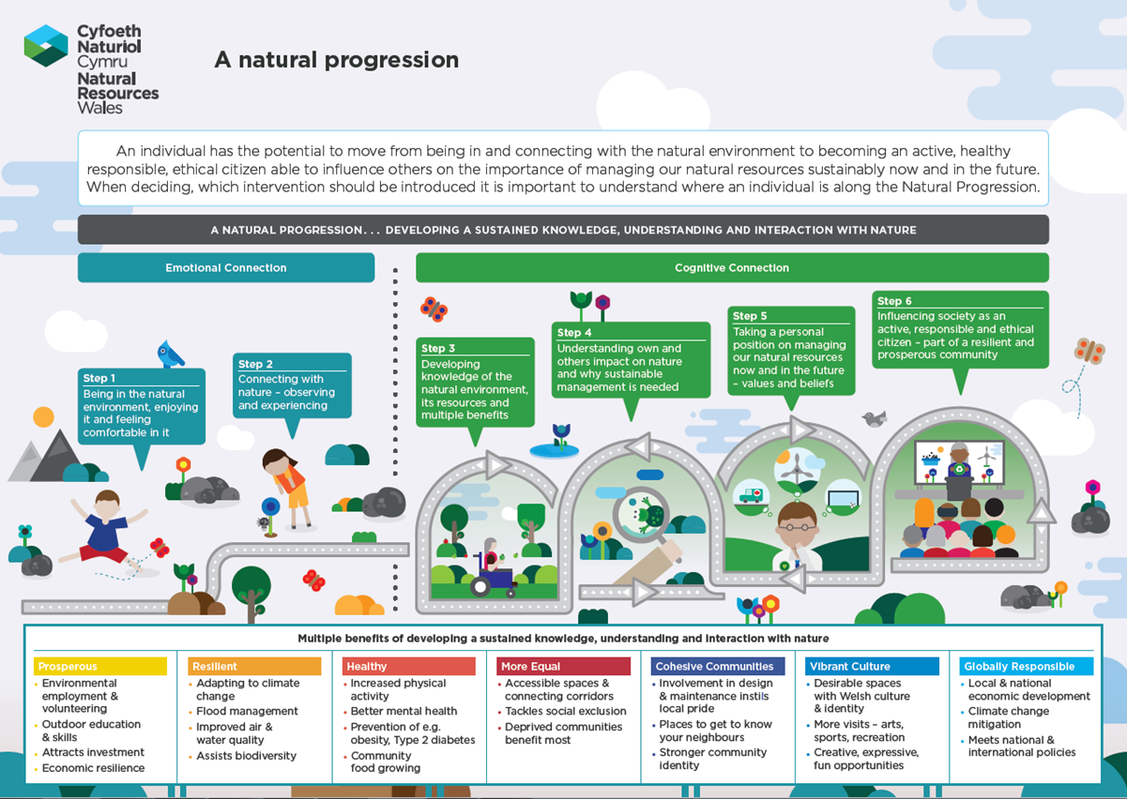
Fostering a Connection to Nature provides multiple long benefits

Slide 8
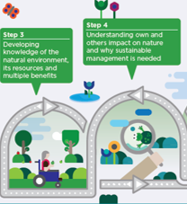
Fostering a Connection to Nature provides multiple life long benefits
Steps 3 & 4
What you can do…influence, advise and provide
Provide direct learning opportunities
Deliver outdoor learning projects
Influence and advise on existing initiatives
Provide outdoor training and skills for providers
Children are 2.7 times more active during a day learning in the woods than in an average school day
Physical and Mental Wellbeing benefits – Healthy and Confident individuals
Positive Behaviour Change
Skills and Knowledge for Employment

Slide 9
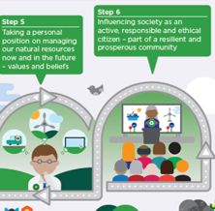
Fostering a Connection to Nature provides multiple lifelong benefits
Steps 5 & 6
What you can do…provide, influence and advise.
Provide or signpost to volunteering, placement opportunities in the outdoors
Influence the preservation and addition of green infrastructure
Advise partners on the multiple benefits
Influence education and training establishments
Physical and Mental Wellbeing benefits – Healthy and Confident individuals
Positive Behaviour Change
Skills and Knowledge for Employment

Slide 10
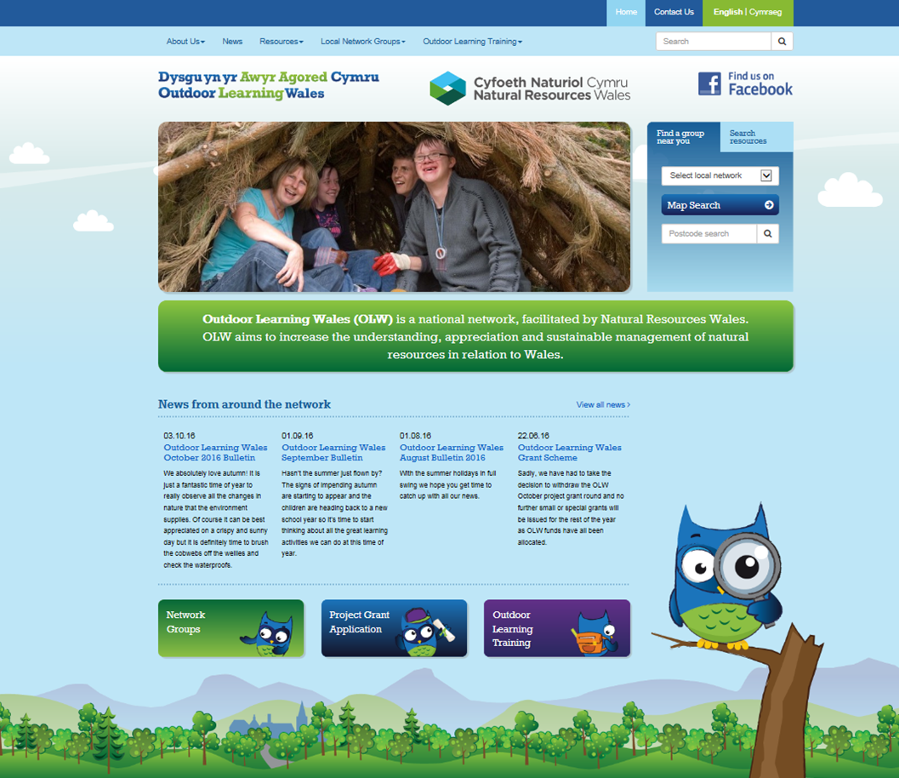


Learning Networks and Partnerships
WCfOL - the national voice for ESDGC and OL
OLW - local place based networks
OLTN - quality assurance for the sector
The Outdoor Learning Sector in Wales is supported by three main networks working together to provide high quality outdoor learning:
Outdoor Learning Wales (OLW)
Wales Council for Outdoor Learning (WCfOL)
Outdoor Learning Training Network (OLTN)
Together they:
provide national and local networking opportunities
provide a voice for the sector
support quality assurance and raise standards across relevant qualifications and training opportunities
ensure the delivery of high quality outdoor learning across Wales

Slide 11

Cysylltwch / Get in touch
Os oes gennych unrhyw broblem neu gwestiwn cysylltwch:
Any problems or queries please get in touch:
addysg@cyfoethnaturiol.cymru
education@naturalresourceswales.gov.uk
0300 065 3000

Slide 12
