Slide 1
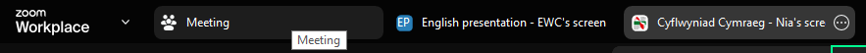
Cyfarwyddiadau ar gyfer dewis eich iaith
Instructions for selecting your language preference
Hofran dros ben eich sgrin i weld yr opsiynau cyflwyno.
I weld y Gymraeg, cliciwch ar y ‘Cyflwyniad Cymraeg’).
Hover over the top of your screen to see the presentation options.
To view the presentation in English, click ‘English presentation’.

Slide 2

Masterclass 2025: The developing brain in a modern educational context
Dr Dean Burnett

Slide 3
The developing brain in a modern educational context
The basics of the brain
How the brain learns and develops, at the biological level
Emotions vs Cognition
The developing brain at different ages (young child, older child, teenager)
Information vs experience
The importance of peers and status (and the effects of lockdown)
Physical v mental health, sport v head injury
The impact of technology on younger brains

Slide 4
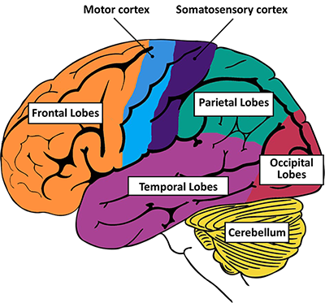
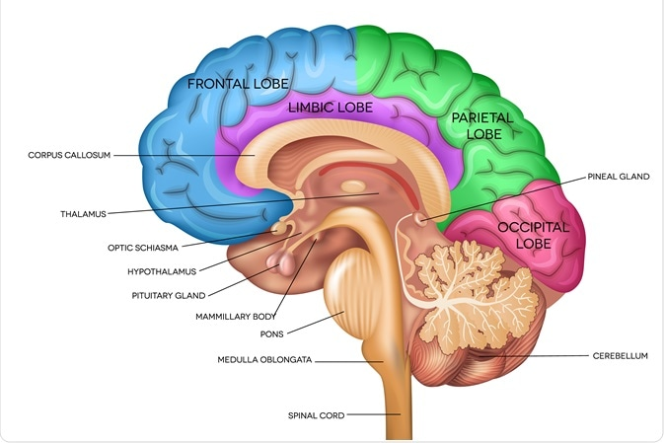
The basics of the brain

Slide 5
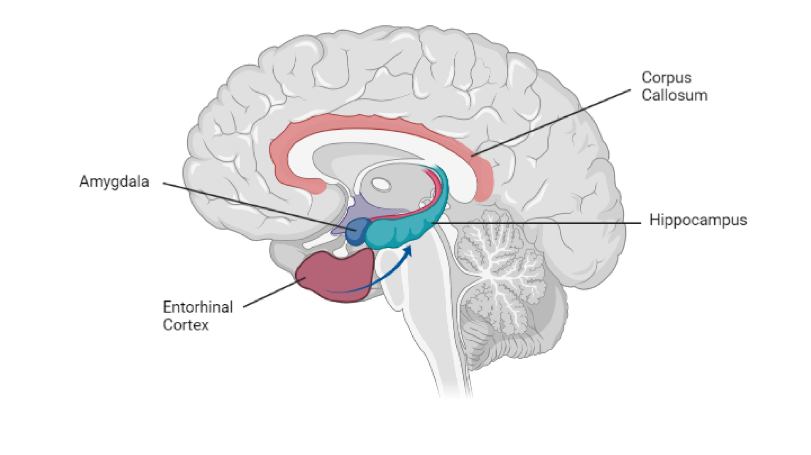
The basics of the brain

Slide 6
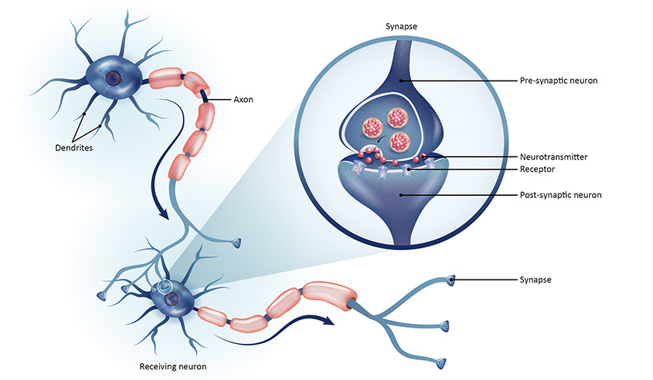
How the brain learns and develops
Everything the brain does is ultimately based on, and the result of, connections between neurons. Synapses.
Everything the brain learns results in new connections formed between brain cells.
These synapses are the building blocks of brain function, and the site of neuroplasticity.

Slide 7
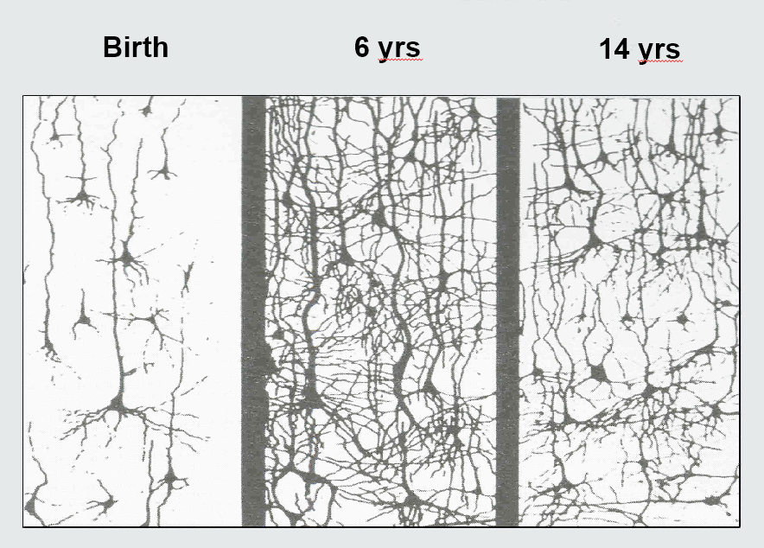
How the brain learns and develops
But it’s not a case of ‘the more the merrier’ with synapses. It’s quality over quantity. The more ‘powerful’ the brain (i.e. the more intellectually capable one) seem to be more efficient. They have brains with better organised and arranged networks. You can see this at work in the developing brains at various ages
Birth
Age 6
Age 14

Slide 8
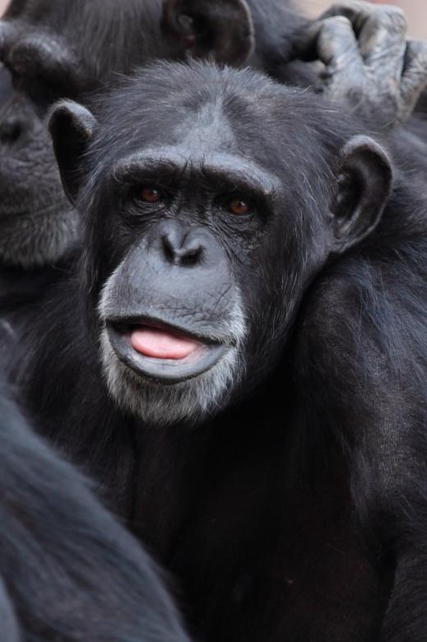
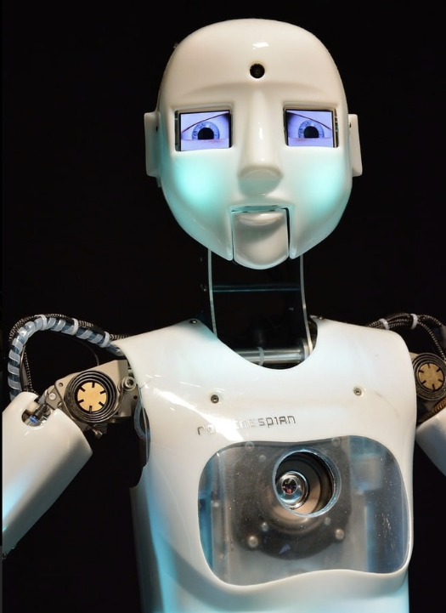
Emotion Vs Cognition
Widely assumed that emotions and cognition (thinking) are two opposite processes, but they’re deeply intertwined.
Emotion = old, fast, powerful, irrational. The precursor of thinking. Still very influential.
Cognition = new, complex, slow, often dominant, but reactive.
Both influence each other. Appraisal of emotions, executive function for cognition

Slide 9
The developing brain, at different ages
Brain development is not a linear process. It has recognised stages. And these have significant effects on an individuals thinking, behaviour, and ability/tendency to learn. Can also determine relationships and interactions with educators and authority figures.
Birth
Age 6
Age 14
NB: This age range is a very loose system, as maturation can be a very individual process, shaped by experience. But there also tend to be reliable milestones.

Slide 10

The developing brain, at different ages (age 0-6)
Period of rapid brain growth, goes from 20% to 80% adult size between birth and age 3.
  Brain is making a LOT of new connections.
Very quick to learn new things
Cognition slower to develop, so emotions more powerful and chaotic
  Tantrums, uncertainty around social norms, underdeveloped ‘Theory of Mind’
    [The ability to understand that other people have their own subjective experience of the world]
Imitation is an important learning tool. ‘Good examples’, etc.

Slide 11

The developing brain, at different ages (age 6-12)
Brain growth slows, but continues
Refines existing abilities, rather than acquiring new ones, and other experiences.
  Ability to focus and pay attention improves, but still not 100% perfect.
Decision making and emotional regulation is better, but all still a work-in-progress.
  You see better self-control and drive for independence.
Social dynamics are increasingly important, but among the most complex human concepts to understand.
  Can risk children being held to higher standards/expectations than is reasonable, particularly in learning contexts.
    Tall children. ‘Gifted’ children.

Slide 12

The developing brain, at different ages (The ‘teens’)
Can actually start from age 11, but we refer to ‘teens’
Young brain experiences and ‘overhaul’. All regions are refined and streamlined for independent adulthood
  ‘Pruning’ - unnecessary synapses acquired during childhood are removed en-masse. Decluttered.
Uneven maturation means emotions and simpler processes are upgraded first, cognition and self-control still developing.
  Results in emotions have more ‘impact’ at this age.

Slide 13
The developing brain, at different ages (The ‘teens’)
Hormonal, physical and neurological changes cause much internal chaos, resulting in less predictable behaviour.
Sleep cycle is disrupted/changed, but routine is not. Many teens are sleep deprived, which has behavioural consequences.
Instinctive drive for independence, new relationships and experiences, means teens will often be less receptive to traditional authorities (parents, teachers), and more willing to engage in novelty and risk.

Slide 14

The developing brain, at different ages – factors and issues
Brain development determines how the brain functions, so anything that alters or disrupts it has lasting impacts that can have complex behavioural outcomes.
  ACE (Aversive childhood experiences), Trauma.
  Attachments styles (Secure or insecure/disrupted. Manifest in educational contexts).
  Neurodivergence.
Ultimately, things that have significant emotional impacts and consequences heavily influence understanding of the world in young people.

Slide 15
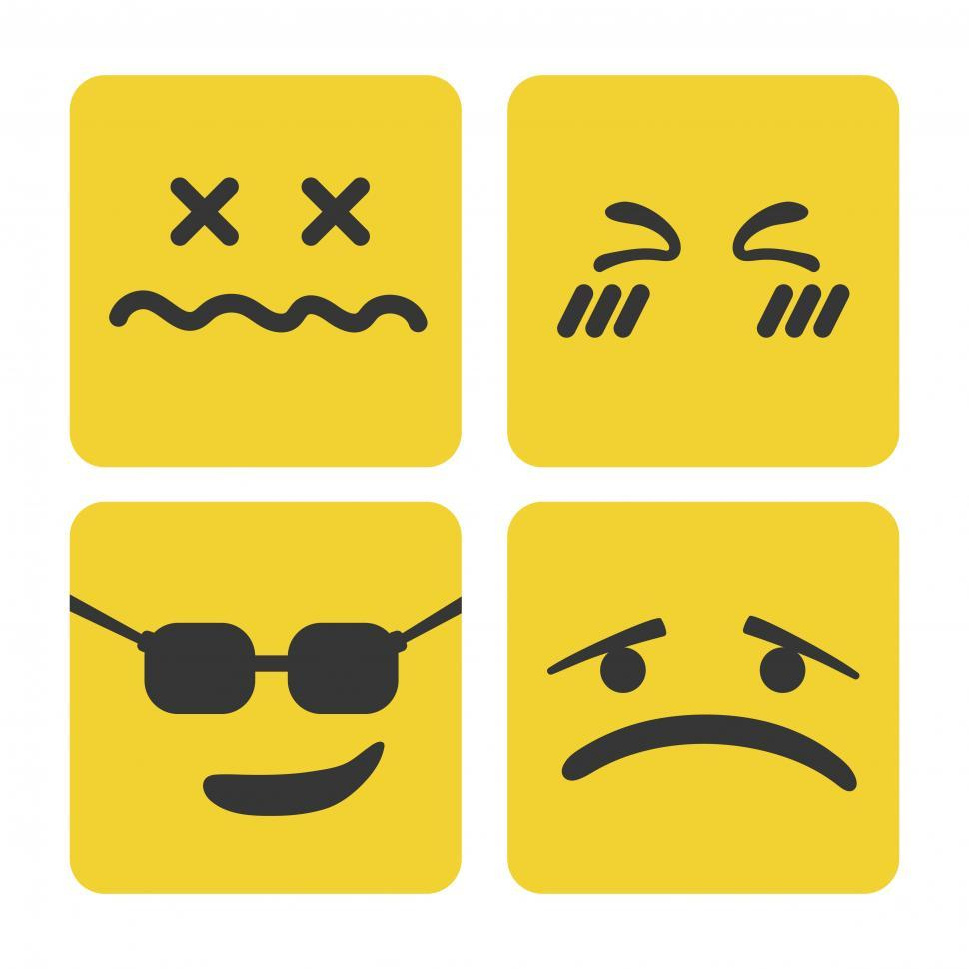
Information vs experience
The human brain evolved to prioritise emotional information. Hence, it’s harder to retain abstract information, no matter how objectively important.
Human sociability and empathy means other people’s interactions tend to dominate.
  Mimicry, role models, influencers etc.
Someone telling them what they want to hear? More appealing than someone telling them what they need to hear (e.g. teachers).
Novelty and risk = more stimulating.
Emotional stimulations + necessary information = ideal combo?

Slide 16


The importance of peers and status
Human are the only ultrasocial species.
Social connections and social standing are vital elements of how we understand both the world and ourselves
  Low social status is strongly linked to poor mental health/wellbeing.
‘Emotional contagion’. Strong emotions in a group setting can easily spread. Disruptive elements thrive.
Role models, good examples, more influential than you might expect.
  ‘Parasocial’ relationships. Much research conducted in an educational context.

Slide 17
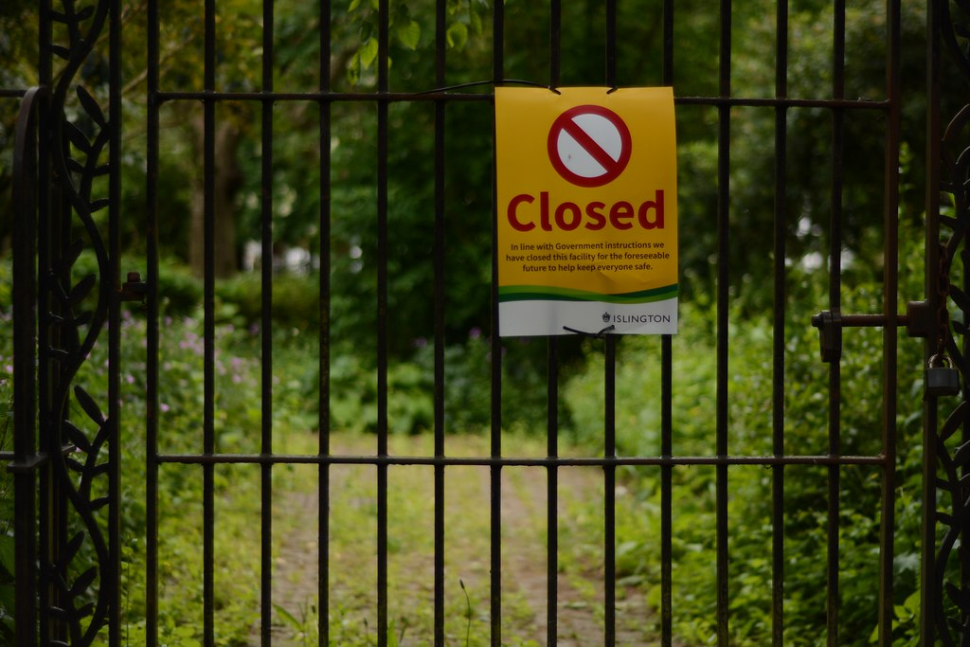
The importance of peers and status – Impact of lockdown?
For younger people, lockdown meant they missed out on social interactions during a key developmental stage. Long term behavioural repercussions? Particularly in educational setting
  Not ‘permanent’, but still a challenge.
Interestingly, adolescent wellbeing was stable, at least at first.
  Removal of typical teen stressors?
Set precedent for attendance being non-essential?
  Arguably adults/parents were even more affected?

Slide 18


Physical v mental health
Sport v head injury
Physical and mental health often discussed as separate things, but they significantly overlap, and both key for wellbeing.
Sport boosts both physical and mental health
BUT risk of head injury often overlooked or ignored
  Particularly an issue with a developing brain.
Brain impact often leads to no symptoms, but long recovery times still essential.
Vital for adults in charge to appreciate and support this
What’s more important, the game, or the player?

Slide 19

The impact of technology on younger brains
However…
  Lack of actual diagnoses doesn’t not mean no issues. Problematic use is a concern.
  Impacts on attention and memory. But not permanent ones.
  Dangerous influences online are a genuine concern. But the good/positive aspects are invariably overlooked.
  Devices in the classroom are a complex issue for teachers.
    Who has authority? Can you confiscate a de
Much attention on the harm technology/smartphones do to young people. But the evidence doesn’t support much of it.
  Little connection between technology exposure and mental health issues. ‘Addiction’ label also over-used.
  Online world is a key part of modern childhood, something many adults ignore.
  Smartphones have increased children’s outdoor activities, not restricted.
  Connections and relationships vital for development, technology makes them easier.
  Imagine the lockdown without them.

Slide 20
The impact of technology on younger brains
However…
  Lack of actual diagnoses doesn’t not mean no issues. Problematic use is a concern.
  Impacts on attention and memory. But not permanent ones.
  Dangerous influences online are a genuine concern. But the good/positive aspects are invariably overlooked.
  Devices in the classroom are a complex issue for teachers.
    Who has authority? Can you confiscate a device so expensive and personal? Can parents overrule teacher’s instructions?

Slide 21
Summary
The development and structure of the brain constantly changes throughout childhood and adolescence, and this has considerable effects on learning and behaviour.
Our emotions have much greater influence over us than many assume, specially when we’re younger. This means negative emotional experiences can have lasting consequences. It also means learning can be enhanced when emotions are incorporated.
When you consider the workings of the brain, the effects of lockdown, sport, head injuries, technology etc. make more sense.

