Slide 1

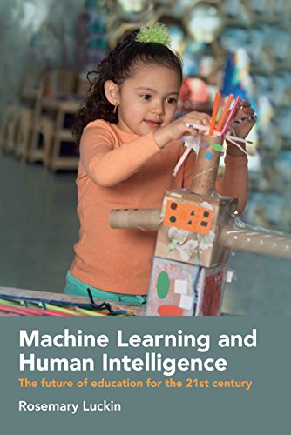



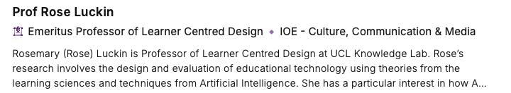
Embracing AI in Education: Opportunities, Challenges, and Ethical Considerations
For all your AI needs: we help you realise the opportunity of AI

Slide 2

What is AI and where are we now with AI?
Why does AI matter to Education?
What does this mean for you?
What should you do?
“Learn Fast Act More Slowly”

Slide 3
What is AI and where are we now with AI?

Slide 4

What is AI?
Technology that analyses its environment and acts with some autonomy to achieve goals

Slide 5
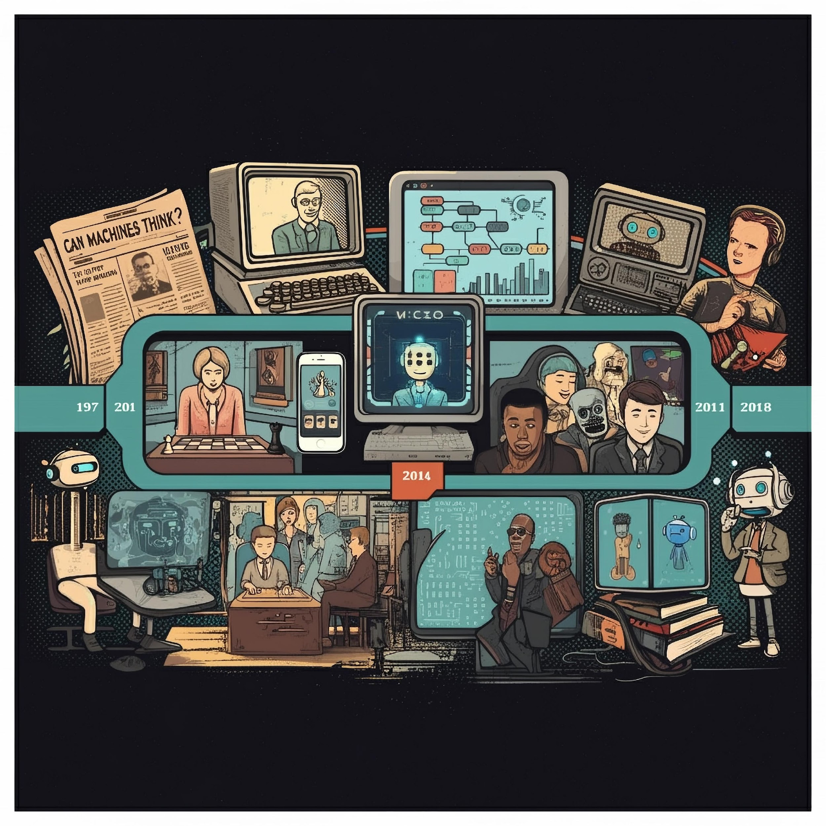

AI is not new
Its history is important
1950
2018
1997
2014
2017

Slide 6

AI Timeline – From Good Old Fashioned AI (GOFAI) to ChatGPT
Automata and other humanoid manifestations are popular
1920: the world Robot is introduced to our language by Karel Čapek
1940: Norbert Wiener: the birth of cybernetics (scientific study of control and communication in animals & machines)
1950: The Turing test “Can Machines Think” and the Turing Test
1956: Dartmouth College meeting and statement - the birth of modern AI
1957: In 1957 Rosenblatt’s perceptron - the first neural network
1960s: The first chatbot called Eliza
1970s: Expert systems
1997: IBM’s Deep Blue wins world chess championship
AI Winter - we realised we had not cracked intelligence - vision is much harder than chess!
Early 2000s: increased interest in machine learning using neural networks and statistical methods.
2009: Convolutional Neural Networks (CNN) introduced
2009: Fei-Fei Li, creates a large dataset reflecting the ‘real world’ ImageNet
2011: Apple integrates Siri to the iPhone
2011: IBM’s Watson wins Jeopardy
2012: Alex Krizhevsky, creates the first CNN, AlexNet based on Fei Fei’s model
2014: A chatbot called Eugene passes the Turing test
2014: Amazon launches Alexa
2017: Google’s AlphaGo beats world champion at board game Go – Deep Neural Networks become the trend
2018: First LLMs created
2022: ChatGPT released and commercial LLMs proliferate
This work is licensed under CC BY-NC-ND 4.0

Slide 7
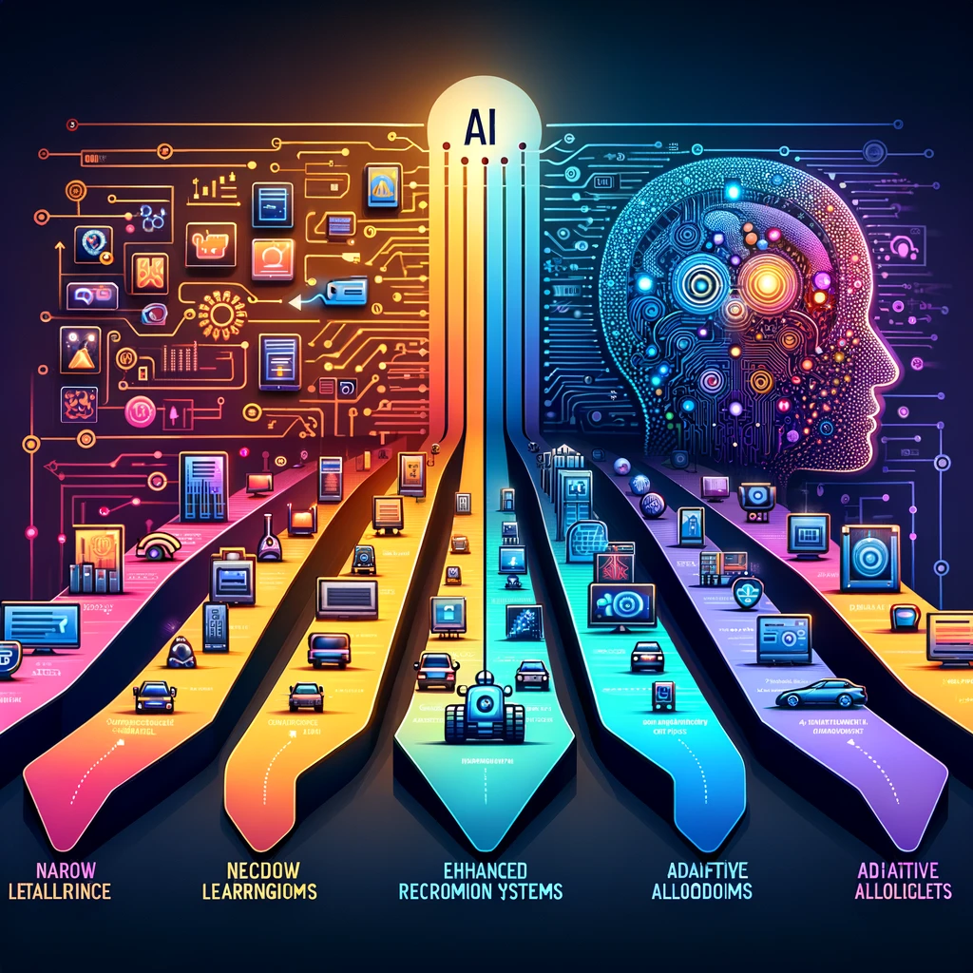
Types of AI
Good Old Fashioned AI (GOFAI): usually rules based;
Machine Learning AI: Neural networks, often with many layers;
Narrow AI: Focuses on a specific task (e.g., playing chess, recommending products);
General AI: Can perform any intellectual task that a human can (not yet achieved).
This work is licensed under CC BY-NC-ND 4.0

Slide 8

What is Generative AI?
Generative AI is a subset of artificial intelligence;
Uses machine learning algorithms to create new, original content;
Trained on vast amounts of data to learn patterns and features;
Can generate content similar to the training data or combine elements to create novel content;
Generative models learn the underlying distribution of the training data;
New content generated then mimics the structure and style of existing data.
This work is licensed under CC BY-NC-ND 4.0

Slide 9


The landscape is changing very quickly…
A perfect storm has brought us here
This work is licensed under CC BY-NC-ND 4.0

Slide 10
The Reality

Slide 11
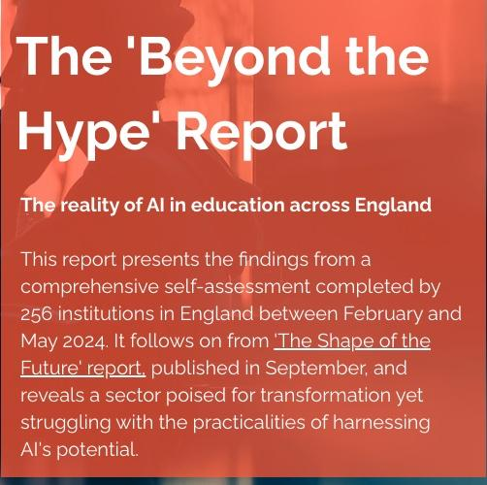
https://www.educateventures.com/beyond-the-hype

Slide 12
The Awareness-Implementation Gap
87% understand general AI concepts
Only 38% confident using AI in classroom
Common uses: Creating teaching resources
  Personalising learning
  Administrative tasks
  Generating feedback
Significant gap between theoretical knowledge and practical application
https://www.educateventures.com/beyond-the-hype

Slide 13
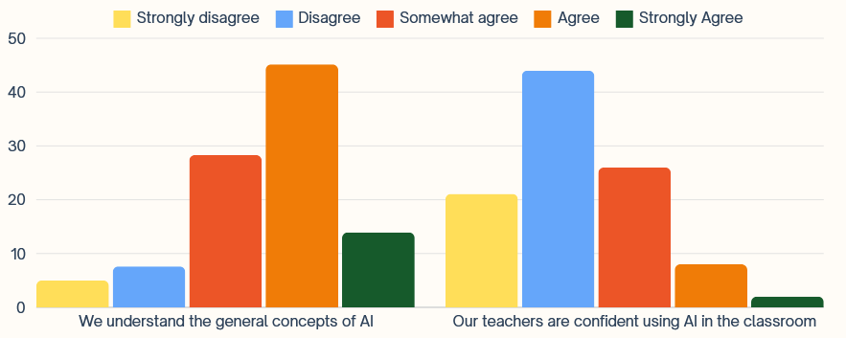
Teacher’s understanding of AI vs how confident they feel using it in the classroom. Y-axis shows percentage of responses
https://www.educateventures.com/beyond-the-hype

Slide 14
Policy and Leadership Challenges
Only 30% have AI policies/strategies in place
Professional development is crucial: Schools with AI-focused CPD show better outcomes
  Stronger identification of educational goals
  Higher AI use by teachers
  More ethical AI practices
Clear need for formal guidance and leadership structures
https://www.educateventures.com/beyond-the-hype

Slide 15
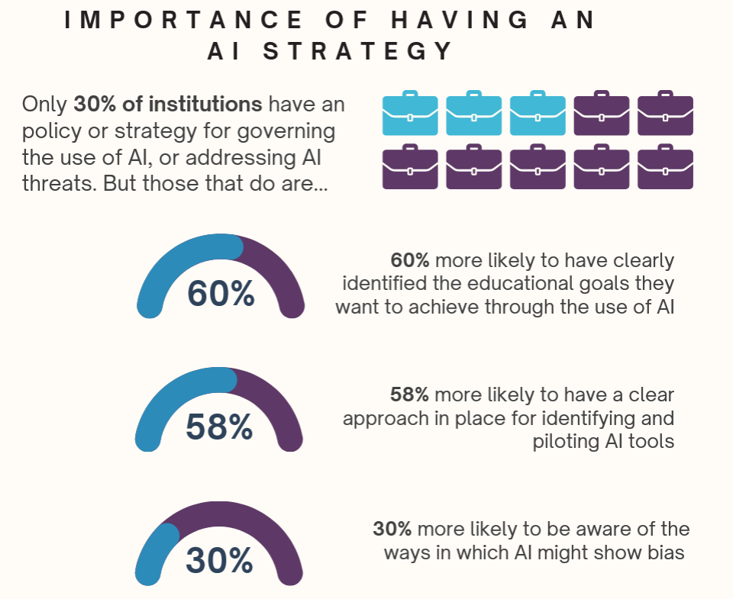
https://www.educateventures.com/beyond-the-hype

Slide 16
Student Usage and Safety
Students more likely to use AI at home than in classroom
Key concerns: Academic integrity
  Data protection
  Potential bias
  Overreliance on AI
Amongst educators, 75% aware of AI bias risks, but few have mitigation strategies Low confidence in safeguarding students using AI tools
https://www.educateventures.com/beyond-the-hype

Slide 17
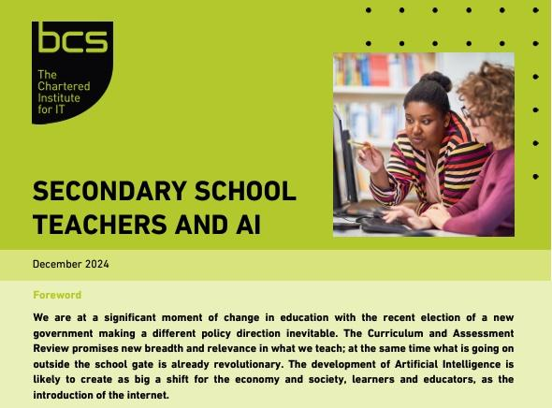

Slide 18
5000 secondary teachers
65% say they aren't using AI - perhaps teachers do not know they are using AI
95% of teachers who said they use AI are self taught
37% of teachers who use AI have told their leadership team

Slide 19
What should we do?
Develop robust professional development programmes
Establish clear AI policies and guidelines
Address ethical concerns systematically
Build an evidence base about AI impacts
Bridge the gap between well-resourced and under-resourced institutions
Learn from international best practices (e.g., Singapore, Estonia, Finland)
https://www.educateventures.com/beyond-the-hype

Slide 20
All schools need an AI Policy
All staff need training urgently

Slide 21
More on this later…

Slide 22

https://www.menti.com/alt5re8bi9yt

Slide 23
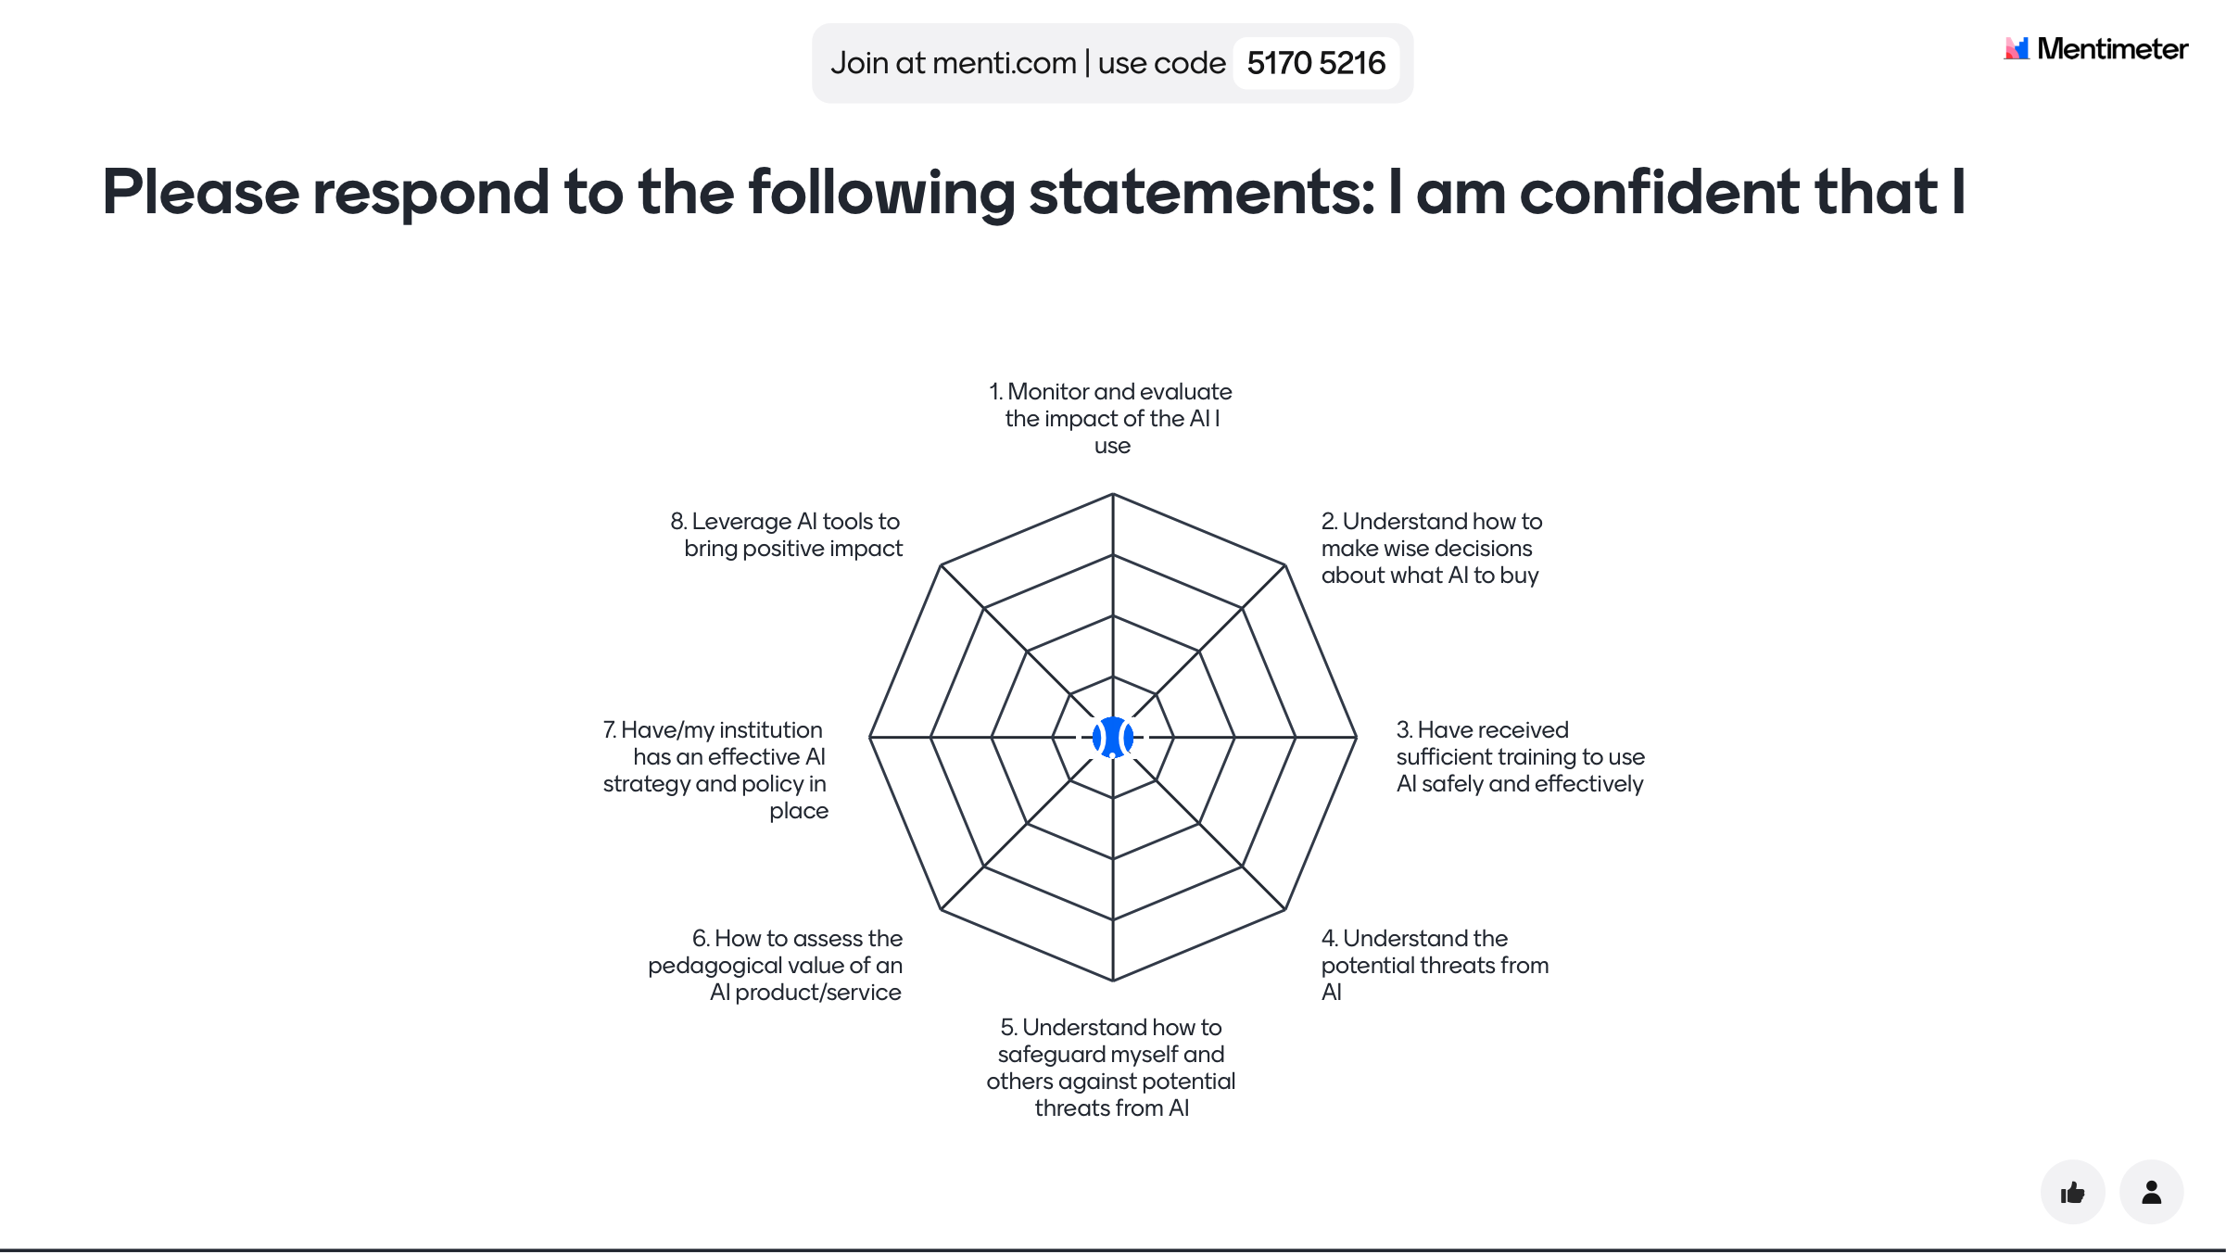

Slide 24
Why does AI matter to Education?

Slide 25
The Opportunities
Adaptive or personalised learning paths
Automated marking and feedback
Augmented and Virtual Reality
AI powered dashboards for learner analytics
Content generation
Teacher and learner assistants
This work is licensed under CC BY-NC-ND 4.0

Slide 26
The Threats
Lack of transparency & Inaccuracy
Personal data & data risk
Inherent bias
Agenda and purpose
Ethics & safeguarding
Un-intended Consequences
This work is licensed under CC BY-NC-ND 4.0

Slide 27
What does this mean for you?

Slide 28

You MUST engage with AI
“Learn Fast Act More Slowly”

Slide 29
Practical Tools for tackling AI in Education

Slide 30
1
AI tools:
Using AI in Education to tackle some of the big educational challenges
Artificial intelligence in Education
2
Increasing Human Intelligence:
Changing Education so that we focus on human intelligence and prepare people for an AI world
3
Learning about AI:
Educating People about AI so that they can use it safely and effectively
This work is licensed under CC BY-NC-ND 4.0

Slide 31
What should you do to create an effective AI Strategy?

Slide 32
The 4D AI Strategy Framework
Luckin and Bagshaw (in press) Charting AI in Education: A Multi-Dimensional Framework for Education Strategy Development

Slide 33
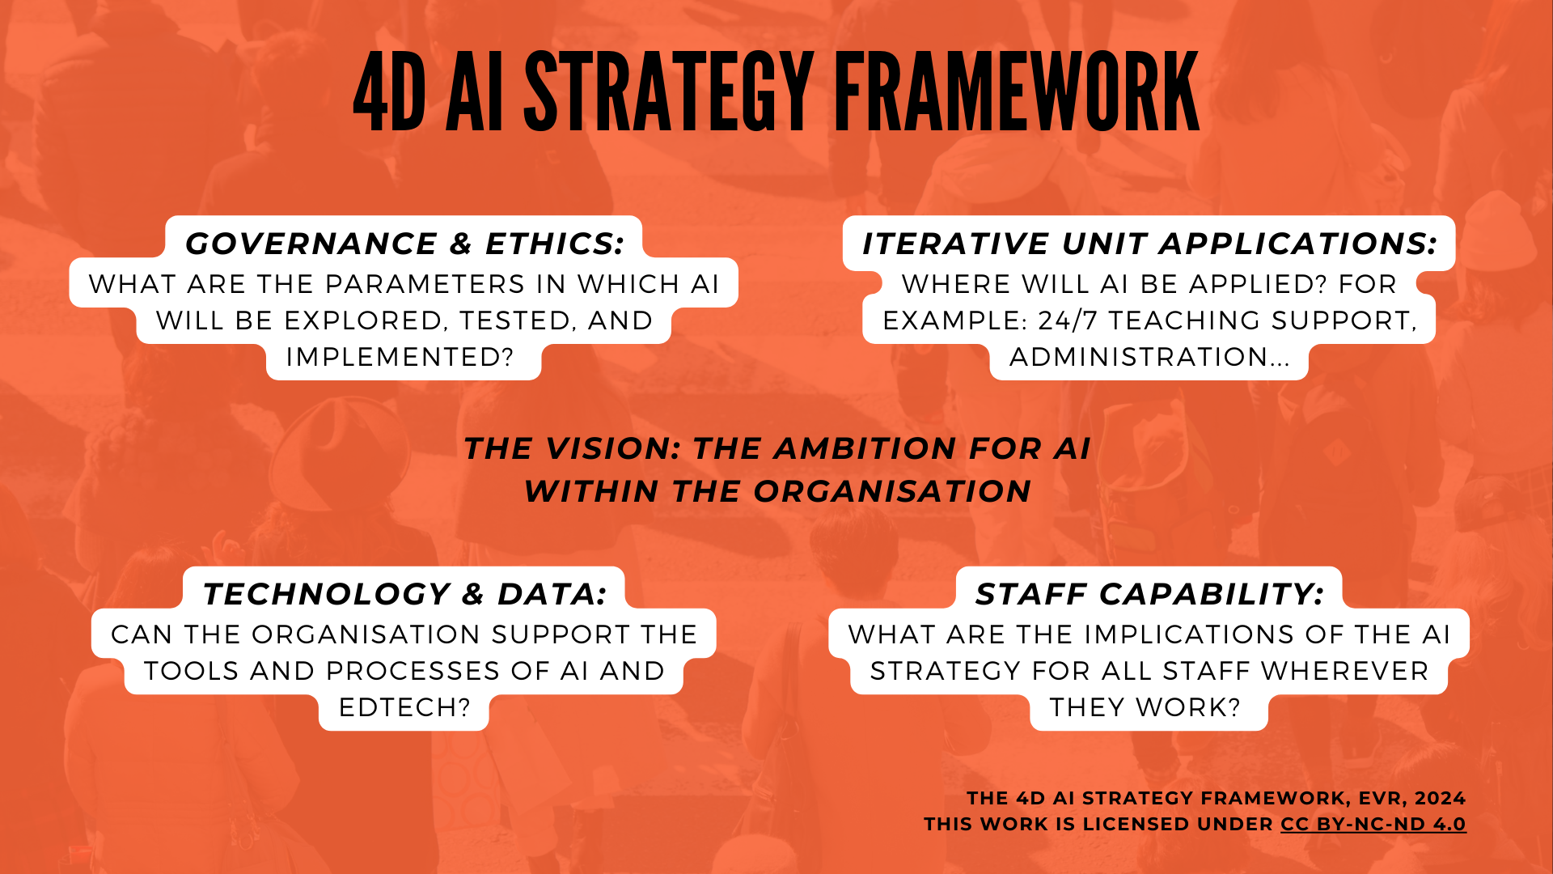

Slide 34
Each quadrant is inter-connected. Not mutually exclusive.

Slide 36

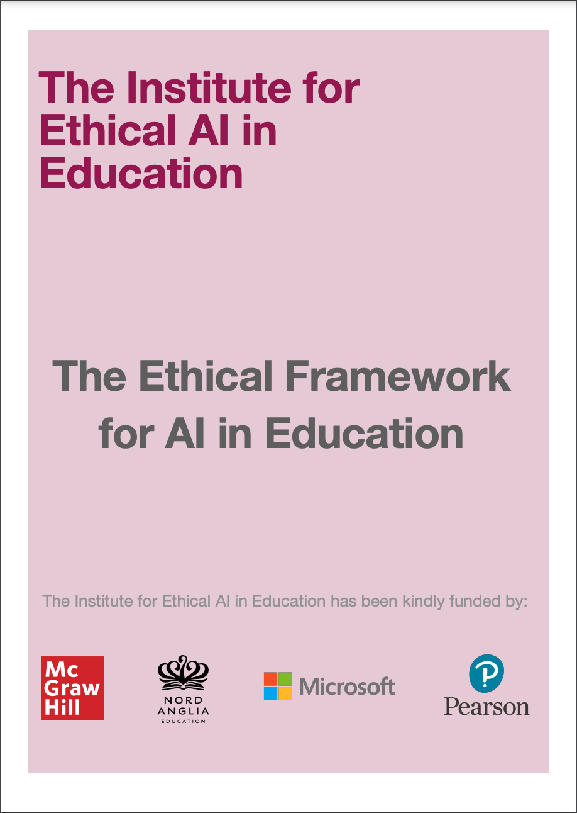

conceived by Sir Anthony Seldon, Priya Lakhani OBE, and Professor Rose Luckin
FREE TO DOWNLOAD https://www.buckingham.ac.uk/wp-content/uploads/2021/03/The-Institute-for-Ethical-AI-in-Education-The-Ethical-Framework-for-AI-in-Education.pdf

Slide 37
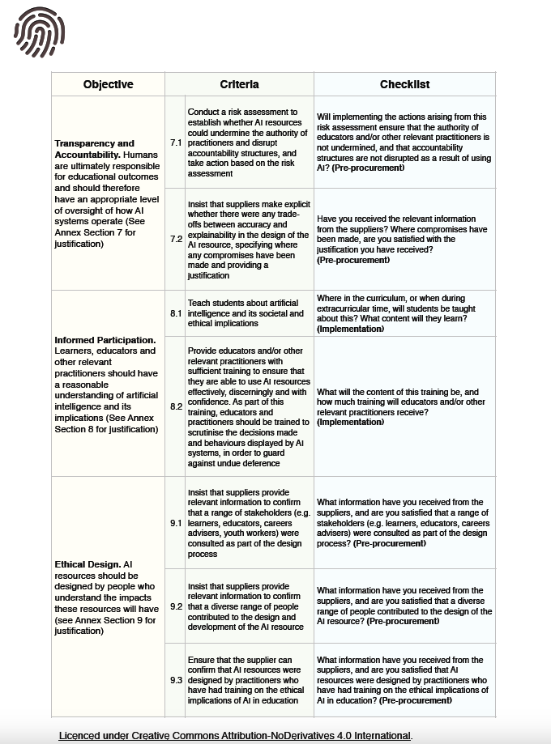
Objectives:
Achieving Educational Goals
Forms of Assessment
Administration and Workload
Equity
Autonomy
Privacy
Transparency and Accountability
Informed Participation
Ethical Design

Slide 38
Publications
Ethical Principles for the Development and Application of Artificial Intelligence in K-12 Education
https://link.springer.com/referenceworkentry/10.1007/978-981-16-2327-1_120-1

Slide 40















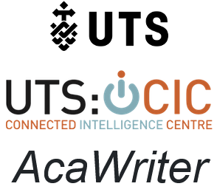





Examples of AI tools that you might apply
This work is licensed under CC BY-NC-ND 4.0

Slide 41
But what is their purpose? Examples of AI use-cases
Teacher admin
Lesson planning and enrichment
Lesson delivery
Student assessments
Teacher professional development and feedback
Streamlining administrative processes to boost productivity
Generate lessons in a range of topics, enrich lessons and boost productivity
Support teachers in lesson delivery through monitoring classroom interactions
Automate assessments, diagnose gaps in learning and recommend tailored interventions
Evidence teacher skills and support mentor-teacher interactions. Identify areas for improvement
Potential AI use-cases
Examples of tools
This work is licensed under CC BY-NC-ND 4.0

Slide 42









Examples of AI use-cases for admin work
General purpose Large Language Models
AI-powered search engines
Writing aids
AI-powered video editing
Description of AI tools
Models like ChatGPT, Claude, or Bard are flexible, easy to use, and can be used for a variety of tasks
Tools such as Perplexity.ai and Bing AI bring AI to search engines, and allow for deeper queries and better search results
These tools use AI to help write anything from marketing copy to research papers, and helps in adjusting tone and appropriate language
Tools that help in editing or transforming videos using AI, such as Descript, in which you can change the video transcript to automatically edit the video.
Examples of tools
This work is licensed under CC BY-NC-ND 4.0

Slide 43
Purpose driven AI (PAI)
AHEAD
Alignment with educational goals: PAI should be developed and used in alignment with well-defined educational objectives.
Enhancing Human intelligence: The goal of PAI is to augment human intelligence, not to replace it.
Evidence-based: The development and implementation of PAI should be grounded in learning science research and evidence-based practices.
Adaptability and personalisation: PAI systems should be adaptable to individual learners' needs, abilities, and contexts.
Ethical and transparent: PAI must be Designed and used ethically, with transparency about its functionalities, limitations, and potential biases.
Luckin, R., Cukurova, M., Kent, C., & du Boulay, B. (2022). Empowering educators to be AI-ready. Computers and Education: Artificial Intelligence, 3, 100076. https://doi.org/10.1016/j.caeai.2022.100076https://oro.open.ac.uk/83662/1/S2666920X22000315.pdf
This work is licensed under CC BY-NC-ND 4.0

Slide 44
The logic model approach ensures that the evaluation of AI use-cases is purpose-driven
Identify potential AI use-cases, based on needs and organisational strategy
Purpose-driven approach to AI
Heatmaps of AI tools aligned to potential use-cases
Build a logic model, defining key expected outcomes for the AI use-case
Build consensus on expected outcomes
Align implementation with research
Develop an implementation plan and research design, closely aligned to the logic model
Research design crafted to test the expected outcomes
Ensure fidelity of implementation
Evaluate the AI use-case, using KPIs and evaluation criteria derived from the logic model
Data sources may include qualitative and quantitative data, as well as tool analytics

Slide 45
AI Use Case
Description: What is the purpose of the AI and what are the intended impacts of its application?
 | Who will benefit and how?
1
2
3
4
 | What are the potential challenges?
1
2
3
4
 | What are the practical steps needed to implement this AI successfully?
1
2
3
4
 | What are the technical and cost implications of implementing this AI?
1
2
3
4
 | What are the ethical implications of this AI and how can they be mitigated?
1
2
3
4
 | What are the staff training implications for implementing this AI effectively?
1
2
3
4
This work is licensed under CC BY-NC-ND 4.0

Slide 46
AI Use Case: Class companion
Description: What is the purpose of the AI and what are the intended impacts of its application?
The tool aims to assist educators in giving regular and consistent feedback to their students on their written work. The tool is also able to scaffold tasks to support students.
 | Who will benefit and how?
1 | Students receive more regular and scaffolded feedback
2 | Feedback is consistent using a rubric
3 | Teachers get insights on students’ work
4
 | What are the potential challenges?
1 | Implementation hurdles
2 | Training for teachers and students
3 | Data privacy concerns
4
EXAMPLE
 | What are the practical steps needed to implement this AI successfully?
1 | Teachers need to design and make tasks
2 | Students need to create accounts
3
4
 | What are the technical and cost implications of implementing this AI?
1 | Free for schools
2 | PC and internet access needed
3
4
 | What are the ethical implications of this AI and how can they be mitigated?
1 | Does this tool serve all groups of users well?
2 | What data is captured and where is it kept?
3 | Does this tool make an impact on learning?
4
 | What are the staff training implications for implementing this AI effectively?
1 | Training needed on use of tool
2 | Training also need for evaluating impact
3
4
This work is licensed under CC BY-NC-ND 4.0

Slide 47

DATA (Aggregated)
TEACHER SURVEYS
Data can be combined across classes and schools to create aggregated data metrics for benchmarking.
Surveys can be conducted with teachers, and this can be triangulated with the other data.
METHODOLOGICAL APPROACH
DATA
DATA
SOURCES
STUDENT SURVEYS
Data will be available for each teacher.
Surveys can be conducted with students to gather their feedback.
TEACHER FOCUS GROUPS
Recordings and transcripts of the focus groups.
47

Slide 48
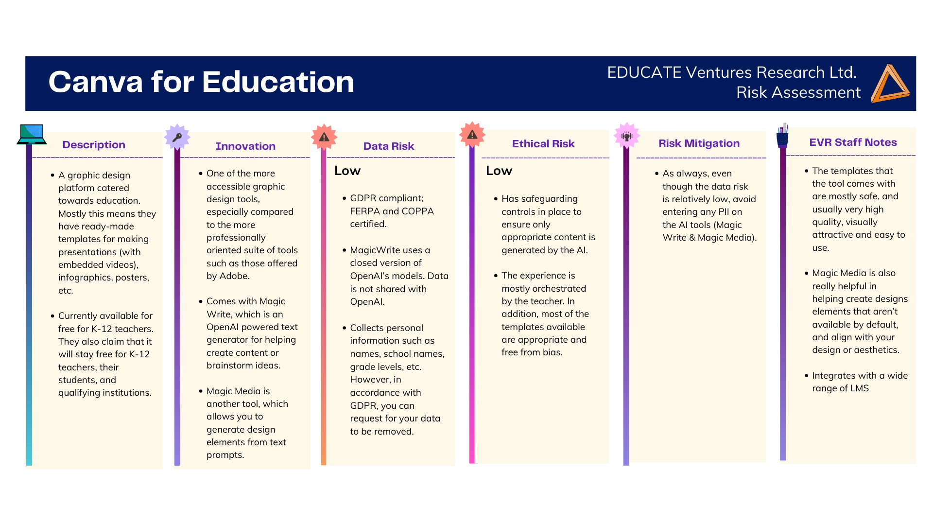

Slide 49
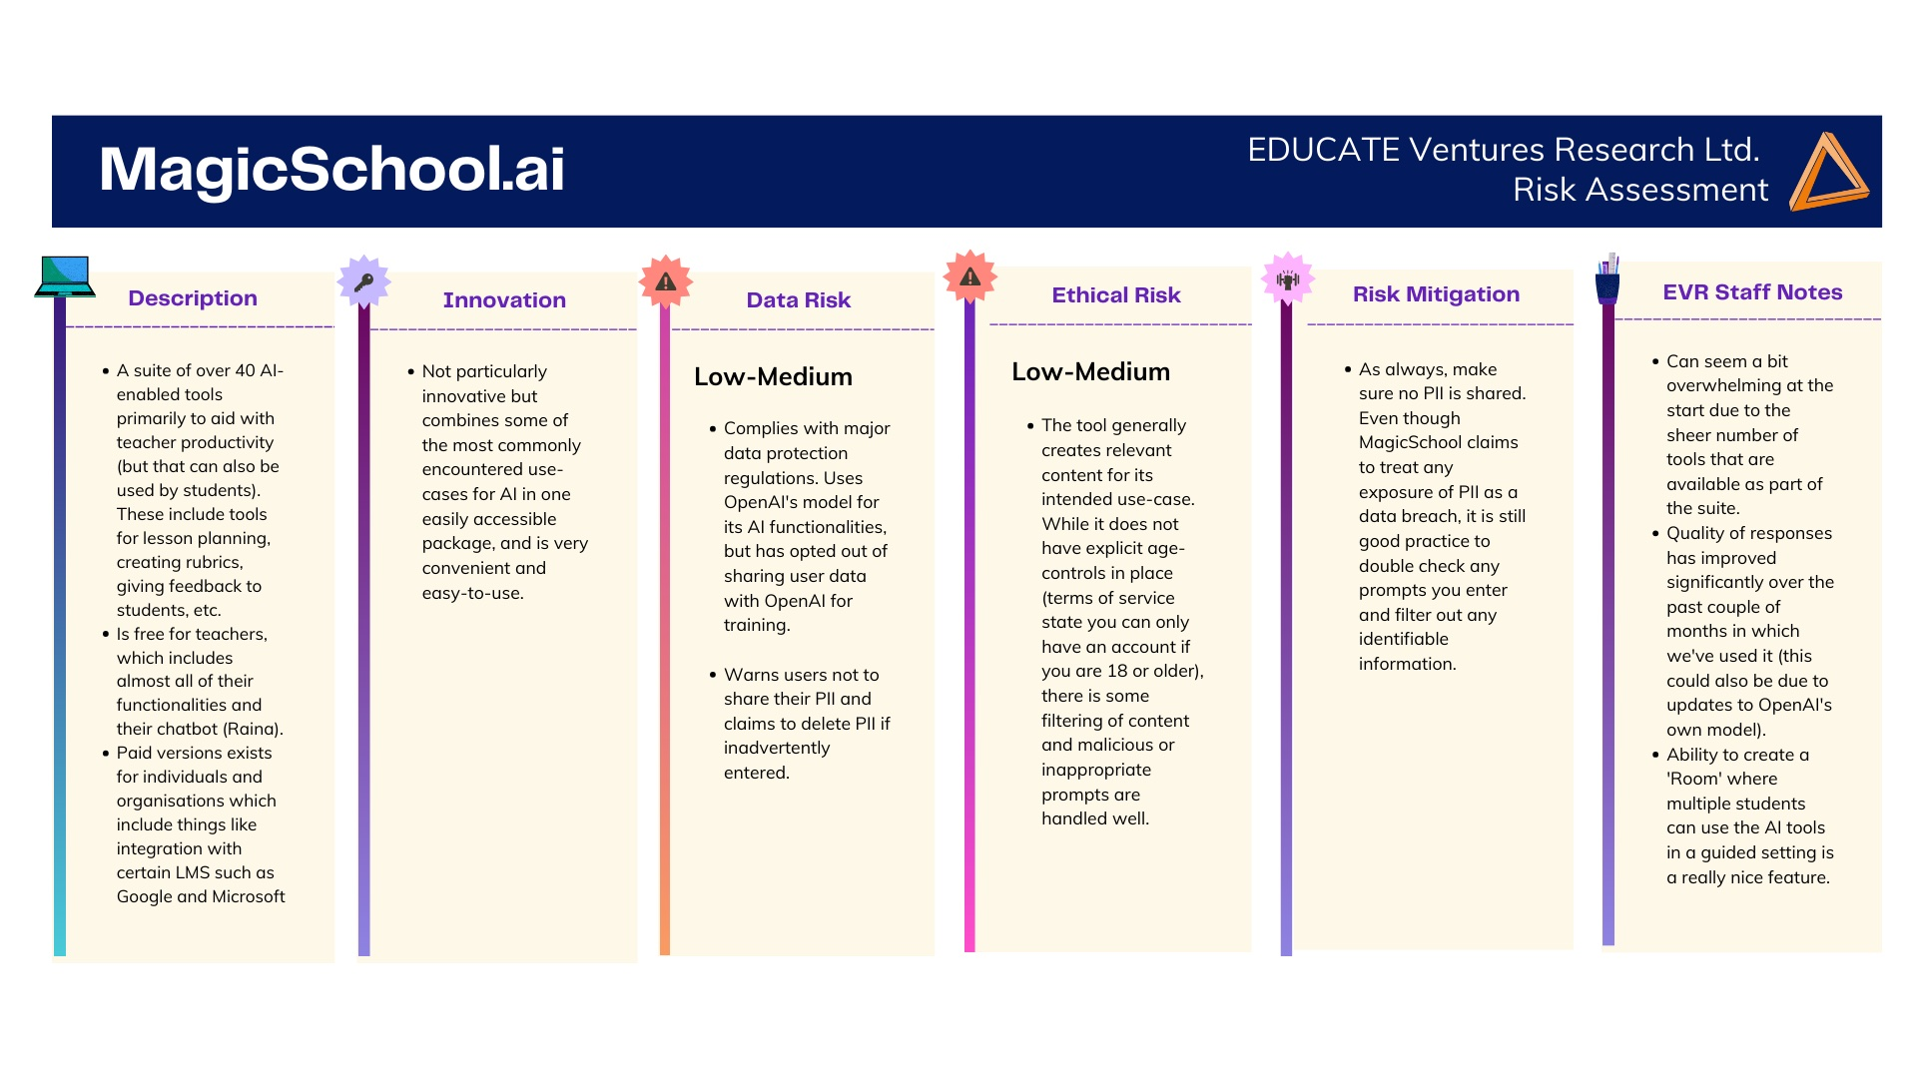

Slide 51
AI Use Case
Description: What is the purpose of the AI and what are the intended impacts of its application?
 | Who will benefit and how?
1
2
3
4
 | What are the potential challenges?
1
2
3
4
 | What are the practical steps needed to implement this AI successfully?
1
2
3
4
 | What are the technical and cost implications of implementing this AI?
1
2
3
4
 | What are the ethical implications of this AI and how can they be mitigated?
1
2
3
4
 | What are the staff training implications for implementing this AI effectively?
1
2
3
4
This work is licensed under CC BY-NC-ND 4.0

Slide 52
Technology and data: getting AI-ready
IT Infrastructure: Does the organisation have sufficient hardware, software and network capability? Do members of staff and students have sufficient levels of access to computing devices?
IT team: Does the organisation have sufficient levels of IT support to maintain and update systems as required?
Data infrastructure: Does the organisation have a data processing pipeline and data storage centre in place?
Data plan: Does the organisation have a strategic plan for collecting and using data, aligned to its overarching vision and AI strategy?
This work is licensed under CC BY-NC-ND 4.0

Slide 53

Strategic approach towards data
The proliferation of online tools (and fine-grained trace data) has resulted in new opportunities to track learning behaviours, and evidence the impact of AI tools, in a rich and dynamic manner
It is essential to carefully craft a targeted approach towards data collection, which aligns to target learning outcomes and leverages various forms of data generation
This work is licensed under CC BY-NC-ND 4.0

Slide 55

Importance of AI Literacy for Staff
Empowers staff to make informed decisions about AI use
Enhances understanding of AI capabilities and limitations
Promotes responsible and ethical use of AI tools
This work is licensed under CC BY-NC-ND 4.0

Slide 56
Importance of AI Literacy for Staff
Reduces risks associated with misuse or overreliance on AI
Facilitates effective communication about AI across departments
Prepares staff for future AI advancements and integration
Supports a culture of innovation and continuous learning
This work is licensed under CC BY-NC-ND 4.0

Slide 57
Key Components of AI Readiness Training
Basic AI concepts and terminology
AI capabilities and limitations in context
Ethical considerations in AI use
Data literacy and responsible data handling
Practical AI tools relevant to staff roles
Critical thinking and AI-assisted decision making
This work is licensed under CC BY-NC-ND 4.0

Slide 59
Student Usage and Safety
Students more likely to use AI at home than in classroom
Key concerns: Academic integrity
  Data protection
  Potential bias
  Overreliance on AI
Amongst educators, 75% aware of AI bias risks, but few have mitigation strategies Low confidence in safeguarding students using AI tools
https://www.educateventures.com/beyond-the-hype

Slide 60
Safeguarding priorities
Protecting children from mis-placed trust
Protecting children's personal data
Protecting children from becoming "de-skilled"
Protecting children's agency
Protecting children's intellectual property
Protecting children from inappropriate tools
Protecting children from "fake" news/images
Protecting children from profiling
Protecting equal access and opportunity
Protecting children from bias
Protecting children from a lack of transparency
Protecting children from over-reliance
This work is licensed under CC BY-NC-ND 4.0

Slide 61
What is AI and where are we now with AI?
Why does AI matter to Education?
What does this mean for you?
What should you do to create an effective AI Strategy?
“Learn Fast Act More Slowly”

Slide 62
Where can you learn more?

Slide 63


Host of the EdTech Podcast
EVR Products & Services
Professor
Rose Luckin
AI CPD for Schools
AI Strategy Development for Schools
Bespoke AI & Data Science Consultancy
hello@educateventures.com
educateventures.com

Slide 64

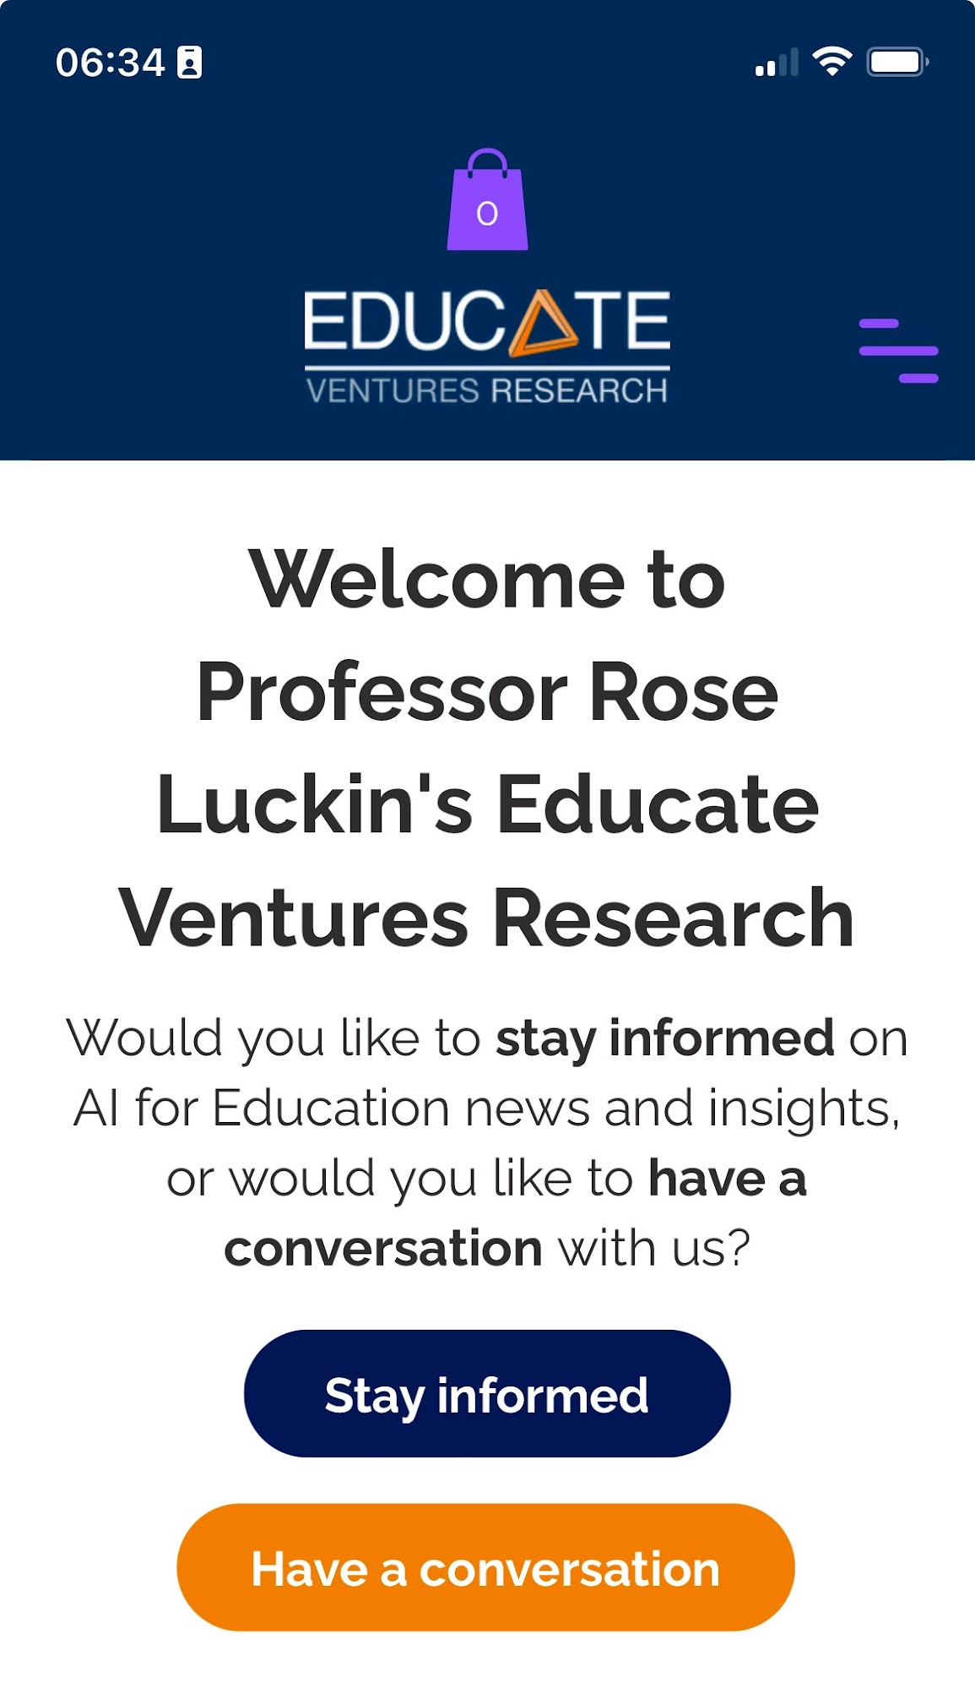

Find out more about AI and EVR

Slide 65
Many Thanks

