Slide 1

Arwain Ymarfer Myfyriol – O Dystiolaeth i Weithredu Effeithiol
Leading Reflective Practice – From Evidence to Effective Action
Yr Athro Carol Campbell
Prifysgol Glasgow
X @CarolCampbell4
Professor Carol Campbell
University of Glasgow
X @CarolCampbell4

Slide 2
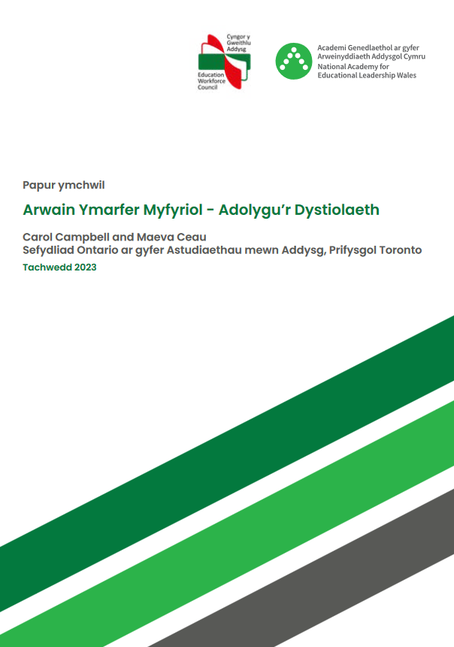
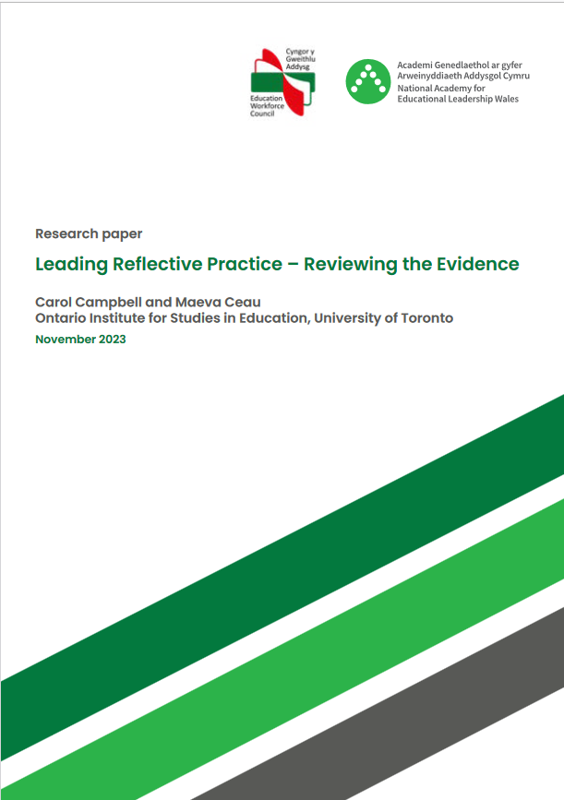

Slide 3
Beth yw Ymarfer Myfyriol? Dros 100 mlynedd o dystiolaeth…
What is Reflective Practice? Over 100 years of evidence…
Dewey (1933) – mae ymarfer myfyriol yn cynnwys meddwl am brofiadau a thystiolaeth o brofiadau i lywio gwybodaeth, credoau, penderfyniadau ac arferion.
Schön (1983) The Reflective Practitioner – o resymoledd technegol i fyfyrdod ar waith.
Agryis and Schön (1974) – o ddysgu “dolen sengl” i “ddolen ddwbl”.
Kolb (1984) – damcaniaeth dysgu trwy brofiad.
Dewey (1933) - reflective practice involves systematic thinking about experiences and evidence from experiences to inform knowledge, beliefs, decisions, and practices.
Schön (1983) The Reflective Practitioner – from technical rationality to reflection in action.
Agryis and Schön (1974) – from “single-loop” to double-loop” learning.
Kolb (1984) – experiential learning theory.

Slide 4
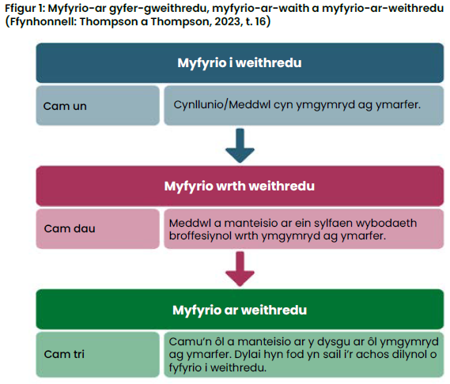
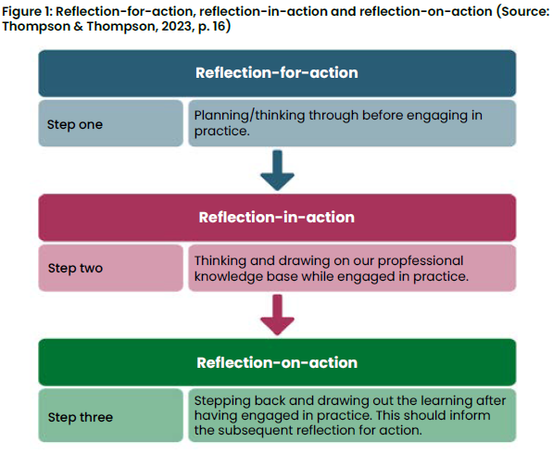
Myfyrdod ar gyfer gweithredu, ar waith ac ar weithredu
Reflection for, in, and on action

Slide 5
Crynhoi 100 mlynedd o fyfyrio ar ymarfer myfyriol!
Summarising a 100 years of reflecting on reflective practice!
Mae ymarfer myfyriol yn cydnabod bod gwaith proffesiynol yn gymhleth a’i fod yn gofyn am ystyried sefyllfaoedd a phrofiadau yn ofalus, a dysgu ohonynt.
Mae dysgu trwy wneud neu hyd yn oed dysgu o wneud yn annigonol, mae angen proses meta-wybyddol fwy datblygedig o fyfyrio ar feddyliau, teimladau, rhagdybiaethau, penderfyniadau a gweithredoedd i lywio dysgu proffesiynol, gwybodaeth ac ymarfer.
Nid “beth wnes i?” yw’r cwestiwn myfyriol canolog, ond yn hytrach “beth ddysgais i yn ystod ac o’r profiad hwn?”, sut bydd y dysgu hwn yn llywio fy ymarfer proffesiynol yn y dyfodol?” a ‘”beth wnaf i nesaf?”.
Reflective practice recognizes that professional work is complex and requires careful consideration of, and learning from, situations and experiences.
Learning by doing or even learning from doing is insufficient, a more advanced meta-cognitive process of reflecting on thoughts, feelings, assumptions, decisions, and actions is needed to inform professional learning, knowledge, and practice.
The central reflective question is not “what did I do?”, but rather “what did I learn during and from this experience?”, “how will this learning inform my future professional practice?”, and “what will I do next?”.

Slide 6
Effaith gadarnhaol bosibl ymarfer myfyriol i arweinwyr
Potential positive impact of reflective practice for leaders
Ategu rhagoriaeth a datblygiad arweinwyr.
Gwella ymddygiadau arwain ac effeithiolrwydd arwain.
Cyfrannu at egni ac ymgysylltiad arweinwyr â gwaith.
Gwella gallu pobl i arwain, gweithio a chyfrannu at dimau.
Supporting leaders’ excellence and development.
Improving leadership behaviours and leadership effectiveness.
Contributing to leaders’ energy and work engagement.
Improving peoples’ capacity to lead, work, and contribute to teams.

Slide 7
Effaith gadarnhaol bosibl ymarfer myfyriol i arweinwyr
Potential positive impact of reflective practice for leaders
Gwella dysgu proffesiynol o fyfyrio ar brofiadau a meddwl yn feirniadol am ragdybiaethau, gweithredoedd, emosiynau a gweithredoedd yn y dyfodol ar gyfer gwella.
Cyflymu dysgu o brofiad, wedi’i gyferbynnu ag ymarfer ychwanegol ond dim myfyrdod ar yr ymarfer hwnnw.
Gwella ymarfer, gan gynnwys tasgau, prosesau a deiliannau perfformiad.
Cefnogi lles trwy brosesu profiadau a delio ag emosiynau.
Enhancing professional learning from reflecting on experiences and critical thinking about assumptions, actions, emotions, and future actions for improvement.
Accelerating learning from experience, contrasted with additional practice but no reflection on that practice.
Improving practice, including tasks, processes, and performance outcomes.
Supporting wellbeing through processing experiences and dealing with emotions.

Slide 8
Ond mae amodau sy’n helpu ymarfer myfyriol effeithiol i gael effaith gadarnhaol yn cynnwys…
But conditions supporting effective reflective practice to have a positive impact include…
Pa mor agored yw unigolyn i fyfyrdod diffuant a dwfn er mwyn dysgu.
Cyfuniad o nodau dysgu’n ystyried tasgau a phrosesau i fyfyrio arnynt, ynghyd â deilliannau perfformio i’w cyflawni.
Ystyried y ffocws ar gyfer myfyrdodau yn ofalus ac ymgymryd â myfyrdod unigol strwythuredig.
Cyfleoedd am fyfyrdod grŵp.
A person’s openness to genuine and deep reflection to learn.
A combination of learning goals considering tasks and processes to be reflected on, as well as the performance outcomes to be achieved.
Carefully considering the focus for reflections and undertaking structured individual reflection.
Opportunities for group reflection.

Slide 9
Ond mae amodau sy’n helpu ymarfer myfyriol effeithiol i gael effaith gadarnhaol yn cynnwys…
But conditions supporting effective reflective practice to have a positive impact include…
Defnyddio myfyrdodau wedi’u hwyluso gan arweinwyr, a all fod o fudd i ddysgu unigol a dysgu tîm.
Sgaffaldio a chymhorthion fel bod unigolion yn deall diben myfyrio ac ymagweddau ar fod yn ymarferydd myfyriol.
Cyfleoedd am adborth allanol ar fyfyrdodau unigol (neu grŵp).
Use of facilitated reflections by leaders which can benefit individual and team learning.
Scaffolding and supports so that individuals understand the purpose of reflection and approaches to being a reflective practitioner.
Opportunities for external feedback on individual (or group) reflections.

Slide 10
Diffiniadau o Ymarfer Myfyriol yn y Sector Addysg
Definitions of Reflective Practice in the Education Sector
Korthagen (2001, t.58): “Myfyrdod yw’r broses feddyliol o geisio strwythuro neu ailstrwythuro profiad, problem, neu wybodaeth neu gipolygon sy’n bodoli. Gall y myfyrdod hwn ddigwydd ar ôl gweithred (myfyrio ar weithred) neu yn ystod gweithred (myfyrio ar waith)”.
Thompson (2021, t.25): “gall myfyrdod fod yn weithgaredd sy’n gwneud inni feddwl am brofiadau mewn ffyrdd sy’n annog cwestiynau, meddyliau newydd a gweithredoedd posibl, a allai yn ei dro arwain at newidiadau mewn safbwyntiau neu ymddygiad”.
Korthagen (2001, p.58): “Reflection is the mental process of trying to structure or restructure an experience, a problem, or existing knowledge or insights. This reflection can take place after an action (reflection- on-action) or during the action (reflection-in-action)”.
Thompson (2021, p.25): “reflection can be any activity that causes us to think about experiences in ways that encourage questions, new thoughts and potential actions, which in turn could lead to changes in perspectives or behaviour”.

Slide 11
Bod yn addysgwr myfyriol yn feirniadol (Brookfield, 2017)
Being a critically reflective educator (Brookfield, 2017)
Myfyrdod, yn cynnwys:
Lens llygaid myfyrwyr;
Lens amgyffredion cydweithwyr;
Lens profiad personol;
Lens theori ac ymchwil.
Yn ogystal, i arweinwyr ffurfiol:
Lens llygaid dilynwyr;
Lens amgyffredion cymheiriaid.
Reflection including:
Lens of students’ eyes;
Lens of colleagues’ perceptions;
Lens of personal experience;
Lens of theory and research.
In addition, for formal leaders:
Lens of the followers’ eyes;
Lens of peers’ perceptions.

Slide 12
Gwreiddio ymarfer myfyriol yn ystod ac yn dilyn dysgu proffesiynol
Embedding reflective practice during and following professional learning
Cyfleoedd parhaus am fyfyrdod a chyfathrebu parhaus y tu hwnt i ddigwyddiadau datblygiad proffesiynol penodol.
Gwneud yn siŵr bod dysgu proffesiynol a myfyrdod yn canolbwyntio ar gyfranogwyr, trwy gydnabod ac adeiladu ar wybodaeth, profiadau a safbwyntiau presennol addysgwyr, gan gefnogi gwelliannau posibl mewn gwybodaeth ac arferion hefyd.
Sustained opportunities for continuing reflection and communication beyond specific professional development events.
Make sure professional learning and reflection are participant-centred by acknowledging and building on educators’ existing knowledge, experiences, and opinions, while also supporting potential improvements in knowledge and practices.

Slide 13
Gwreiddio ymarfer myfyriol yn ystod ac yn dilyn dysgu proffesiynol
Embedding reflective practice during and following professional learning
Sefydlwch awyrgylch cadarnhaol i gefnogi twf a datblygiad addysgwyr.
Crëwch brofiadau cymdeithasol rhyngweithiol ar gyfer dysgu, rhyngweithiadau a thrafodaethau cydweithredol.
Cynhaliwch gytgord rhwng beth sy’n cael ei ddweud a beth sy’n cael ei wneud mewn dysgu proffesiynol i gefnogi ymarferwyr myfyriol.
(Mann & Walsh, 2017)
Establish a positive atmosphere to support educators’ growth and development.
Create interactive social experiences for collaborative learning, interactions, and discussions.
Maintain congruence between what is said and what is done in professional learning to support reflective practitioners.
(Mann & Walsh, 2017)

Slide 14
Buddion Ymarfer Myfyriol yn y Sector Addysg
Benefits of Reflective Practice in Education Sector
Mae gwelliannau personol a phroffesiynol yn cynnwys hunanymwybyddiaeth, gwell gallu i ddatrys problemau, hunaneffeithiolrwydd, effaith broffesiynol, a gwell perfformiad, gan gynnwys gwybodaeth ac arferion addysgegol athrawon ac arferion arweinyddiaeth unigol a gwasgaredig.
Gall ymarfer myfyriol effeithiol arwain at well adborth i fyfyrwyr neu werthusiadau o’u profiadau addysgu a dysgu, a gwell deilliannau i fyfyrwyr.
I gyfrannu at welliannau i fyfyrwyr, mae angen i ymarfer myfyriol gynnwys ffocws ar gyfarwyddo ac anghenion dysgu myfyrwyr, gan gynnwys dadansoddi data myfyrwyr.
Personal and professional improvements include self-awareness, improved problem-solving capacity, self-efficacy, professional agency, and improved performance including teachers’ pedagogical knowledge and practices and individual and distributed leadership practices.
Effective reflective practice can result in enhanced student feedback or evaluations of their teaching and learning experiences, and improved student outcomes.
To contribute to improvements for students, reflective practice needs to include a focus on instruction and students’ learning needs, including analysing student data.

Slide 15
Amodau a Chymhorthion ar gyfer Ymarfer Myfyriol Effeithiol yn y Sector Addysg
Conditions and Supports for Effective Reflective Practice in Education Sector
Pwysigrwydd arweinwyr yn rhoi pwys ar ymarfer myfyriol, ei annog a chymryd rhan ynddo.
Mae angen dysgu proffesiynol wedi’i hwyluso ar ddiben, prosesau a defnyddio ymarfer myfyriol i ategu myfyrdodau dyfnach ac ymgysylltu dilys, wedi’i gyferbynnu â myfyrdod arwynebol yng nghyd-destun perfformedd.
Mae cyfleoedd am ymarfer myfyriol cydweithredol, gan gynnwys mentora, annog a chydweithredu gan athrawon, yn bwysig.
Adnoddau ac offer ar gael i hwyluso ymarfer myfyriol.
Importance of leaders valuing, encouraging, and engaging in reflective practice.
Facilitated professional learning on the purpose, processes, and use of reflective practice is needed to support deeper reflections and authentic engagement, contrasted with surface reflection in a context of performativity.
Opportunities for collaborative reflective practice, including mentoring, coaching and teacher collaboration, are important.
Availability of tools and resources to facilitate reflective practice.

Slide 16
Amser sgwrs!
Time for a chat!
C1: Pa fuddion ydych chi wedi’u cael o gymryd rhan mewn ymarfer myfyriol a pha amodau ategodd y profiadau hyn?
C2: Beth yw’r blaenoriaethau ar gyfer gwella datblygiad ymarfer myfyriol a’r defnydd ohono – i chi’ch hun, eich tîm, eich sefydliad?
Q1: What benefits have you experienced from engaging in reflective practice and what conditions supported these experiences?
Q2: What are priorities for improving the development and use of reflective practice – for yourself, your team, your organisation?

Slide 17
Nodweddion Ymarfer Myfyriol Effeithiol
Features of Effective Reflective Practice
Diben
Prosesau
Llywio Gwelliannau mewn Arferion
Amodau cefnogol
Purpose
Processes
Informs Improvements in Practices
Supportive Conditions

Slide 18
Diben
Purpose
Eglurder diben:
  Gall ymarfer myfyriol gynnwys amrywiaeth o ddibenion, mae’n bwysig bod yn glir am ddiben(ion) arfaethedig pob gweithgaredd myfyriol a wneir.
Perthnasedd y ffocws:
  Mae myfyrdodau yn fwy effeithiol pan fyddant yn canolbwyntio ar brofiadau a materion sy’n bwysig ac sy’n berthnasol i’r cyfranogwyr
Clarity of purpose:
  Reflective practice can involve a range of purposes, it is important to be clear about the intended purpose(s) of each reflective activity undertaken.
Relevance of focus:
  Reflections are more effective when they focus on experiences and issues that matter and are relevant to the participant.

Slide 19
Prosesau
Processes
Dyfnder myfyrdod:
  Digon dwfn i gynnwys myfyrdod ar faterion addysgegol ynghyd â hunanfyfyrdod i asesu rhagdybiaethau, credoau, gwerthoedd ac emosiynau'r ymarferwr.
Ehangder myfyrdod:
  Digon eang i gynnwys ystyriaeth feirniadol o’r cyd-desun diwylliannol, cymdeithasol, gwleidyddol a sefydliadol.
Ymholi gweithgar:
  Mae'n cynnwys proses ymholi weithgar sy’n myfyrio ar gwestiynau neu anogwyr, gan fyfyrio ar brofiadau, casglu a dadansoddi tystiolaeth, a rhoi cynnig ar newidiadau yn ymarferol.
Depth of reflection:
  Sufficiently deep to include reflection on pedagogical issues as well as self-reflection to assess the practitioner's assumptions, beliefs, values, and emotions.
Breadth of reflection:
  Sufficiently broad to include critical consideration of the cultural, social, political, and institutional context.
Active inquiry:
  Involves an active process of inquiry reflecting on questions or prompts, reflecting on experiences, gathering, and analyzing evidence, and trying out changes in practice.

Slide 20
Prosesau
Processes
Seiliedig ar dystiolaeth:
  Seiliedig ar ddata a thystiolaeth perthnasol i gyd-destun.
Myfyrdod ar lwyddiannau a methiannau:
  Mae’n canolbwyntio ar brofiadau llwyddiannus a phrofiadau o fethiant i ddeall beth sy’n cael ei wneud yn dda a beth sydd angen gwella.
Strwythuredig, ond hyblyg:
  Wedi’i hwyluso a’i strwythuro i ddarparu digon o gymorth, ond yn ddigon hyblyg i ganiatáu i ymarferwyr fabwysiadu arferion myfyriol sy’n fwyaf addas i’w buddiannau, eu hanghenion a’u cyd-destun.
Evidence-based:
  Based on context-relevant data and evidence.
Reflection on successes and failures:
  Focuses on both successful and failed experiences to understand what is done well and what needs improvement.
Structured yet flexible:
  Facilitated and structured to provide sufficient support but flexible enough to allow practitioners to adopt reflective practices that are most suited to their interests, needs, and context.

Slide 21
Prosesau
Processes
Cydweithredol:
  Mae’n ymgysylltu â rhyngweithiadau a myfyrdodau cydweithredol ffurfiol ac anffurfiol wedi’u hwyluso.
Yn cynnwys anghytgord:
  Mae’n meithrin anghytgord gwybyddol i sicrhau bod gwerthoedd a chredoau sylfaenol wedi dod yn rhagdybiaethau ymhlyg a chaiff ymddygiadau arferol eu nodi a’u harchwilio, gyda newidiadau posibl i weithredoedd yn y dyfodol.
Collaborative:
  Engages facilitated formal and informal interactions and collaborative reflections.
Includes dissonance:
  Fosters cognitive dissonance to ensure underpinning values and beliefs that have become implicit assumptions and routine behaviours are identified and examined with potential changes to future actions.

Slide 22
Prosesau
Processes
Darparu adborth:
  Mae’n cynnwys adborth i ddatgelu rhagdybiaethau a mynd i’r afael â gwrthrychedd rhagdybiaethau rhywun, mynd i’r afael â risg tuedd i gytuno, a llywio newidiadau awgrymedig yn y dyfodol i arferion.
Provides feedback:
  Includes feedback to uncover assumptions and address the subjectivity of one's perceptions, address the risk of confirmation bias, and to inform suggested future changes in practices.

Slide 23
Llywio Gwelliannau mewn Arferion
Informs Improvements in Practices
Nodi newidiadau angenrheidiol:
  Mae’n arwain at ddysgu newydd ac, o bosibl, newid mewn rhagdybiaethau, gwerthoedd, credoau, gwybodaeth ac arferion.
Llywio cynlluniau ar gyfer ymarfer yn y dyfodol:
  Mae’n cynnwys cynllunio at y dyfodol ar sail profiadau yn y gorffennol a rhoi cynnig ar ddulliau newydd i gyrraedd nodau a ddymunir ac arwain at weithredoedd ar gyfer gwella.
Identifies necessary changes:
  Leads to new learning and potentially a change in assumptions, values, beliefs, knowledge, and practices.
Informs plans for future practice:
  Includes planning for the future based on past experiences and trying out new approaches to reach desired goals and lead to actions for improvement.

Slide 24
Amodau Cefnogol
Supportive Conditions
Arweinyddiaeth:
  Mae arweinwyr yn cymryd rhan mewn ymarfer myfyriol, yn ei annog ac yn rhoi pwys arno.
Diwylliant diogel:
  Mae’n gofyn am amgylchedd diogel mewn diwylliant dibynadwy sy’n rhoi pwys ar fyfyrdod ac nad yw’n cymryd rhan mewn barnu negyddol.
Dysgu proffesiynol i fod yn ymarferydd myfyriol:
  Mae datblygu arfer myfyriol a dod yn ymarferydd myfyriol effeithiol yn gofyn am ddatblygiad â ffocws a chymhorthion dysgu proffesiynol.
Leadership:
  Leaders engage in, encourage, and value reflective practice.
Safe culture:
  Requires a safe environment in a trusting culture that values reflection and does not engage in negative judgement.
Professional learning to be a reflective practitioner:
  Developing a habit of reflection and becoming an effective reflective practitioner require focused development and professional learning supports.

Slide 25
Amodau Cefnogol
Supportive Conditions
Offer ac adnoddau ar gael i fyfyrio:
  Mae fframweithiau, canllawiau, offer ac adnoddau (print, wyneb yn wyneb ac ar-lein) i hwyluso a chofnodi ymarfer myfyriol yn ddefnyddiol.
Amser:
  Mae angen i ymarfer myfyriol fel arfer gael ei ymarfer yn fynych ac mae angen amser pwrpasol ar gyfer myfyrdod dwfn.
Availability of tools and resources for reflection:
  Frameworks, guides, tools, and resources (print, in person and online) to facilitate and record reflective practice are helpful.
Time:
  Reflective practice as a habit needs to be practiced frequently and requires dedicated time for deep reflection.

Slide 26
Amser sgwrs!
Time for a chat!
C3: Sut ydych chi (neu sut byddwch chi) yn datblygu ymarfer myfyriol effeithiol ymhellach?
Diben – eglurder, perthnasedd
Prosesau – dyfnder ac ehangder myfyrdod, ymholi gweithredol, seiliedig ar dystiolaeth, myfyrdod ar lwyddiannau a methiannau, strwythuredig ond hyblyg, cydweithredol, yn cynnwys anghytgord, yn rhoi adborth.
Llywio gwelliannau mewn arferion – yn nodi newidiadau angenrheidiol, yn llywio cynlluniau ar gyfer arferion yn y dyfodol
Amodau Cefnogol – arweinyddiaeth, diwylliant diogel, dysgu proffesiynol, offer ac adnoddau ar gael, amser.
Q3: How are (or will) you further develop effective reflective practice?
Purpose – clarity, relevance
Processes – depth and breadth of reflection, active inquiry, evidence-based, reflection on successes and failures, structured yet flexible, collaborative, includes dissonance, provides feedback.
Informs Improvements in Practices – identifies necessary changes, informs plans for future practices
Supportive Conditions – leadership, safe culture, professional learning, availability of tools and resources, time.

Slide 27
Ymarfer Myfyriol yng Nghymru: O Dystiolaeth i Weithredu
Reflective Practice in Wales: From Evidence to Action
Mae’r dystiolaeth ryngwladol yn glir; pan gaiff ei ddefnyddio’n effeithiol, gall ymarfer myfyriol fod o fudd i weithwyr proffesiynol, dysgwyr a gwelliannau addysgol mewn sefydliadau a systemau. Nid yw dysgwyr Cymru’n haeddu llai.
C4: Beth sydd ei angen nawr a nesaf i sicrhau bod ymarfer effeithiol yn cael ei gefnogi a’i wreiddio yng Nghymru?
The international evidence is clear, when used effectively, reflective practice can benefit professionals, learners, and educational improvements in institutions and systems. The learners of Wales deserve no less.
Q4: What is needed now and next to ensure effective practice is supported and embedded in Wales?

Slide 28
Diolch!
X @CarolCampbell4
Thank you!
X @CarolCampbell4

